Slide 1


DO YOU KNOW WHAT TO DO?
Emergency preparedness
Funded by the U.S. Dept of Homeland Security under the Urban Area Security Initiative
and the State and Local Government Coordination and Preparedness Program.

Slide 2
IN CASE OF EMERGENCY
THINK
PREPARE
ACT
There are skilled and caring emergency professionals throughout North Central Texas ready to help if and when disaster strikes. But you are your own best protection. This helpful guide will teach you how to think, prepare and act to protect your personal safety and the safety of those around you.

Slide 3

THINK
TAKE THE EXTRA STEP TO PROTECT YOURSELF

Slide 4



Slide 5


SEVERE WEATHER
WEATHERING THE STORM
In North America an average year has:
100,000 thunderstorms
10,000 severe thunderstorms
5,000 floods
1,000 tornadoes
2 deadly hurricanes
In North Central Texas
an average year has:
258 severe thunderstorm events (large hail, damaging winds)
68 flash flood events
12 tornadoes
Less than 1 hurricane

Slide 6

SEVERE WEATHER
LIGHTNING SAFETY
If you hear thunder, you are close enough to be struck by lightning—find safe shelter immediately.
Move to a sturdy building and stay away from the windows (don’t take shelter in a shed, under isolated trees or in a convertible vehicle).
If a sturdy shelter is not available, get inside a hardtop vehicle and keep the windows up.
Get out of boats and away from water.
Unplug appliances and avoid using the telephone except in an emergency (cell phones are okay, corded phones are not)

Slide 7


SEVERE WEATHER
FLOOD SAFETY
TURN AROUND
DON’T DROWN!

Slide 8
SEVERE WEATHER
FLOOD SAFETY
Get out of areas subject to flooding, like dips, low spots, canyons, washes, etc.
Avoid already flooded and high-velocity flow areas—don’t attempt to cross a flowing stream.
Never drive through flooded roadways in case the roadbed is no longer intact.

Slide 9
SEVERE WEATHER
FLOOD SAFETY
If your vehicle stalls, leave it immediately and seek higher ground.
Be cautious at night when it’s harder to recognize flood dangers.
Don’t camp or park your vehicle along streams and washes, particularly during threatening conditions.

Slide 10

SEVERE WEATHER
HAIL SAFETY
If weather conditions are prime for a storm, move cars,
boats, RVs and lawn and patio furniture into a covered area.
During a storm, seek shelter. Hail of any size can be
dangerous when pelted in high winds.
Surfaces may become slick, so use caution if you’re outside.
When driving into a hailstorm, find a safe place to pull over and turn your car so the hail is hitting the windshield. The safety glass will protect you. The hail could break the glass in other windows.

Slide 11

SEVERE WEATHER
TORNADO SAFETY
In a home or building, move to a pre-designated shelter, such as a basement.
If underground shelter is not available, move to an interior room or hallway on the lowest floor and get under a sturdy piece of furniture.
Stay away from windows.

Slide 12
SEVERE WEATHER
TORNADO SAFETY
Don’t try to outrun a tornado in your car—leave it immediately and seek shelter in a sturdy building.
Mobile homes should always be abandoned.
If no shelter is available, get out of vehicles and find the most low-lying area (ditch, ravine, etc.), lay flat on your stomach and cover your head with your hands.

Slide 13

SEVERE WEATHER
EXTREME HEAT SAFETY
STAY OUT OF THE SUN.
Use sunscreen (SPF 15 or higher).
STAY HYDRATED.
Drink plenty of non-alcoholic and caffeine-free fluids.
INSULATE.
Install window air conditioners snugly.
Check air-conditioning ducts for proper insulation.
Weather-strip doors and sills to keep cool air in.

Slide 14
SEVERE WEATHER
EXTREME HEAT SAFETY
HELP PREVENT DROUGHT.
Water your lawn only when necessary and
by adhering to local water restrictions.
HELP PREVENT WILDFIRES.
Respect ”no burn” days.
AVOID FIRES.
Dispose of cigarettes responsibly. Dispose of hot charcoal
in a non-flammable container or hose down before dumping.

Slide 15


Slide 16

SPOT THE HAZARDS
+ Industrial Chemicals
+ Biological
+ Nuclear/Radiological
+ Transportation of
Hazardous Materials
+ Household Chemicals
+ Epidemics/Pandemics
+ Carbon Monoxide
Poisoning
+ Workplace or
SCHOOL Shootings
+ Gas Well & Pipelines
+ TERRORISM
+ Traveling During
the Holidays
+ Holiday Hazards
+ 9-1-1 Emergency
+ House Fires

Slide 17

SPOT THE HAZARDS
HAZARDOUS MATERIALS
Stay aware of your surroundings.
Use your senses to help you
decide how to act. (Do you see a gas cloud?
Smell a sharp odor? Hear an explosion?)
Follow directions from officials about
sheltering-in-place or evacuating.

Slide 18
SPOT THE HAZARDS
GAS WELLS AND PIPELINES
There is typically little or no warning with incidents involving gas wells and/or pipelines. Because of this, it’s critical that you be prepared
in the event of an emergency.

Slide 19
SPOT THE HAZARDS
GAS WELLS AND PIPELINES
DO
Leave the area immediately on foot
Warn others in the area
Refrain from activities that could cause heat sparks
Notify 9-1-1 of the leak when you reach safety
DON’T
Light a match, start an engine, or switch electrical equipment on and off (including lights)
Attempt to use a cell phone until you’ve left the area—it
can potentially cause a spark
Drive into a vapor cloud
Make contact with any escaping material, some products may
be toxic or corrosive

Slide 20

SPOT THE HAZARDS
TERRORISM
Develop a disaster plan.
Make sure your Emergency Supply Kit is ready.
Identify an internal room that you can shelter in and block out contaminated air in case of a chemical or biological attack.
In the case of a nuclear attack, your three best tools are time, distance, and shielding to minimize your exposure to radioactive material.
Follow directions from officials.
Stay alert and informed at all times!

Slide 21

SPOT THE HAZARDS
MASS VIOLENCE
Remain calm and quiet.
Be aware of your environment and any possible dangers.
Take note of the two nearest exits in any facility you visit.
If you are unable to leave the area, block and secure the door.
As a last resort, protect yourself and attempt
to take the active shooter down.

Slide 22

SPOT THE HAZARDS
EPIDEMICS AND PANDEMICS
Make sure your Emergency Supply Kit is ready.
Educate yourself about types of epidemics
and how they may affect you.
Follow directions from officials about
sheltering-in-place or evacuating.
Practice healthy habits that may protect you and
others later: wash your hands, cover coughs and sneezes,
and stay home from work or school if you are sick.

Slide 23
PREPARE
A LITTLE PREPARATION CAN MAKE ALL THE DIFFERENCE

Slide 24
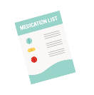
MAKE A PLAN
GET READY
Emergency Supply Kit
Create a Communications Plan
Caring for Those with Functional Needs
Planning for Pets
Register for Local Alerts
Purchase a NOAA All Hazards Radio

Slide 25

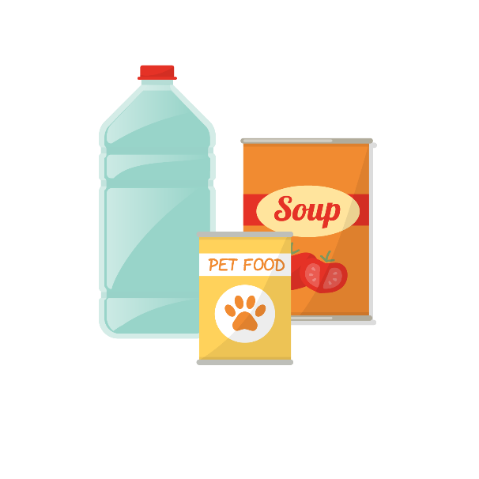
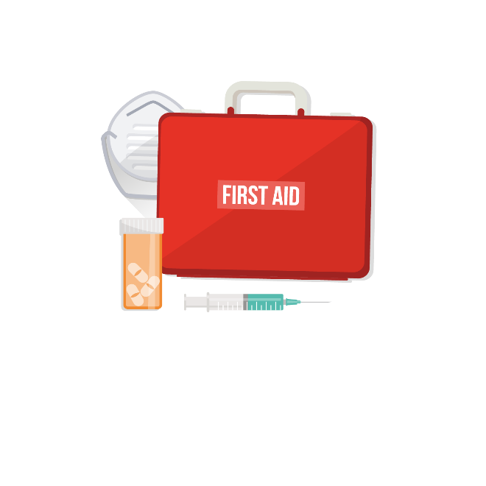

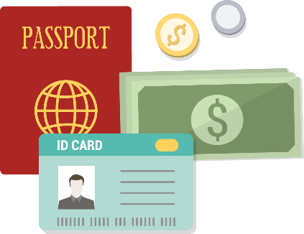
BUILD A KIT
GET READY
FOOD & WATER
FIRST AID KIT
RADIO & PHONE
CASH AND I.D.

Slide 26

BUILD A KIT
GET READY

Slide 27
ACT
YOU ARE YOUR OWN
BEST PROTECTION

Slide 28

GET INVOLVED
Personal Responsibility
Volunteer Service Training
Citizen Corps
Radio Amateur Civil Emergency Service
SKYWARN Storm Spotters
Neighborhood Watch
The National Crime Prevention Council

Slide 29
AFTER DISASTER
Sheltering-In-Place
Evacuating
Disaster Recovery – Finding Hope
Health and Safety Guidelines
Returning Home
Seeking Disaster Assistance

Slide 30

RESOURCES
Local County Emergency Management Directory
Texas Division of Emergency Management (TDEM)
www.dps.texas.gov
Federal Emergency Management Agency (FEMA)
www.fema.gov
Department of Homeland Security
www.dhs.gov
Knowhat2do.com

Slide 31
THINK
PREPARE
ACT

Slide 32

QUESTIONS?

