Slide 1

Creating Capabilities
North Central Texas Public Works Emergency Response Team (PWERT)

Slide 2
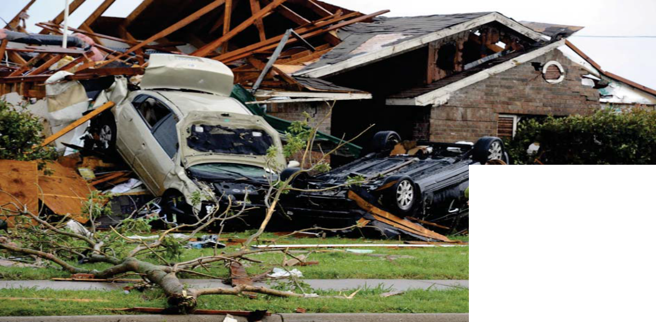
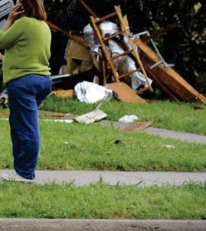
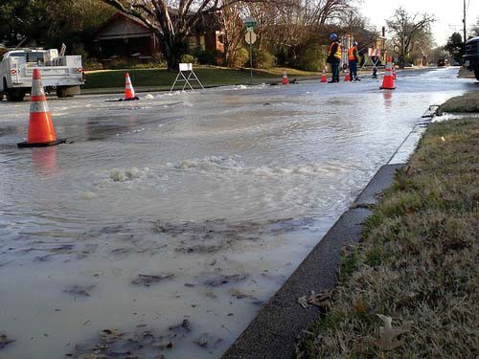
Assessing the Need
High winds
Tornadoes
Hail
Snow
Ice
Flooding
Blackouts
Line ruptures

Slide 3
Purpose
Enhance the region's ability to manage a major emergency beyond existing local resources
A cooperative arrangement enabling jurisdictions to:
Work out in advance legal and financial issues
Simplify the resource request process
Expedite recovery

Slide 4
Scope
Focused on initial response and short term recovery
- Help stabilize the situation
Reduce workload of impacted jurisdiction by:
Finding requested resources
Organizing deployment based on jurisdiction request
Staging management
Assignment coordination, improvement of span of control
Enhance planning function - future operational periods
Maintain documentation for PWERT response

Slide 5
Terms of Agreement
Terms of the agreement:
NIMS approach
Responding agency under direction of their own supervisor
Self sufficient - responding agency responsible for their own food, water, internal communications, fuel, and support
Operational costs - no reimbursement for first 36 hours
Insurance (workmen's compensation, auto liability) - each party responsible for it's own actions
NOTE: Signed agreements are provided to the North Central Texas Council of Governments PWERT representative who maintains the repository of all associated documents

Slide 6
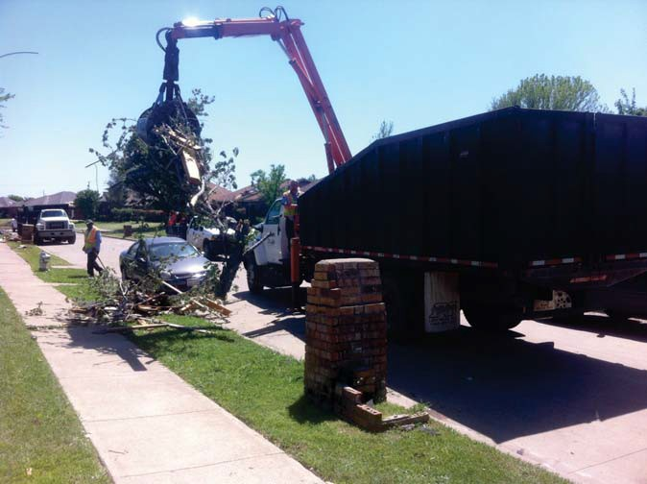
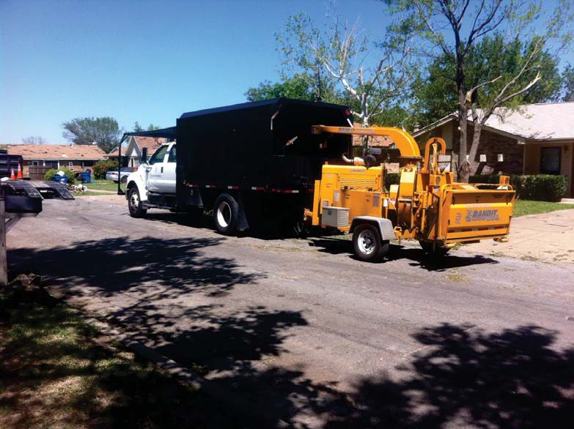
Activation Process
Request assistance:
972-827-8758
Provide details to Hot Phone operator:
What you need
When you need it
Where to report
Local contact person

Slide 7
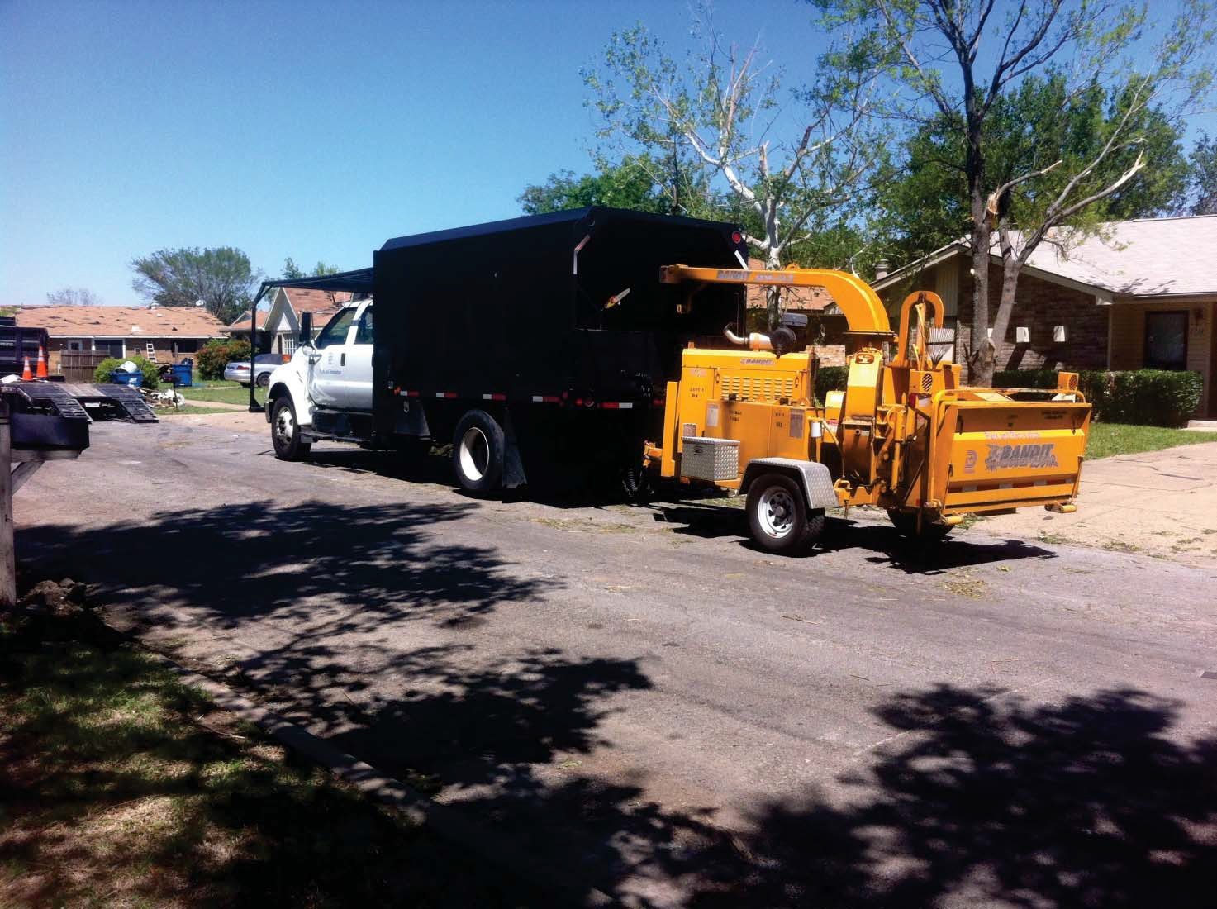
Responding Agency Process
Once contacted by PWERT Coordinator:
Determine resource availability
Obtain approval to deploy
Inform PWERT Coordinator of ability to respond
Await assignment from PWERT Coordinator
NO SELF-DISPATCHING OF PWERT RESOURCES

Slide 8
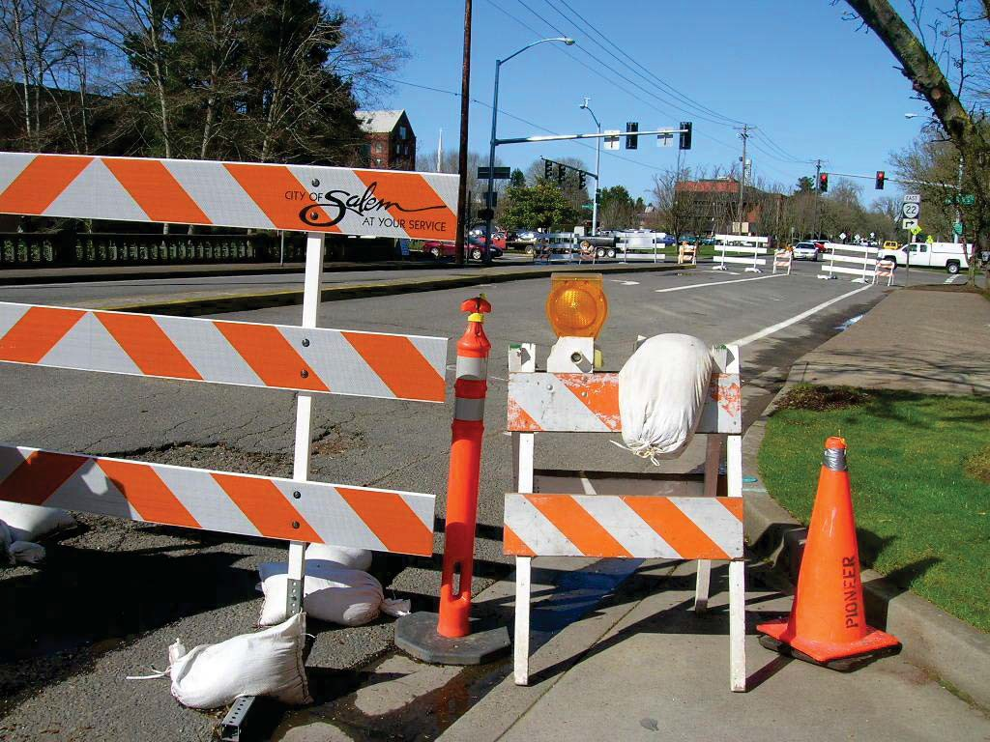
Example Resources
Personnel
Barricades
Heavy equipment
Chainsaws
Trucks
Trailers
Signage
Pumps
Generators
Sand bags
Lighting

Slide 9
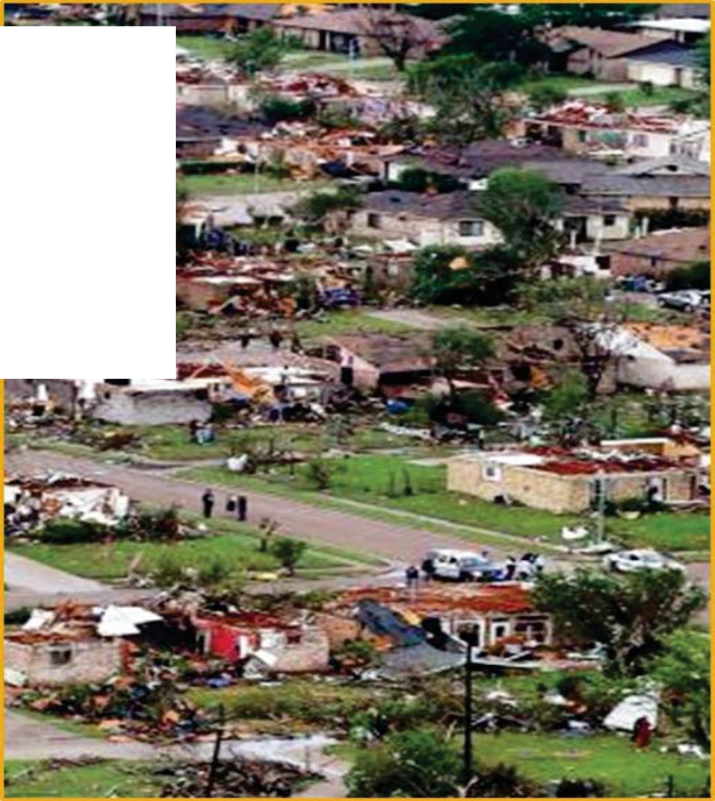
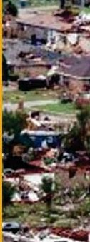
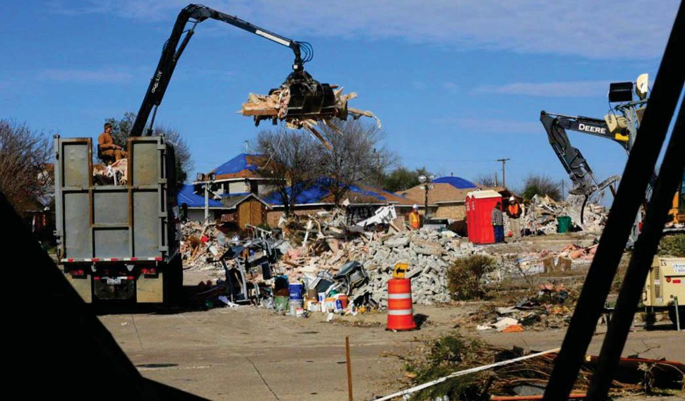
Example Responses
Hurricane Harvey, 2017
Holiday tornadoes, 2015
Flooding, 2015
Winter weather, 2014-2015
Lancaster tornado, 2012

Slide 10

NEXT STEPS:
Review Mutual Aid Agreement (MAA) and discuss any questions
Determine local participation in process for approval
Get MAA approved and signed to become a member jurisdiction

Slide 11
PWERT Contact Information
Manny Palacios, Chair NCT PWERT
mpalacios@weatherfordtx.gov
Barry Fulfer, Secretary
NCT PWERT
bdfulfer@gptx.org
Ed Balderas, Vice Chair NCT PWERT
ebalderas@rowlett.com
Jessica Mason, NCTCOG Rep NCT PWERT
jmason@nctcog.org

