Slide 1
What are SSOs and TMDLs?
How do they relate and why does this matter to you?

Slide 2
What is a TMDL?
A TMDL (Total Maximum Daily Load) is a water quality improvement project — a science-based approach preventing waterways from becoming dangerous to use. A TMDL is a numerical value that represents the highest amount of a pollutant a surface water body can receive and still meet the standards, like a budget for pollutants for impaired waterbodies. It estimates the amount of a pollutant like that a water body can receive and still support its designated uses like fishing, general recreation, and general support of aquatic life.
In North Central Texas, the primary pollutant of concern is E. coli.

Slide 3
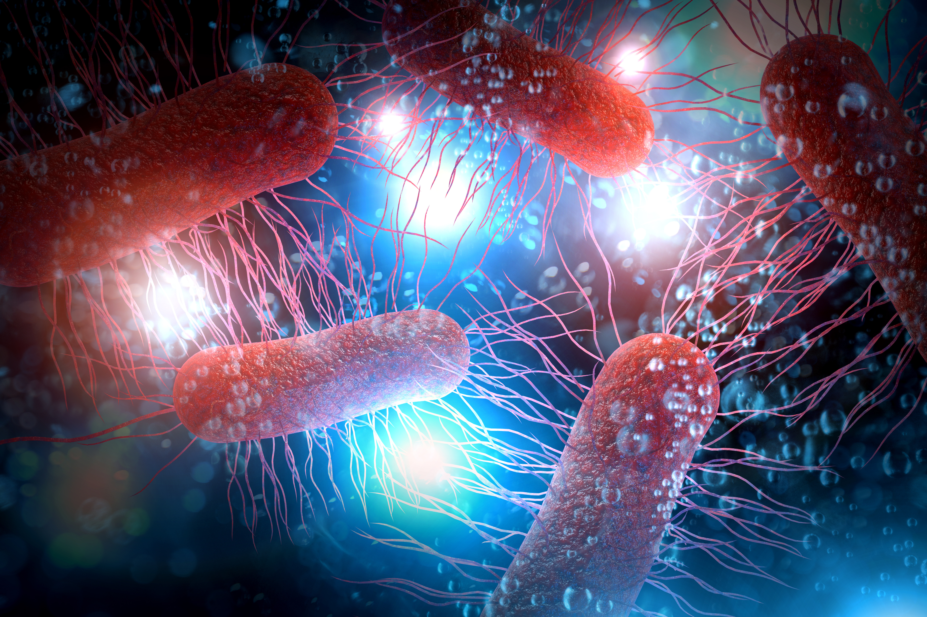
What is E. coli and where does it come from?
Escherichia coli, commonly known as E. coli, is a type of bacteria. Specific strains of E. coli can cause food poisoning and lead to symptoms such as severe abdominal cramps, watery stool (which may be bloody), vomiting, and fever. These harmful strains can be transmitted through contaminated food, Contaminated Water, or person-to-person contact.
E. coli can come form a variety of sources, including pet waste, sanitary sewer overflows, agricultural practices, wastewater treatment plants, illicit discharges, septic systems, wildlife waste, and more.

Slide 4
What are SSOs and what causes them?
Sanitary Sewer Overflows (SSOs) occur when untreated or partially treated sewage is released from a municipal sewer system into the environment. These overflows can carry harmful bacteria, viruses, protozoa, helminths (intestinal worms), and inhaled molds and fungi. It’s essential to address SSOs promptly to protect public health and prevent environmental damage.
Sanitary Sewer Overflows (SSOs) occur when areas of the sewer system have exceeded capacity. They can be caused by extreme rainfall, obstructions in sewer lines, sewer main breaks, or improper sewer design. SSOs can discharge to surface waters, streets, parklands, buildings, or other property.

Slide 5
How can you prevent SSOs?
SSOs can be prevented by only flushing the three P’s: Pee, Poop, and Toilet Paper and properly disposing of Fats, Oils, and Grease (FOGs). Watch this video for more information about what to flush: Click here to view!
FOGs should always be thrown in the trash or recycled in a grease trap. Though they are liquid at room temperature, FOGs solidify and trap other materials which causes blockages in pipes and drains.
Household products (including some marked ‘flushable’) such as baby wipes, facial wipes, sanitary pads, and tampons create blockages in sanitary sewers as well.
Limiting harsh and toxic chemicals like cleaning products that go down the drain also help in preventing SSOs.

Slide 6
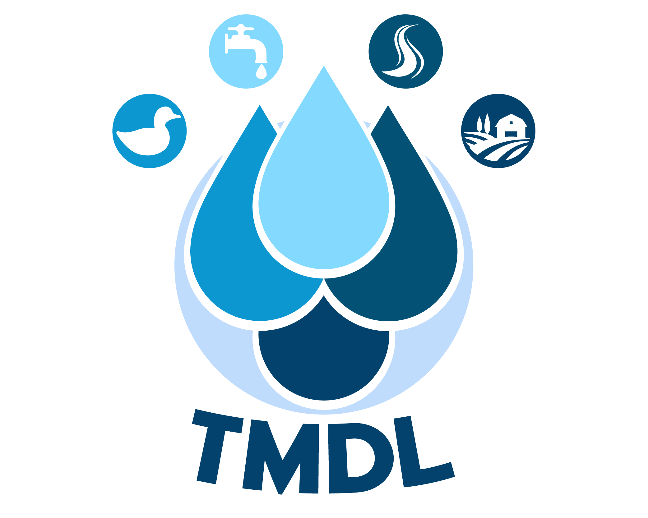


The preparation of this document was financed through funding from the Texas Commission on Environmental Quality.
The North Central Texas Council of Governments (NCTCOG) is working with stakeholders to implement best management practices to address and prevent bacteria impairments in the North Central Texas region.
To view the current Implementation Plan, or to utilize available resources, please visit www.nctcog.org/TMDL

