Slide 1
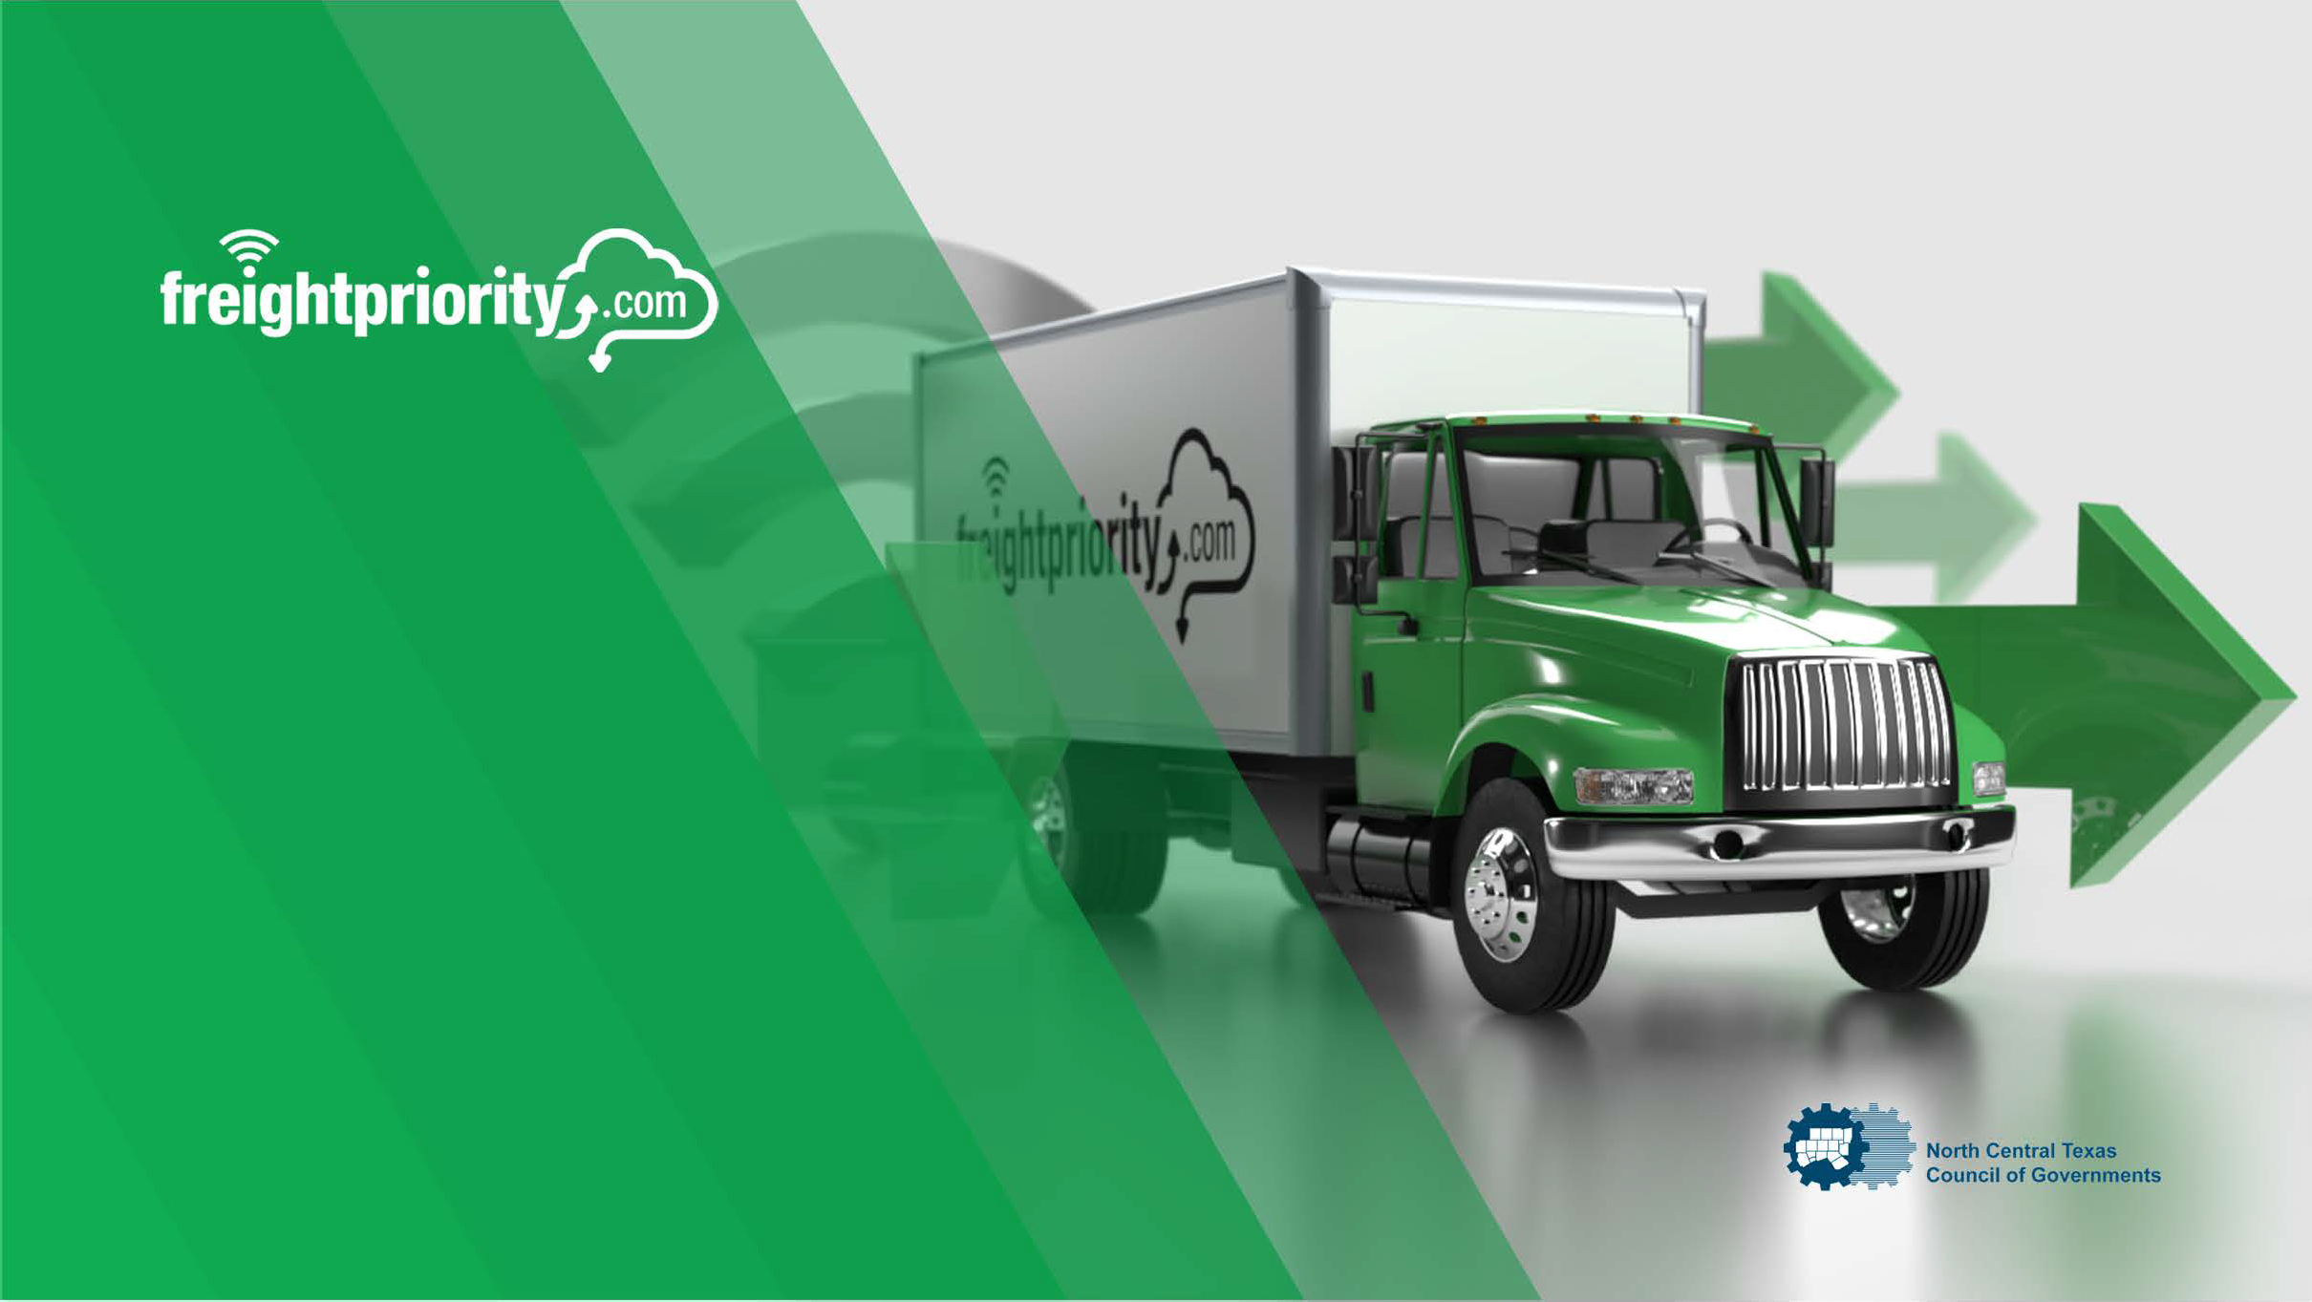

NCTCOG Freight Optimization System
Presentation to
Regional Freight Advisory Committee
May 14, 2024

Slide 2
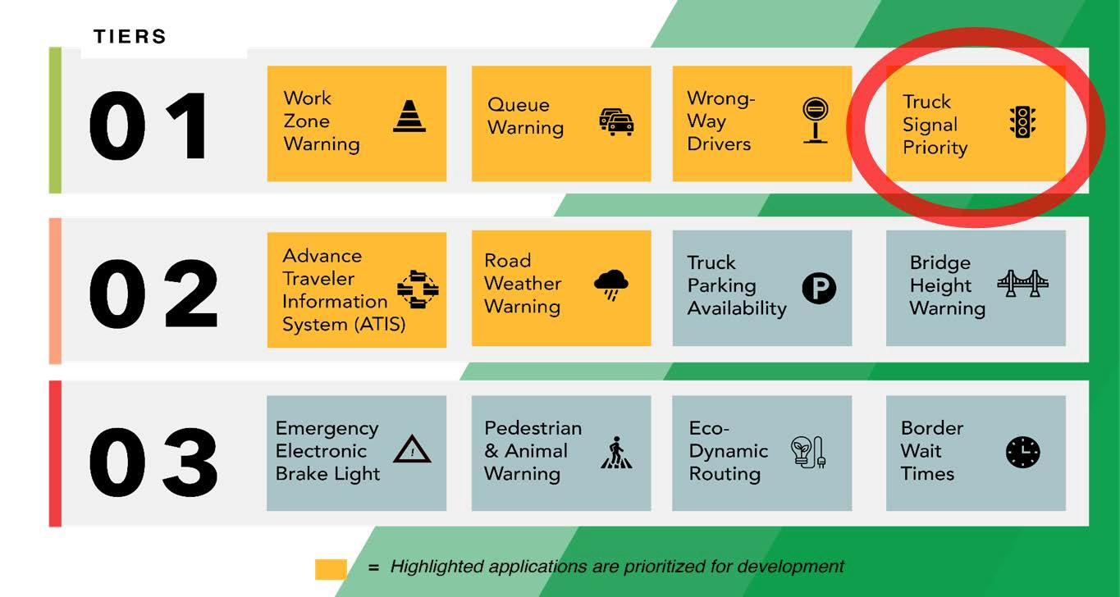
Project Context
DFW is the largest inland port & distribution ecosystem in the US
40+ Freight-Oriented Developments (FODs)
Shippers send trucks through traffic signals to/from FODs to expressways
Additional regional & local distribution on major arterials
TxDOT: Texas Connected Freight Corridors Program

Slide 3

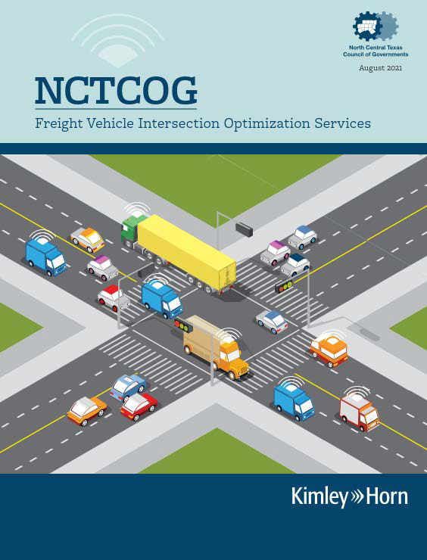

NCTCOGFreight Vehicle IntersectionOptimization ServicesProject
selected as the
best alternative of 9 proposals received
  No Hardware
  No Cost to Participants
  Largest Deployment Alternative
  Leveraged Mature Software (i.e., Software as a Service (SaaS))

Slide 4
Example

Slide 5
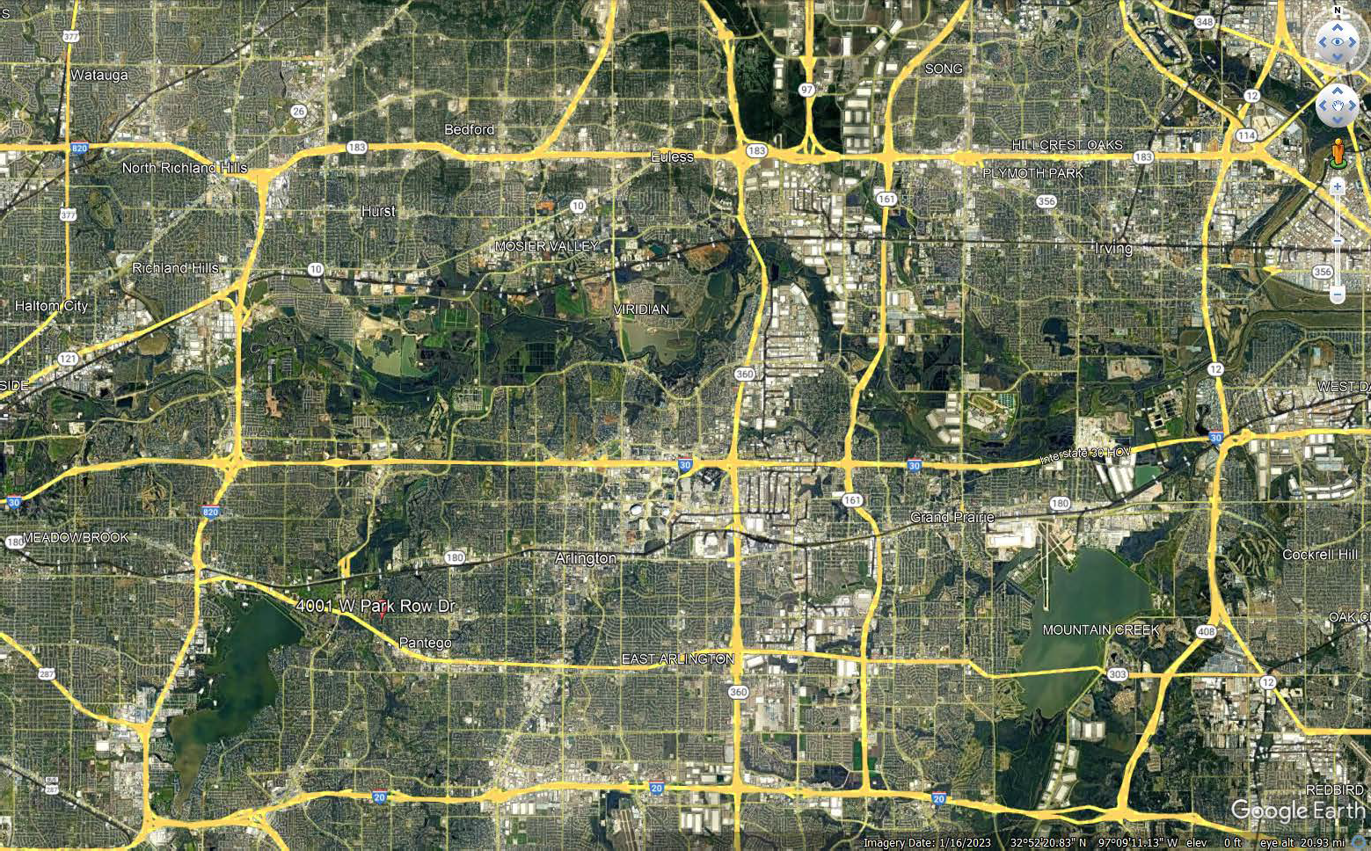

EXAMPLE CORRIDOR
Beltline Road
NCTCOG

Slide 6
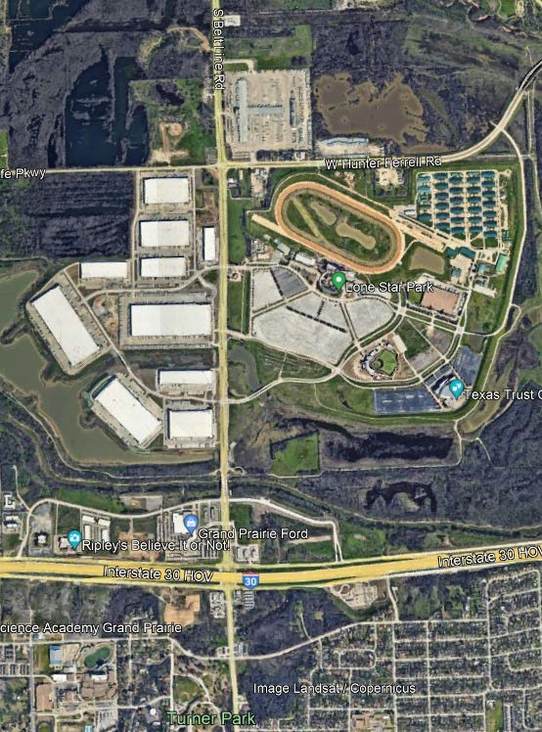

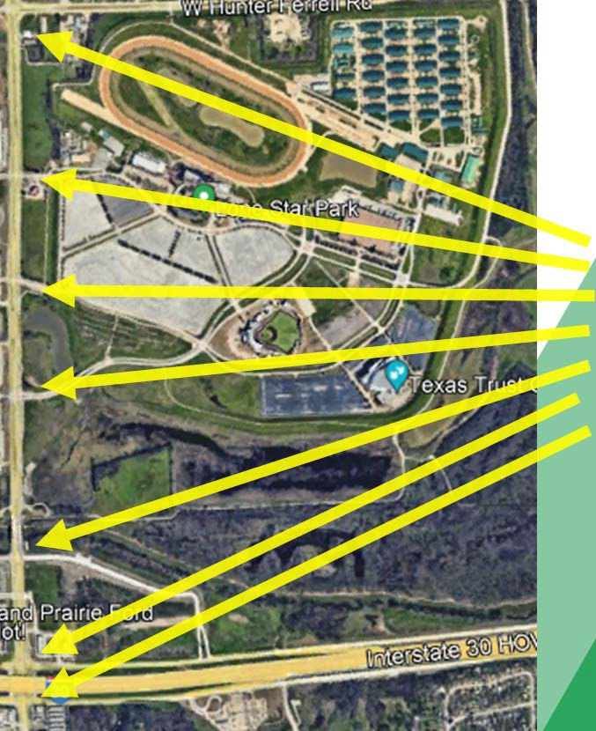

Traffic Signals
Belt Line Road
North Grand Prairie
Beltline Road
7 signals used for example

Slide 7

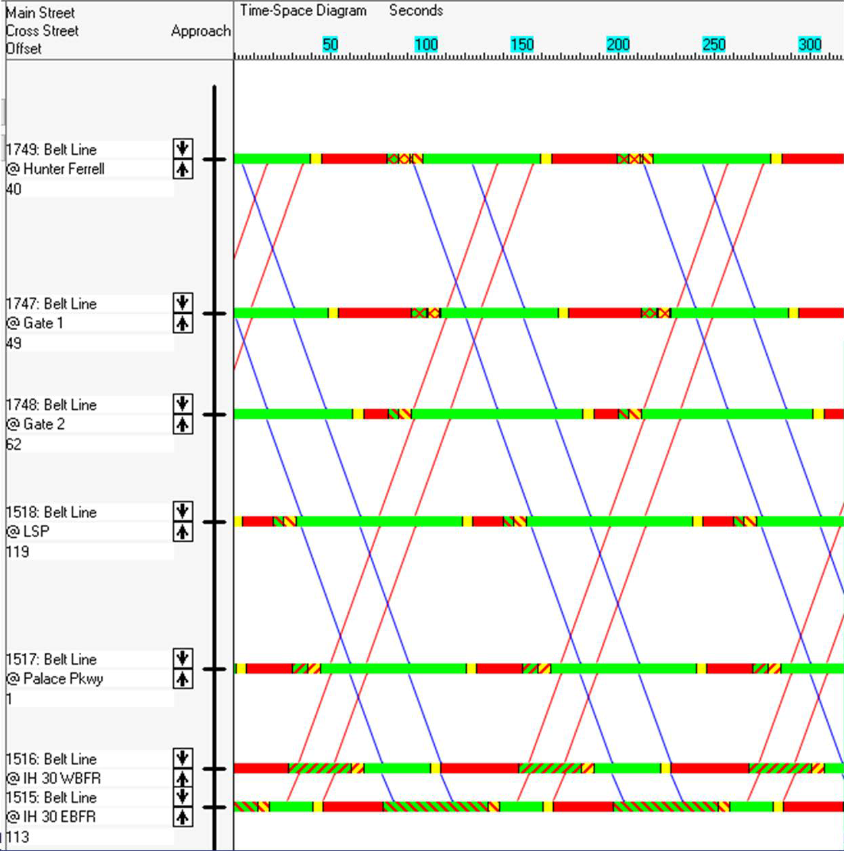
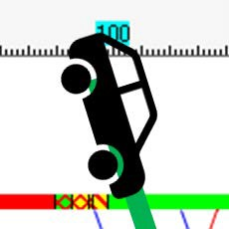

Traffic Signal Operation
Red Signal
Green Signal
Cross Street
Belt Line Road
Cross Street
TimeSpace Diagram
Cross Street
Cross Street
Cross Street
Time

Slide 8
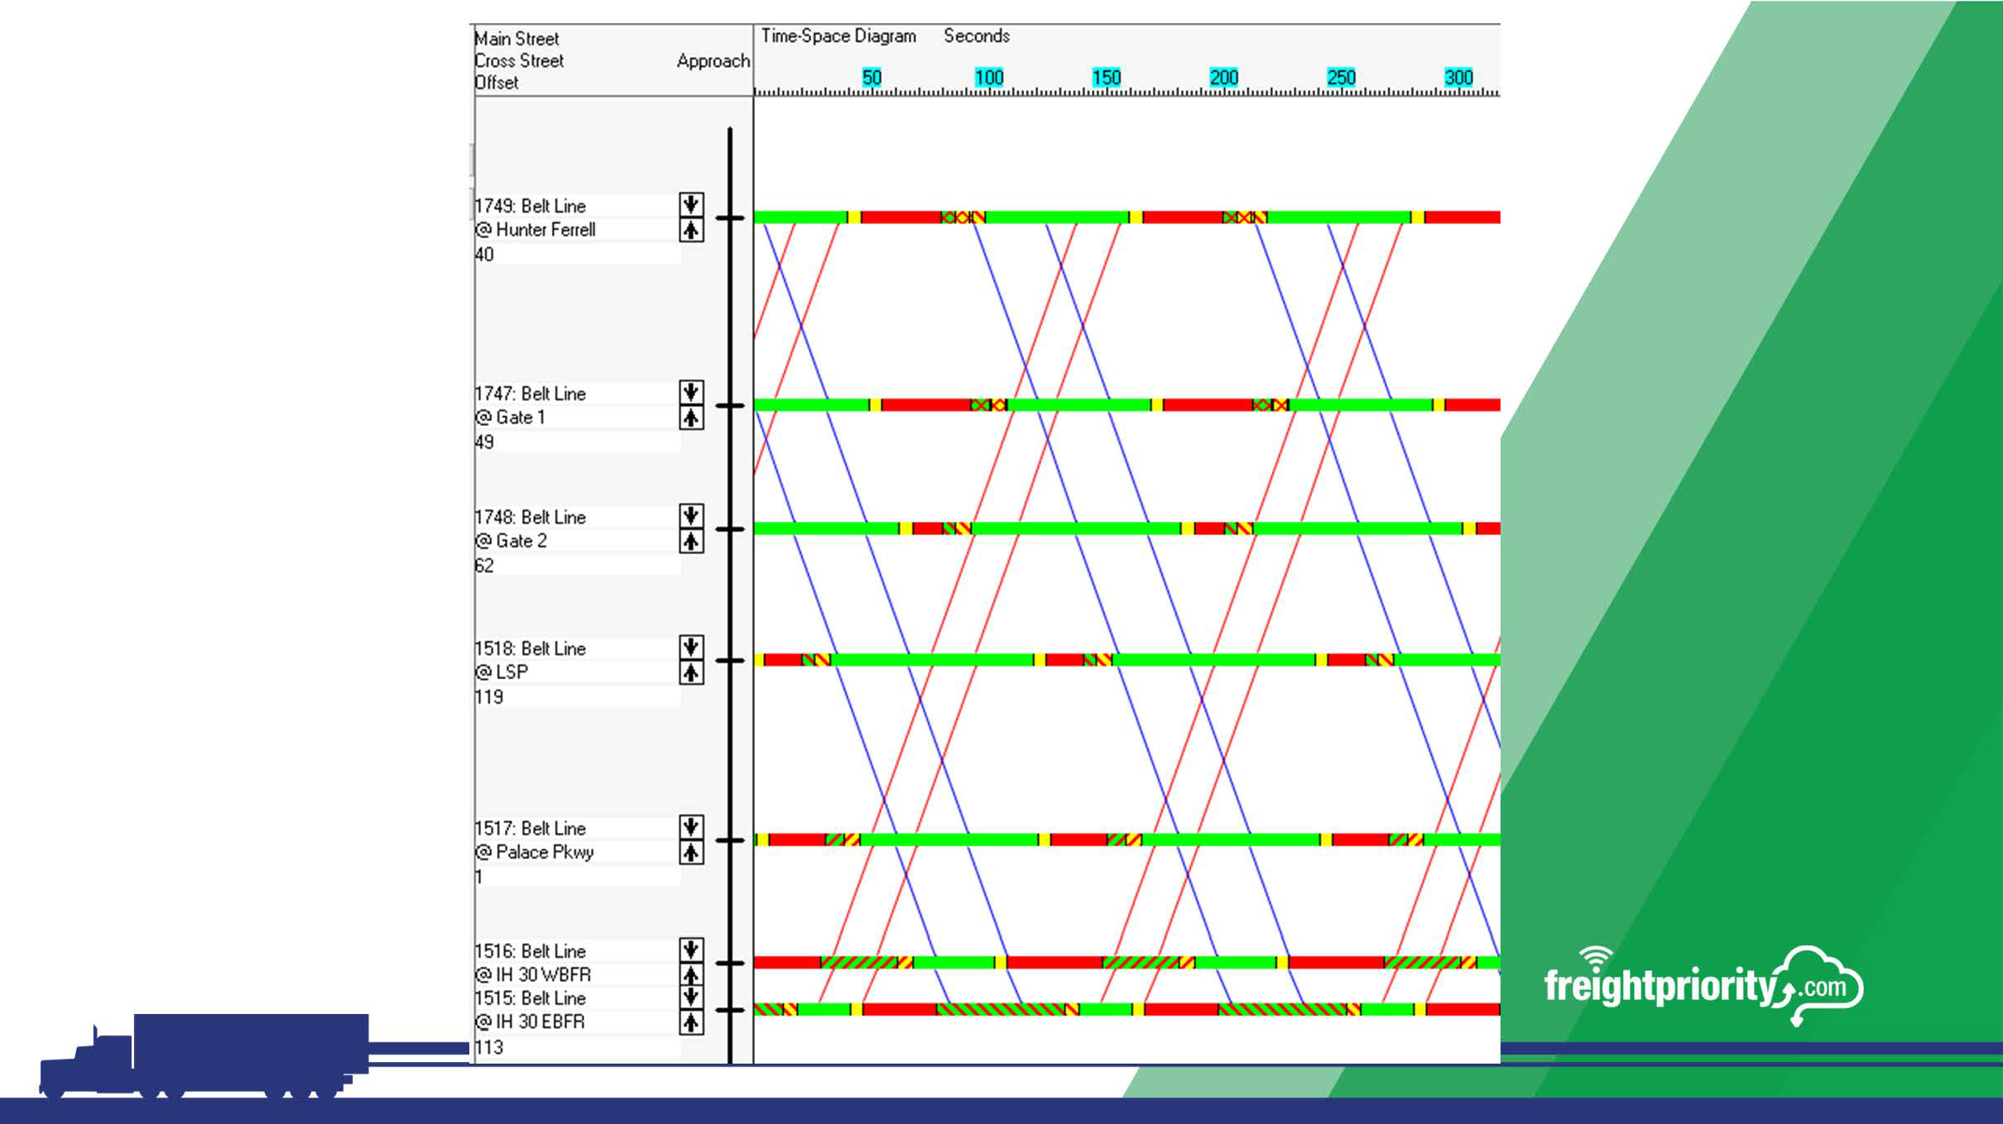
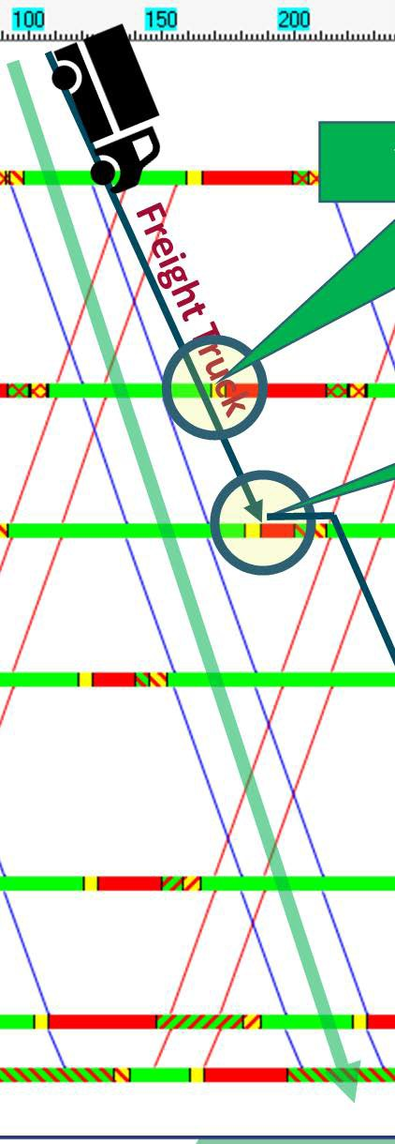




Traffic Signal Operation
Yellow Indication! Stop?
Arrive well into the Yellow Indication! Stop!
!
TimeSpace Diagram
!!!

Slide 9
Project Focus

Slide 10
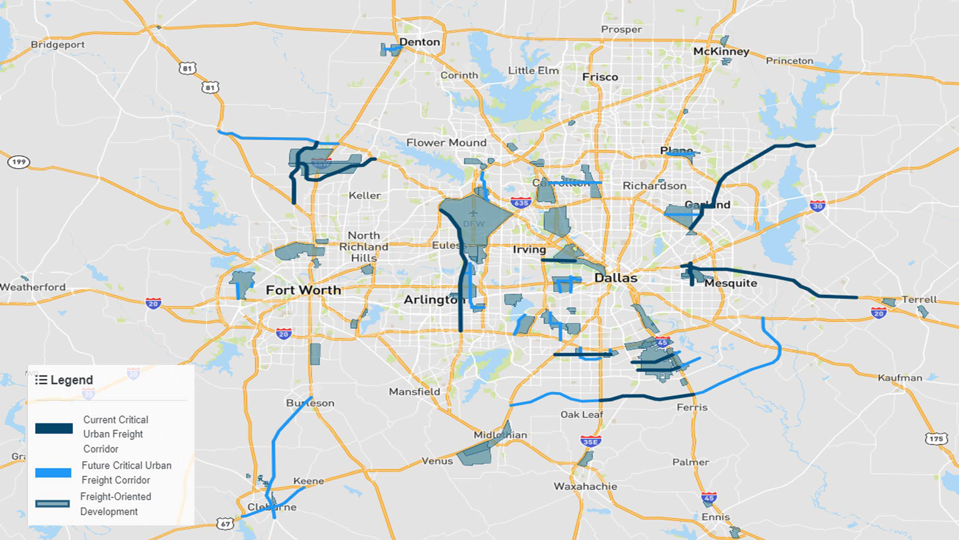



Slide 11



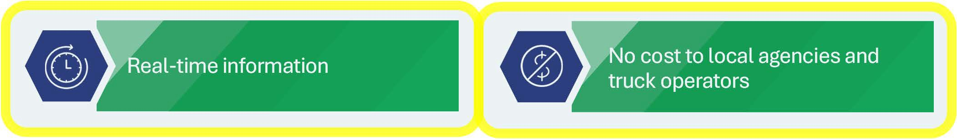


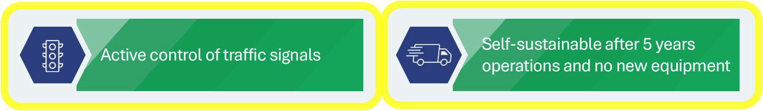

Project Vision
Track benefit-cost
Real-time information
No cost to local agencies and truck operators
Active control of traffic signals
Self-sustainable after 5 years operations and no new equipment

Slide 12










Project Concept
Freight Signal Priority
Green Light Optimized Speed Advisory (GLOSA)
~10 AVL suppliers
+ app adopters
50,000+ trucks (5,000 simultaneous in the system at once)
500 traffic signals (NTCIP)
7 agencies
Cloud deployment

Slide 13
Deployment Locations
HowToProvideInput

Slide 14
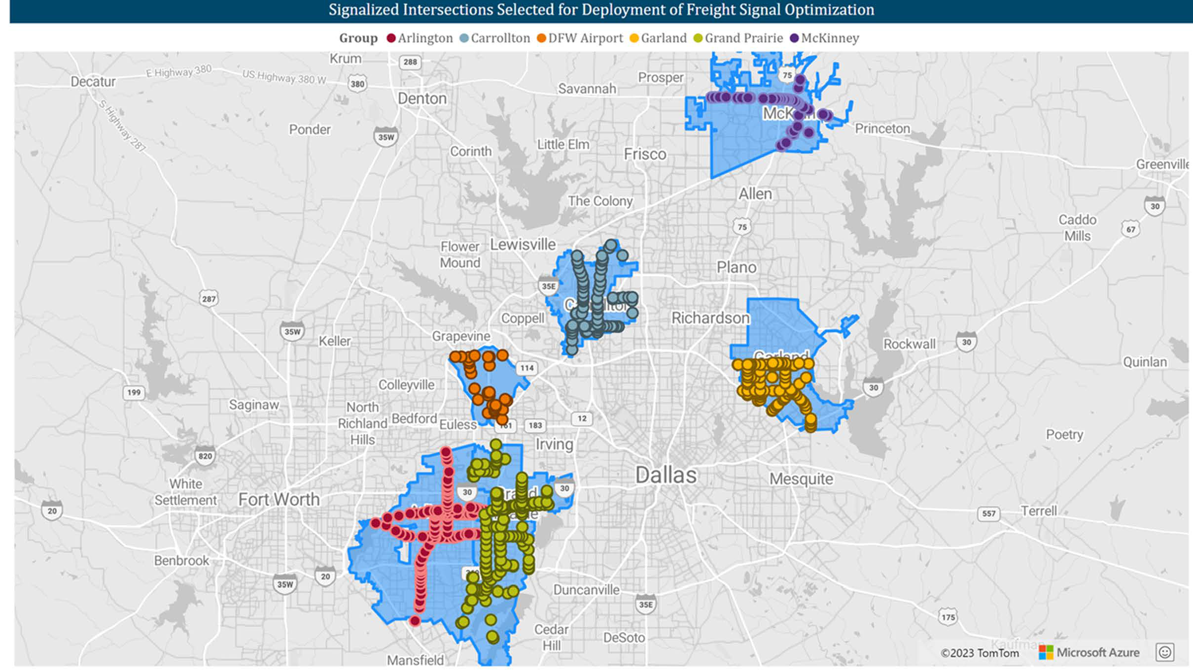

Slide 15
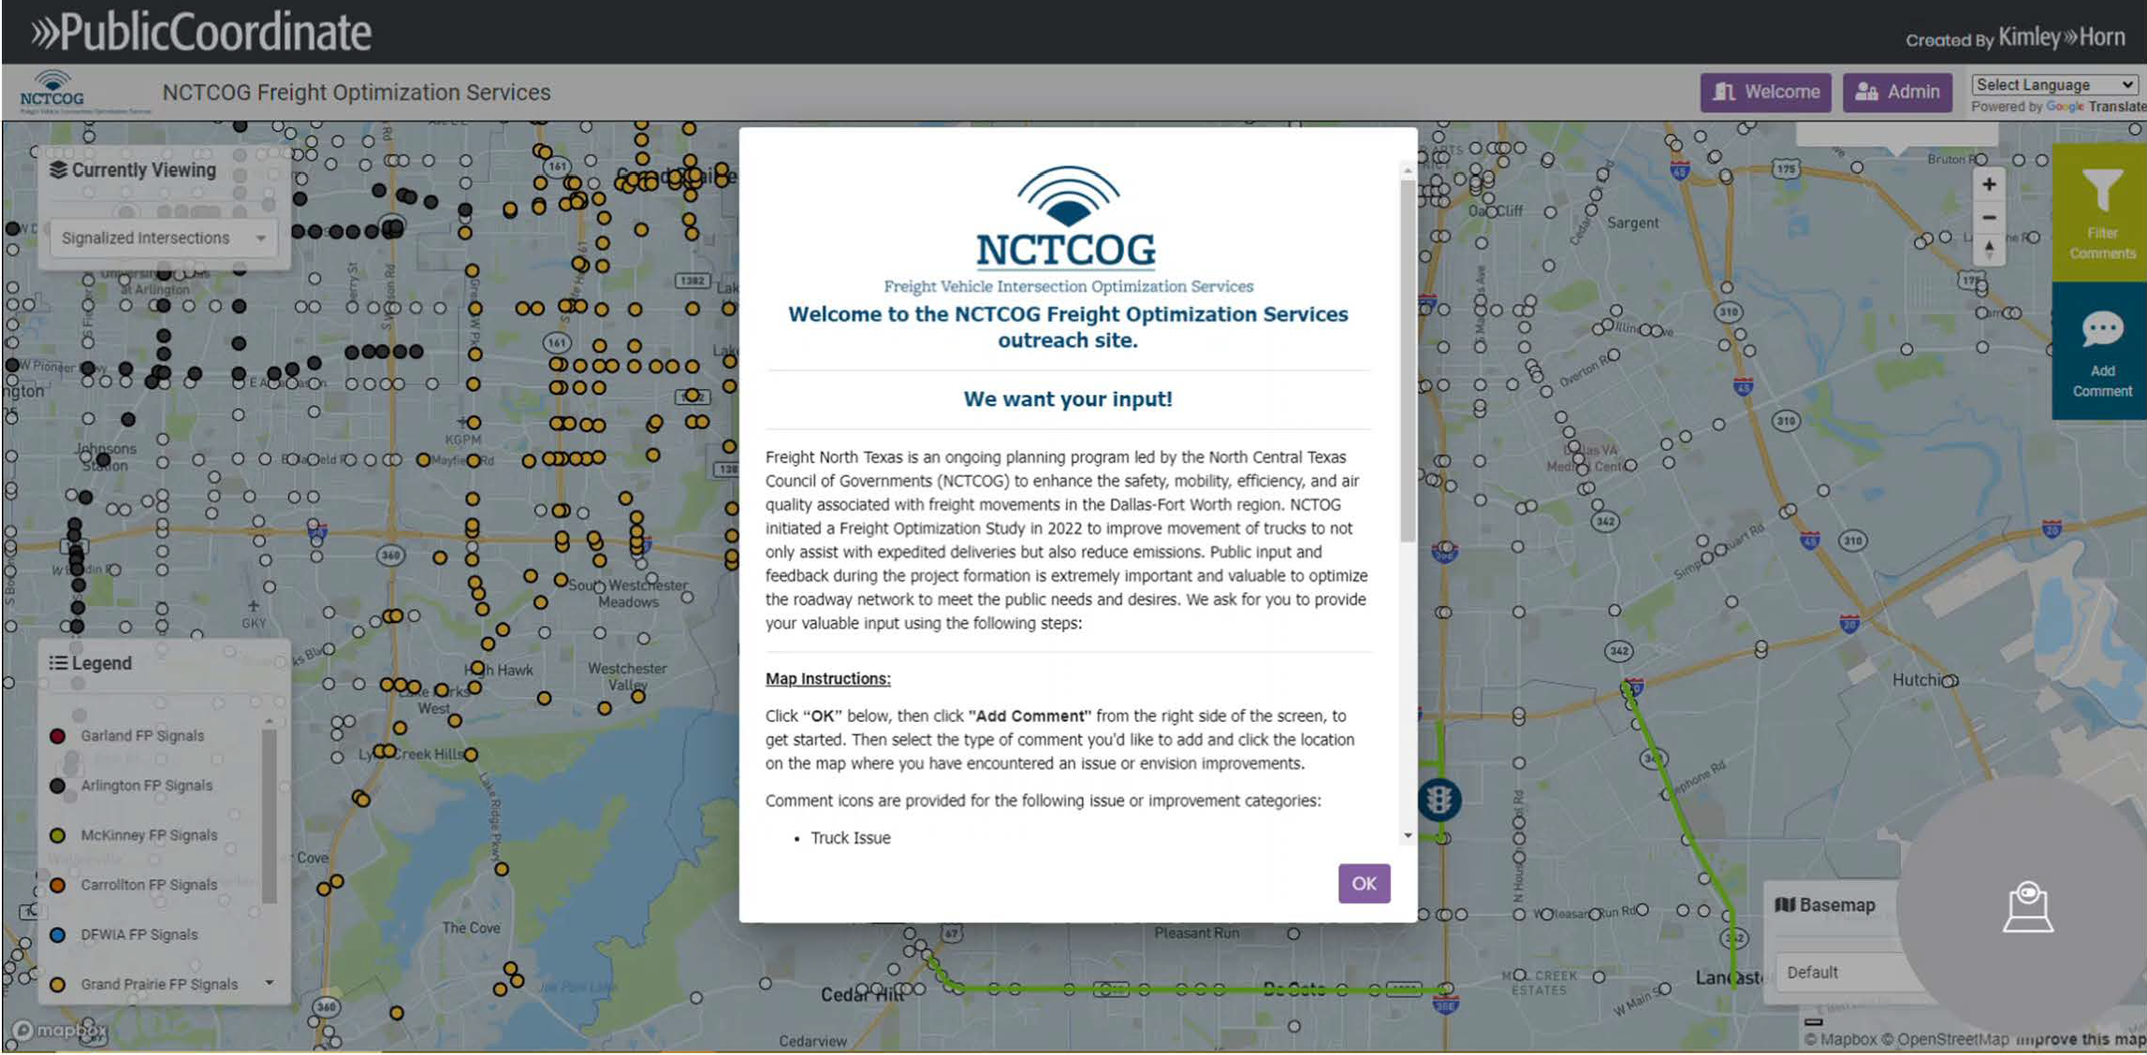

Slide 16
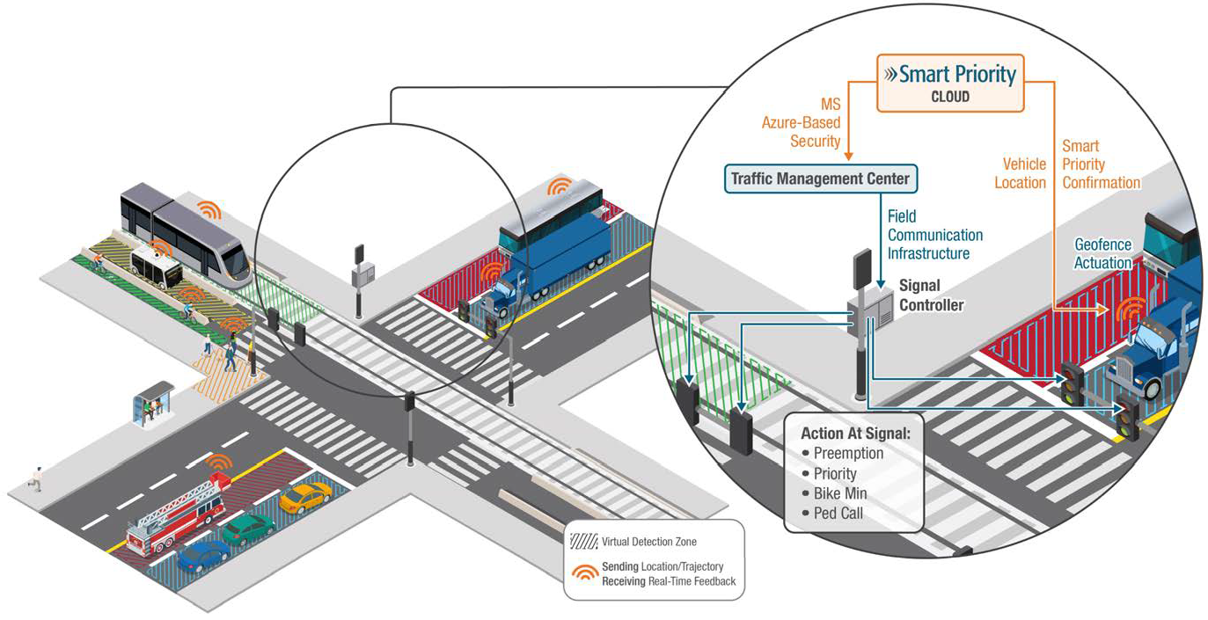
Smart Priority

Slide 17
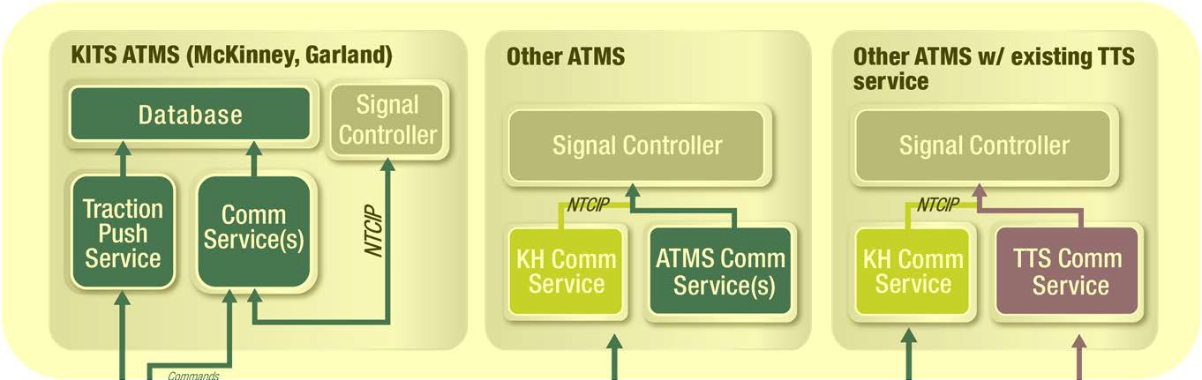
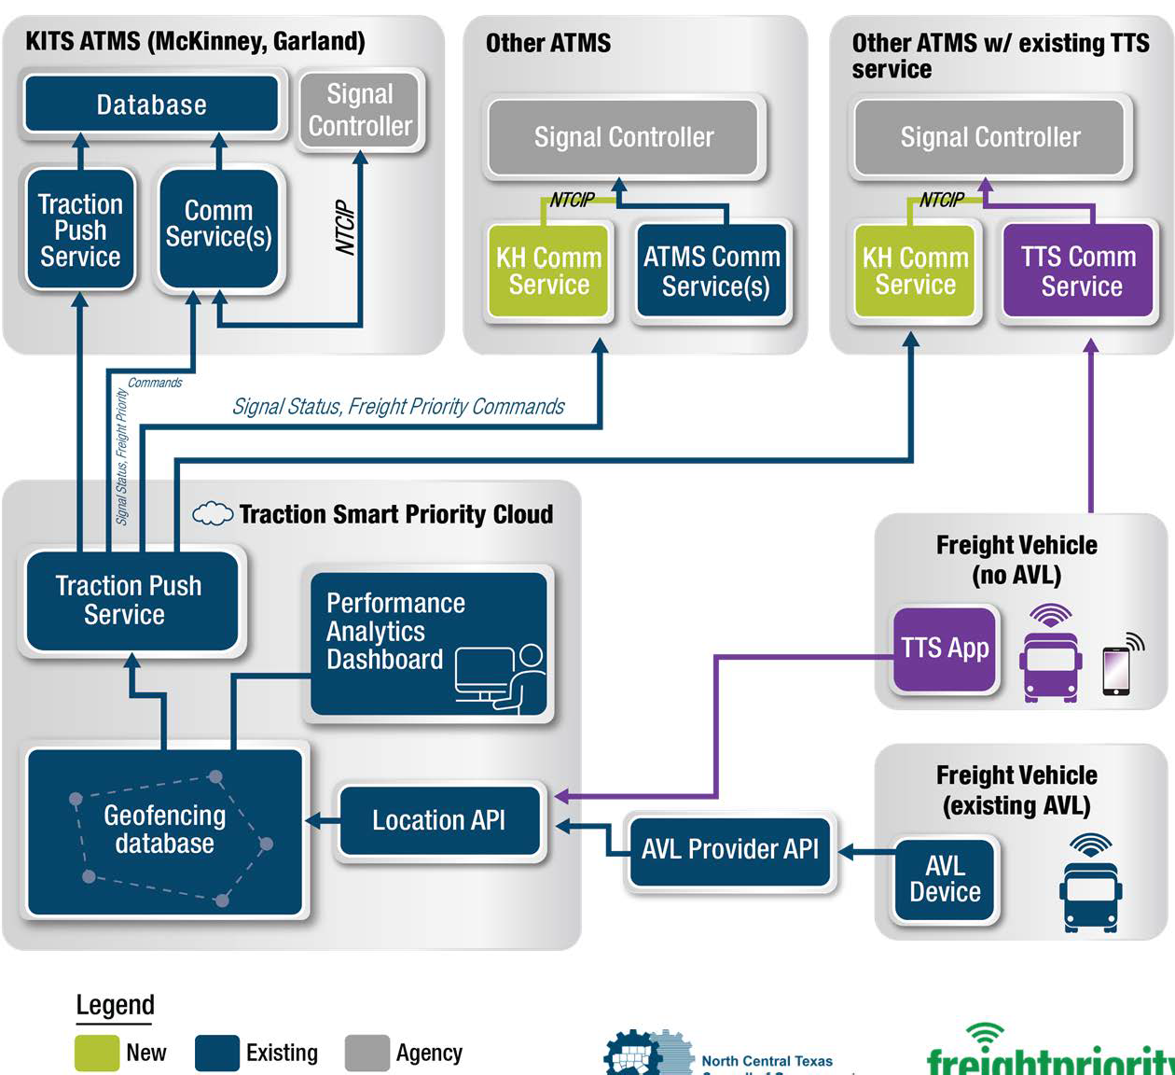

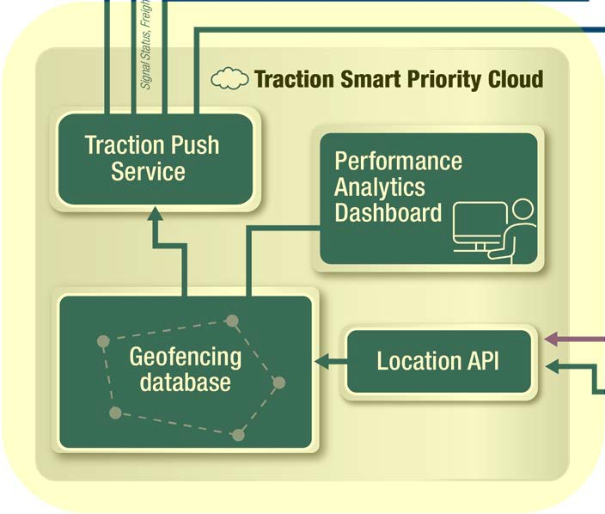
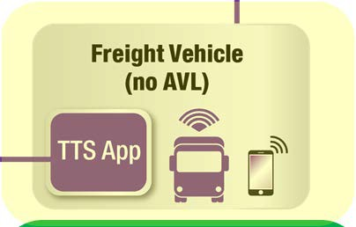
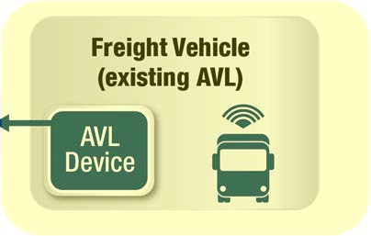
Freight Signal Priority Architecture

Slide 18


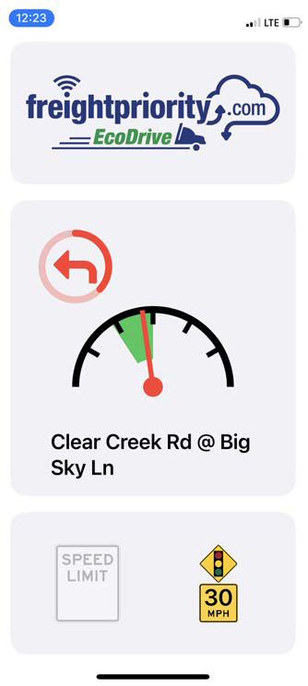
Speed Recommendation
GLOSA
Green Light Optimization Speed Advisory

Slide 19
G LO SA
Green Light
In the “green band” drive safely
Optimization Speed Advisory
Advisory Speed
Predicted Signal Indication for “Other” movements
Posted Speed Limit When Known

Slide 20
Specific Locations

Slide 21
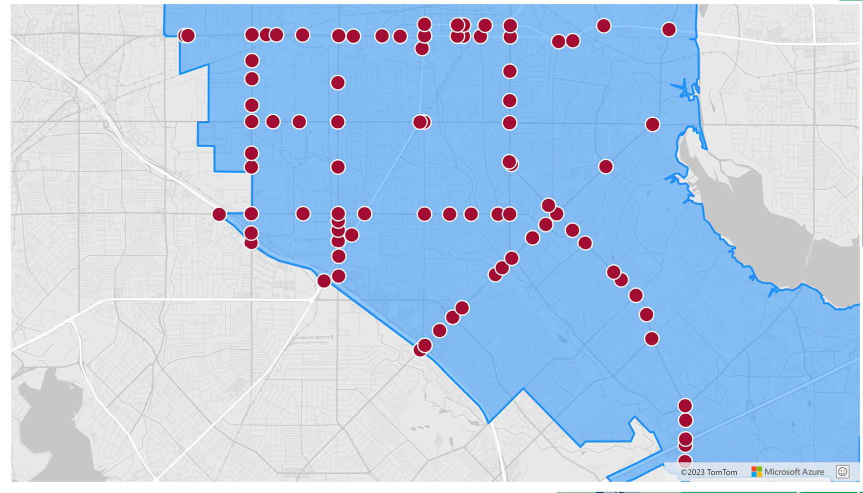
GarlandLocations

Slide 22
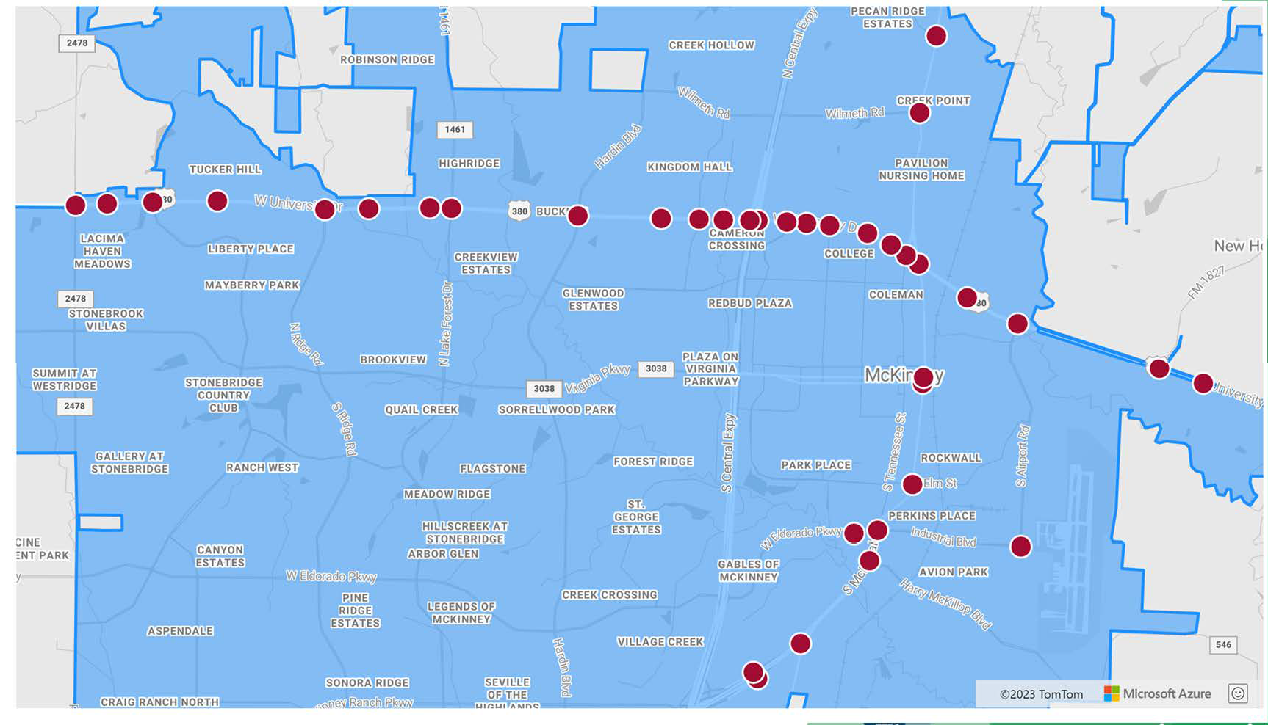
McKinney Locations

Slide 23
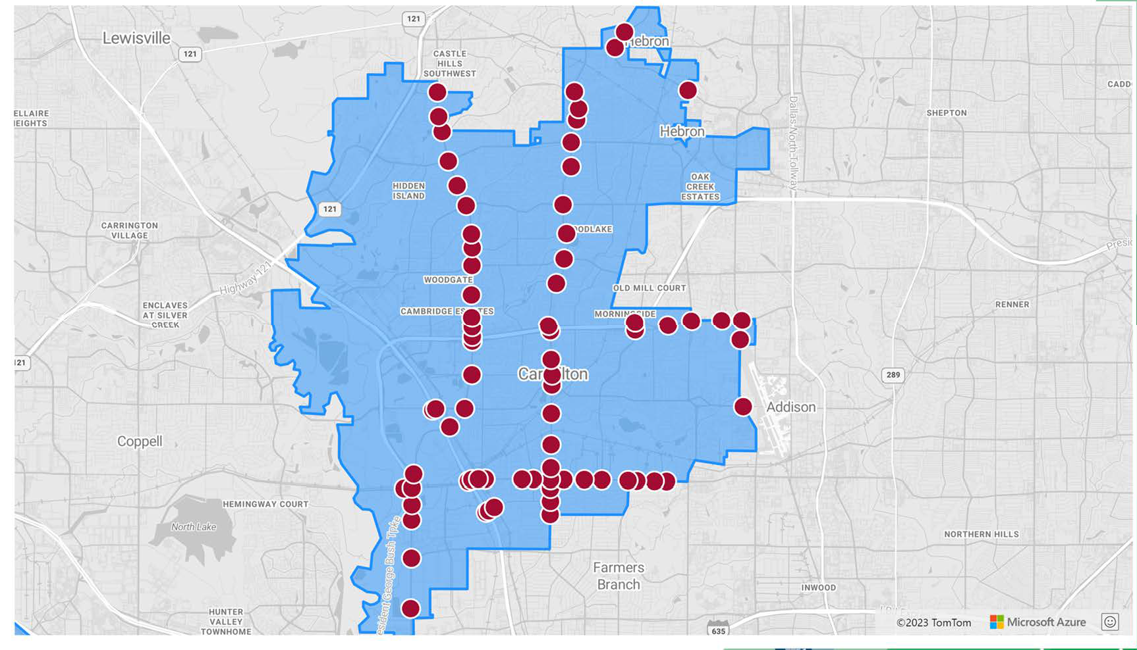
CarroltonLocations

Slide 24
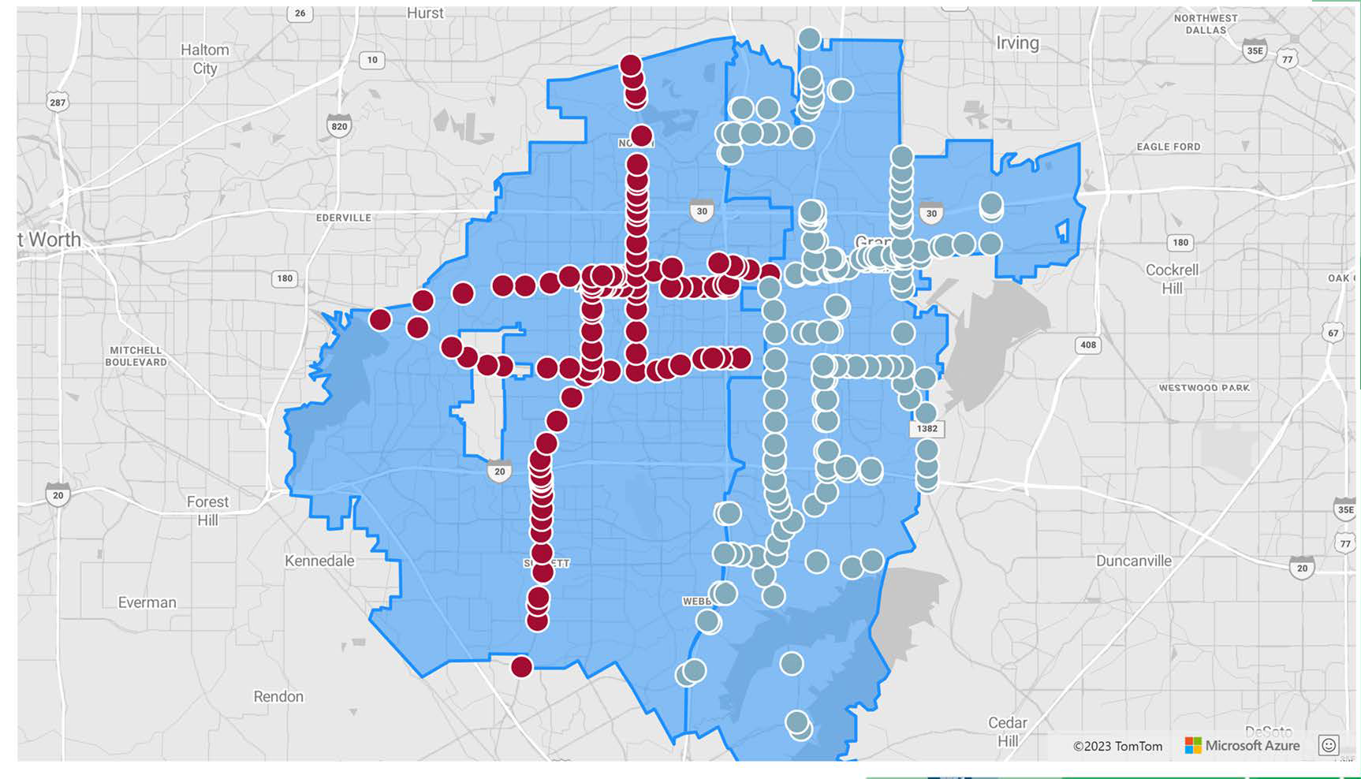
Arlingtonand GrandPrairieLocations

Slide 25
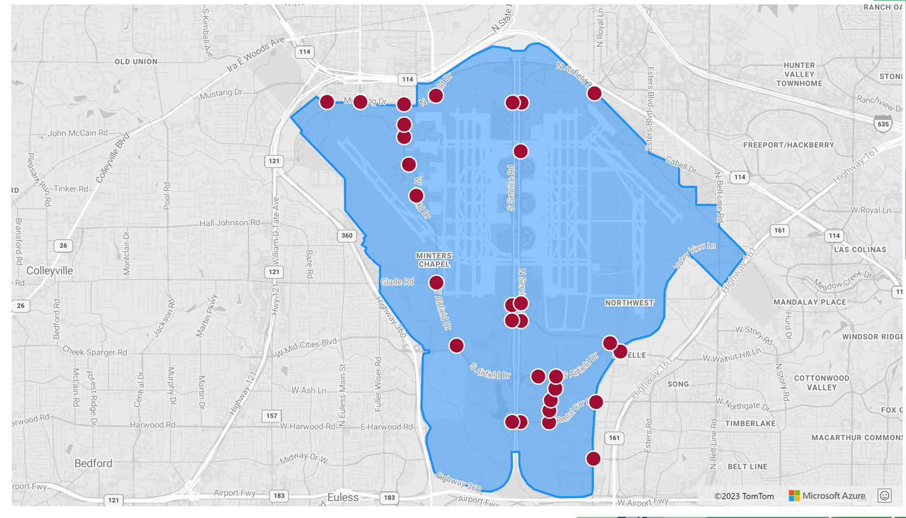
DFWIALocations

Slide 26
BehindtheScenes

Slide 27
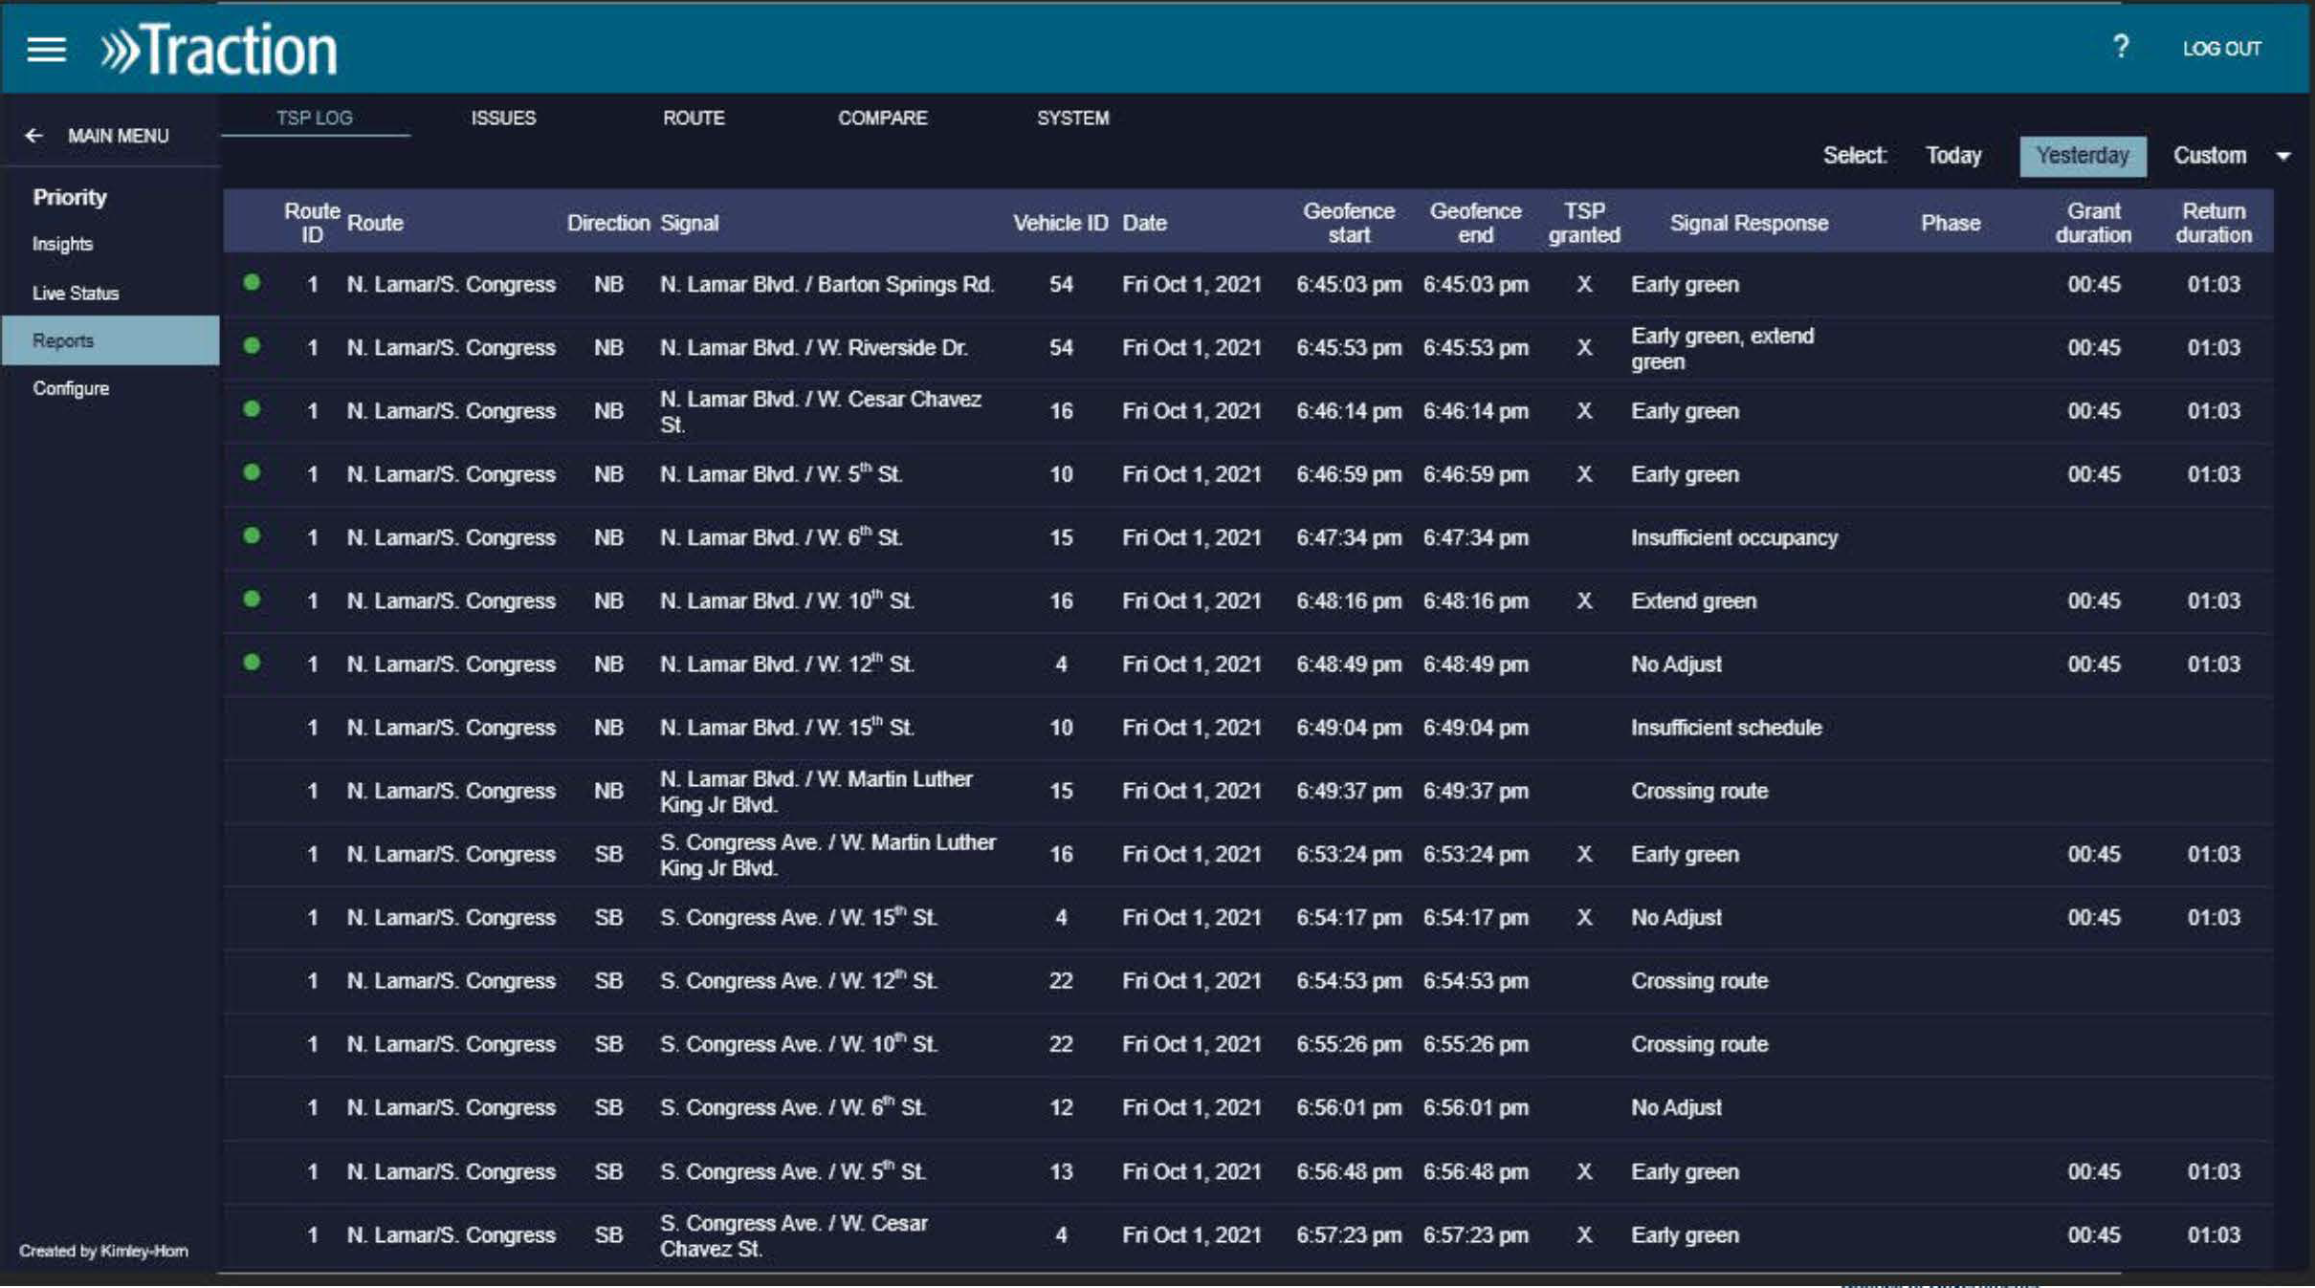

Slide 28
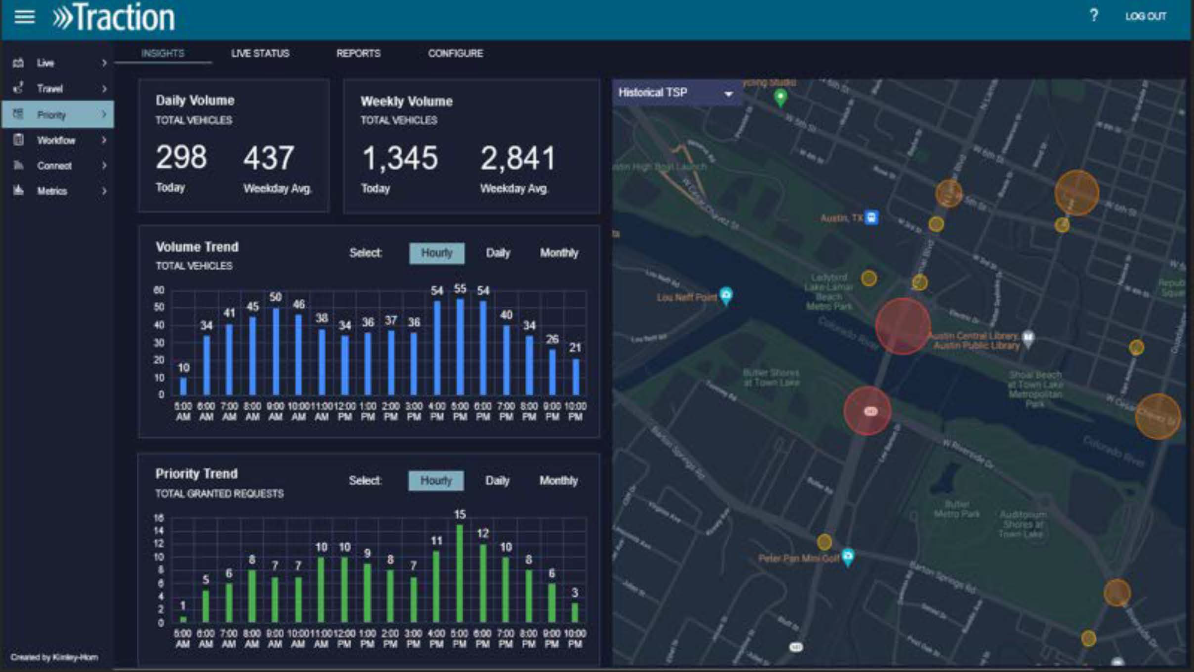

Slide 29
Public Engagement

Slide 30
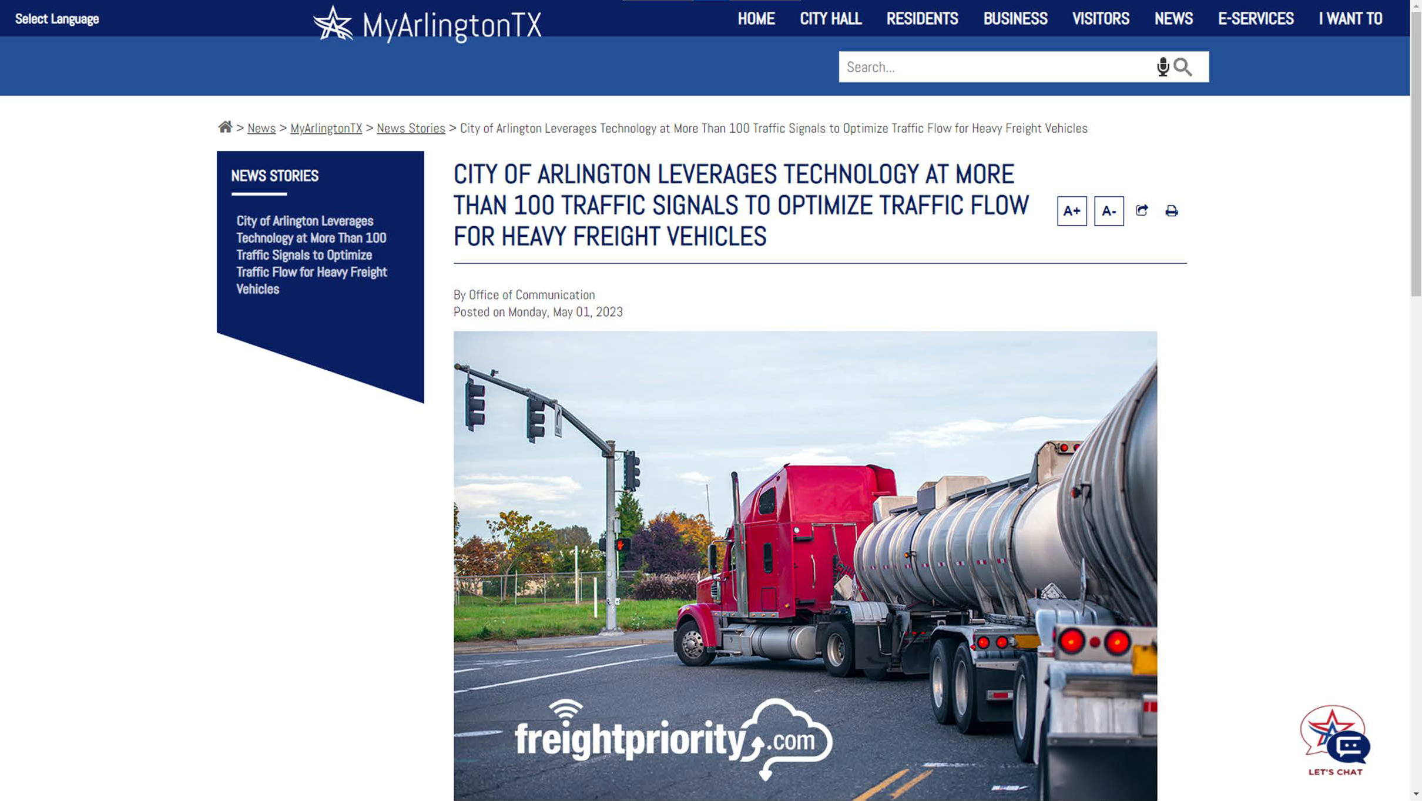

Slide 31
BENEFITS

Slide 32
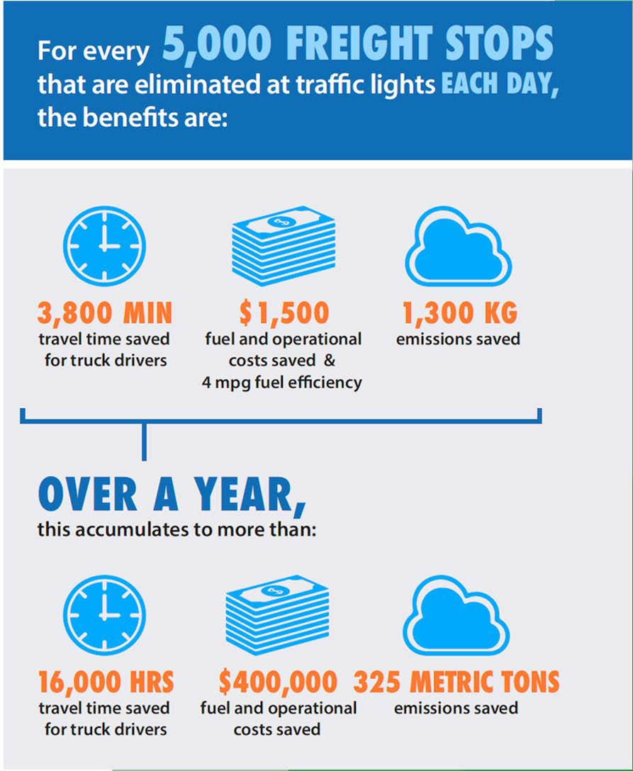
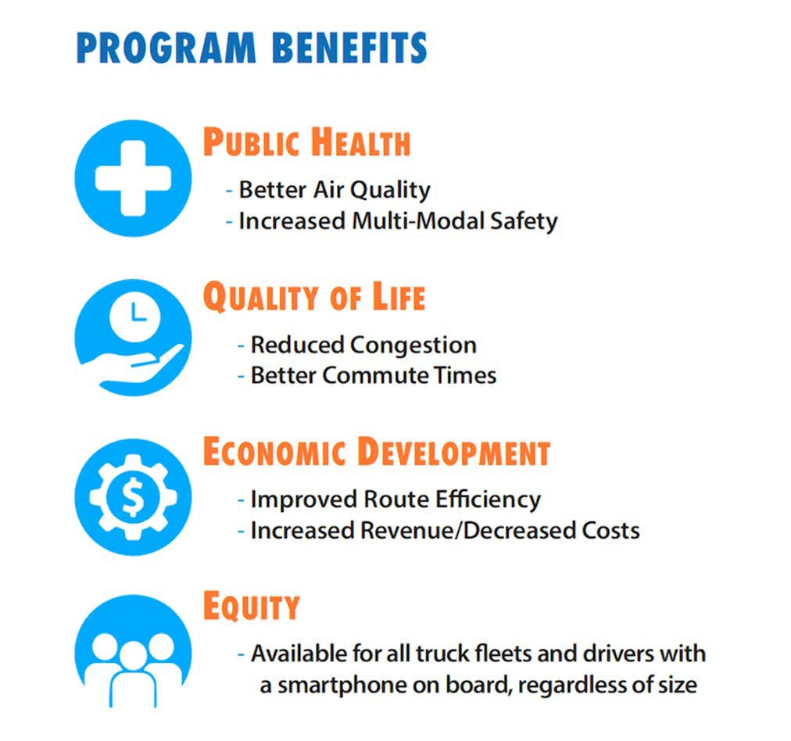
ExpectedBenefits

Slide 33
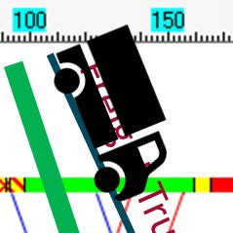




Traffic Signal Operation
Green Extension
Green Extension
Freight Priority ! Never Stop at a Signal Again
Green Extension
Time

Slide 34

EPA MOVES
Tabulations of emissions outputs for buses/trucks of various types (articulated, alternative fuels, etc.)
Based on “operating modes” which is a combination of vehicle speed and “scaled tractive power”
https://www.epa.gov/sites/default/files/2020
-11/documents/420r20018.pdf
Note: Very dense technical document

Slide 35
Tracking Benefi ts

Slide 36
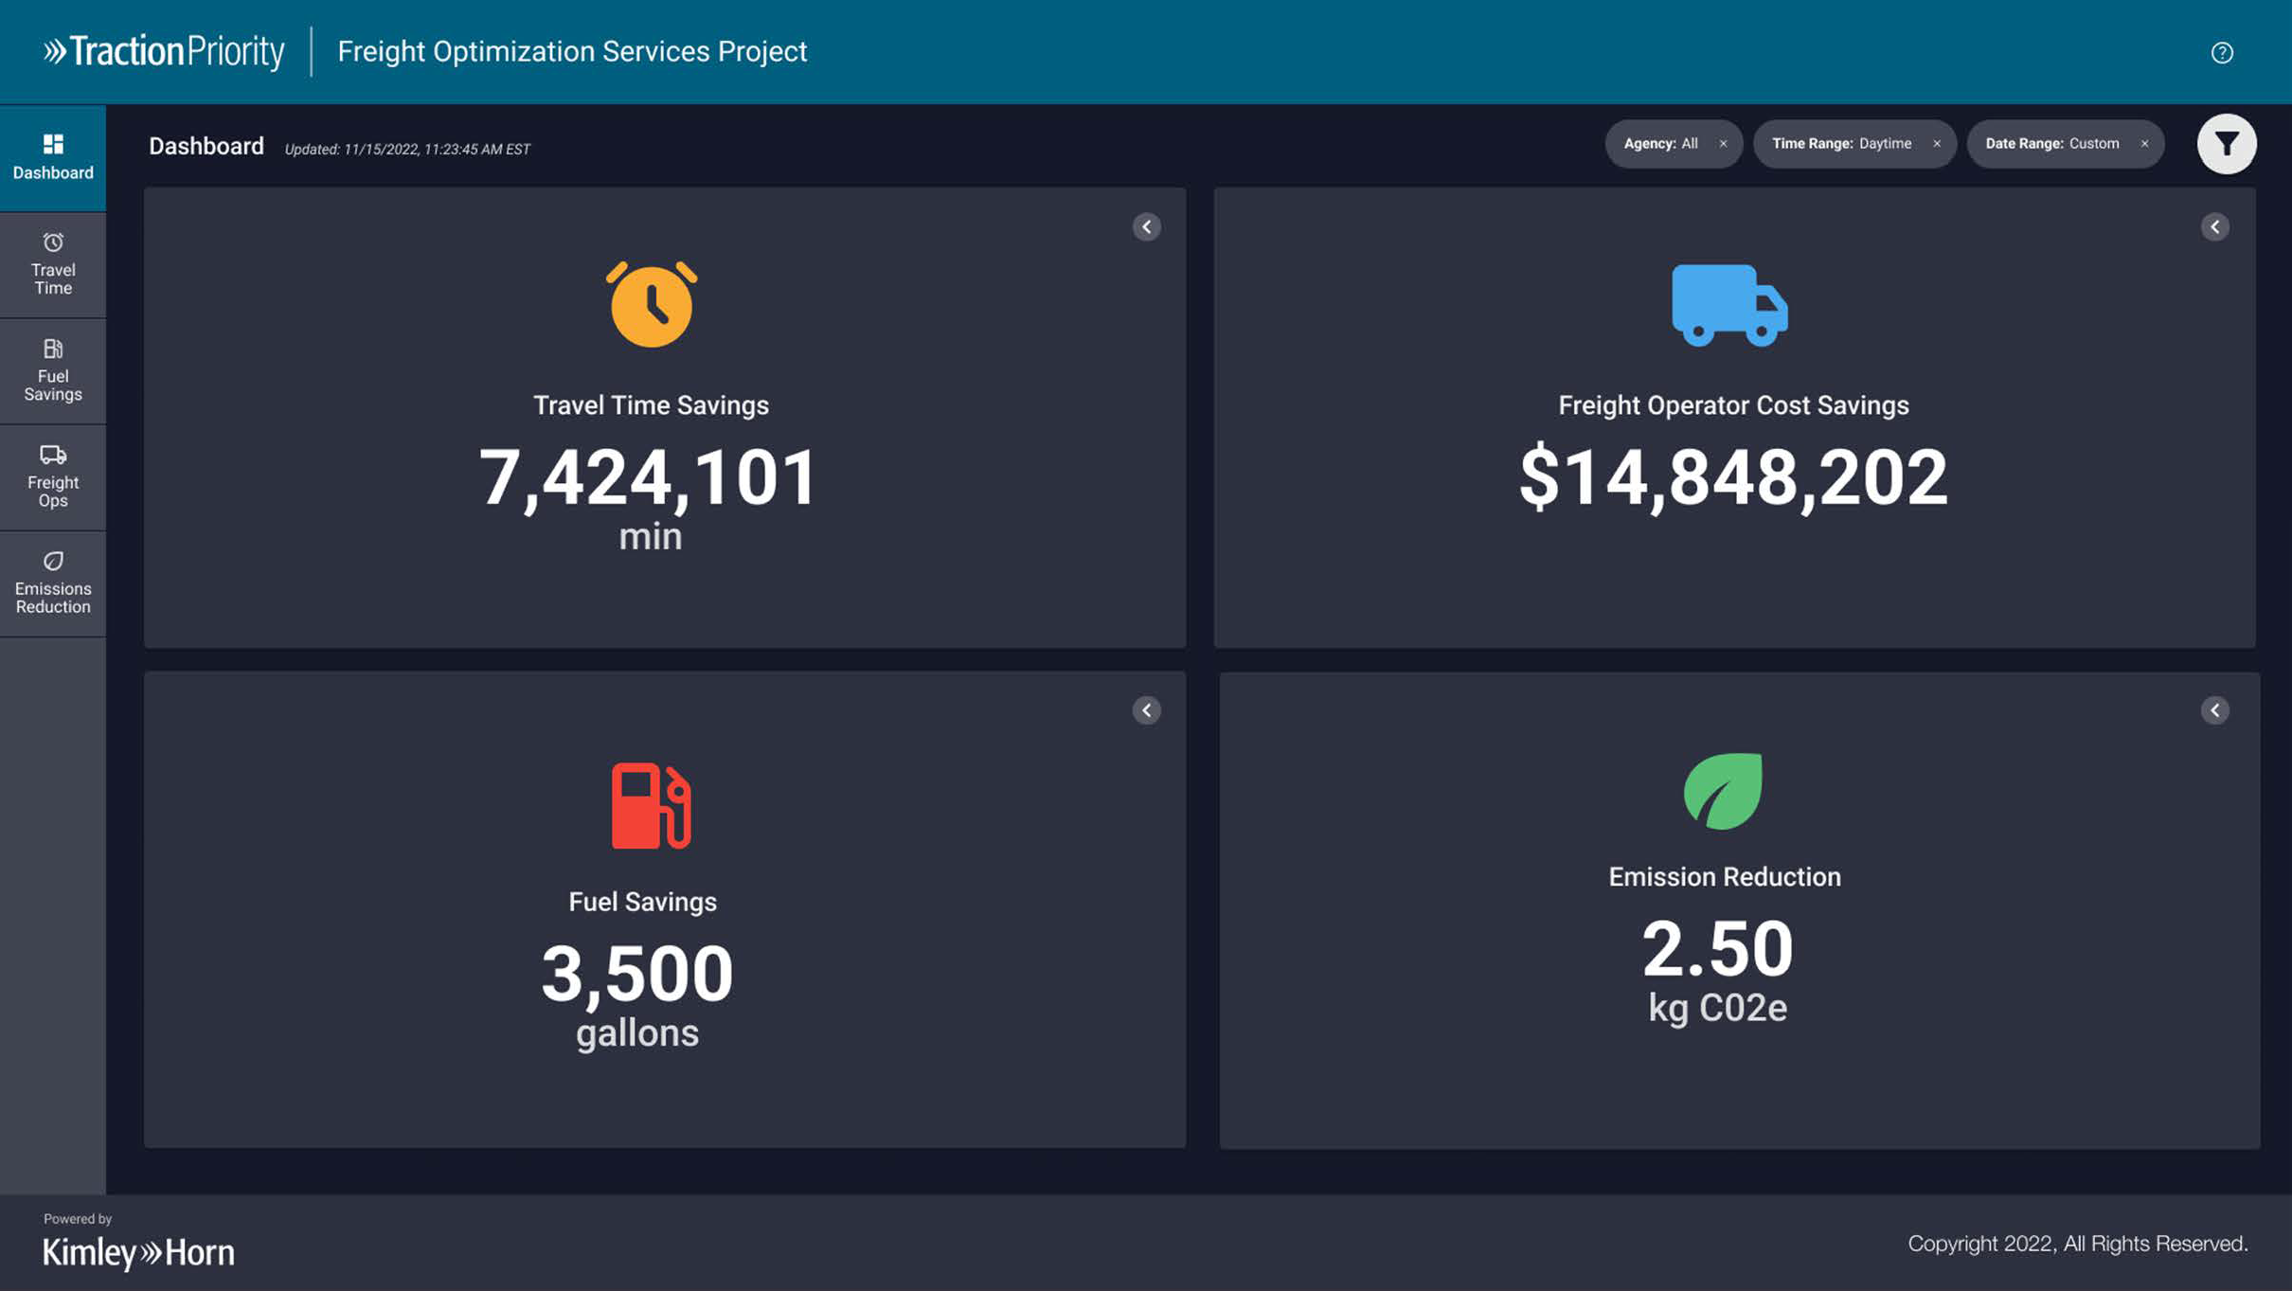

Slide 37
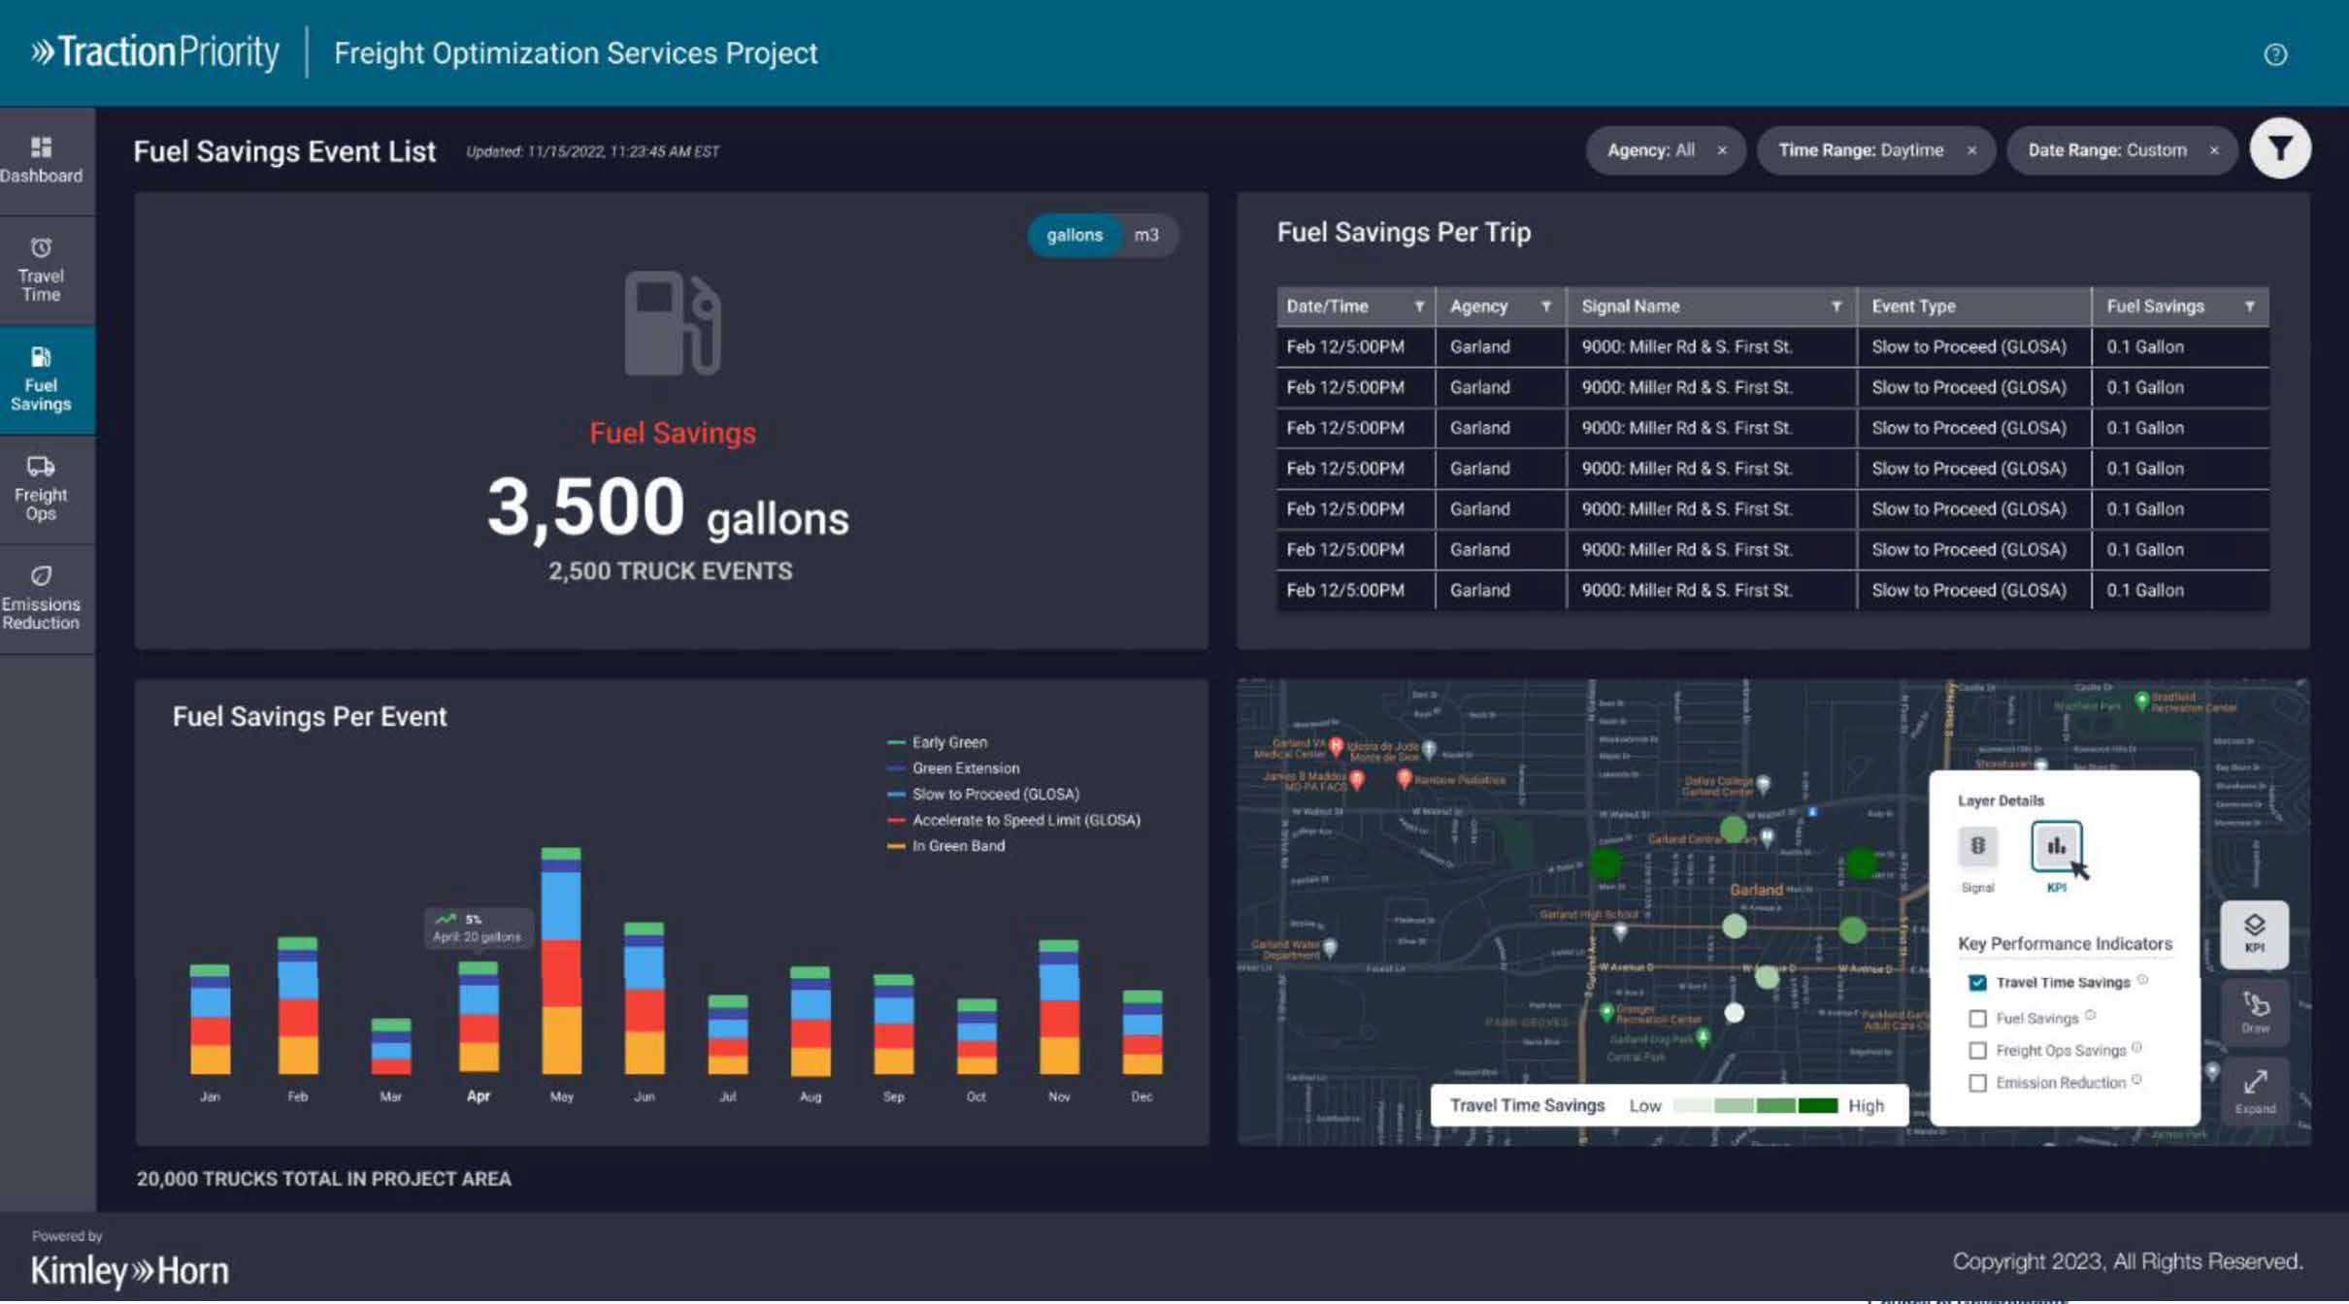

Slide 38
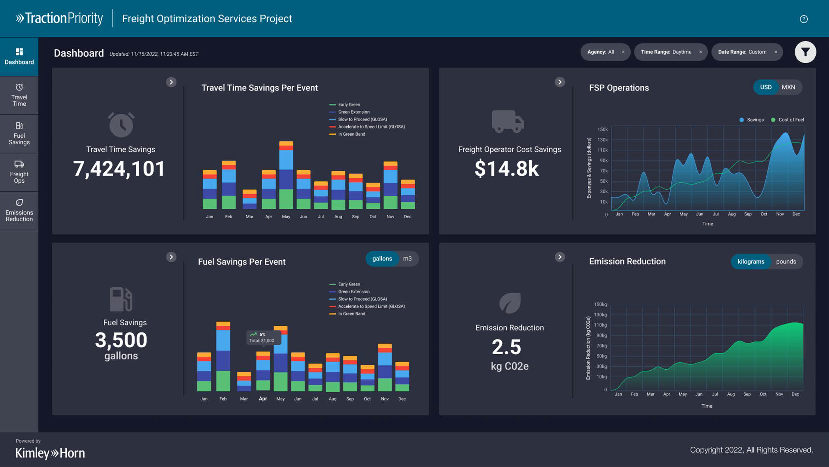

Slide 39
Project Status

Slide 40
Project Status
Application on Apple store now.
Application near release to Google.
Discussions with in-cab electronic logging devices (ELDs).
Marketing via TxTA newsletter and direct outreach.

Slide 41
Today’sActions
Sign up to get first access to the mobile app
Review the Freight Priority website at www.freightpriority.com
DM0
Suggest signals for improvements
Let us know what you think!

Slide 42
Slide 41
DM0
Added a slide to double-down on immediate actions!
Dyer, Megan, 2023-12-14T14:50:16.825

Slide 43


Contact Information
Natalie Bettger
Senior Program Manager
nbettger@nctcog.org
Kent Kacir, P.E.
Project Director
Kent.Kacir@kimley-horn.com
Connor Sadro
Transportation Planner III
csadro@ntcgog.org
www.freightpriority.com

