Slide 1
PWCS Fifth Edition
DIVISION 1000 Edits
As of 10/19/2018

Slide 2
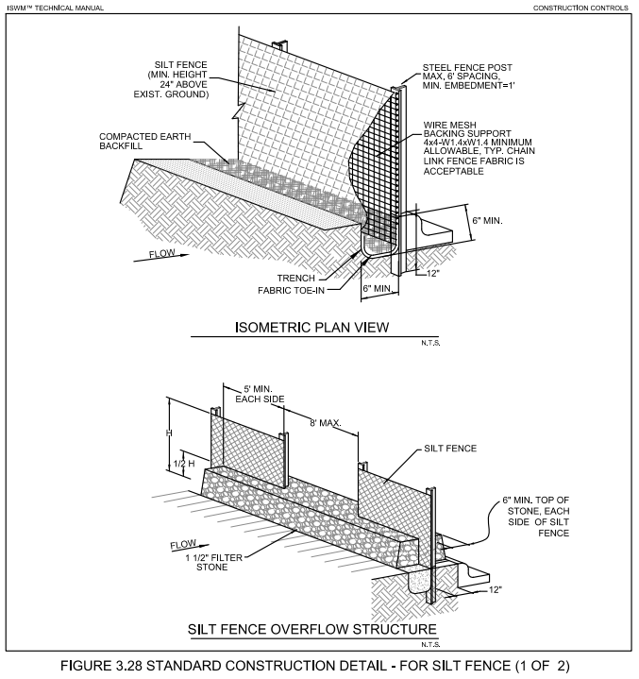
1020A
SILT FENCE
Replacing Original Drawing 1020

Slide 3
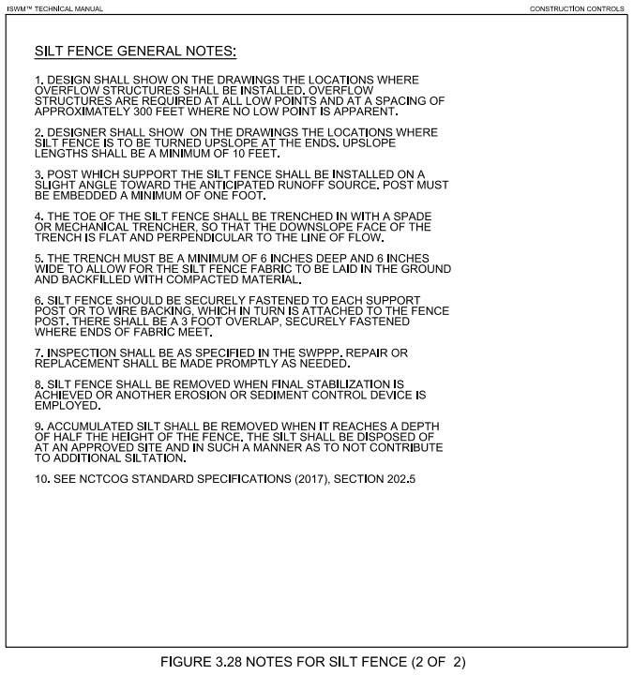
1020B

Slide 4
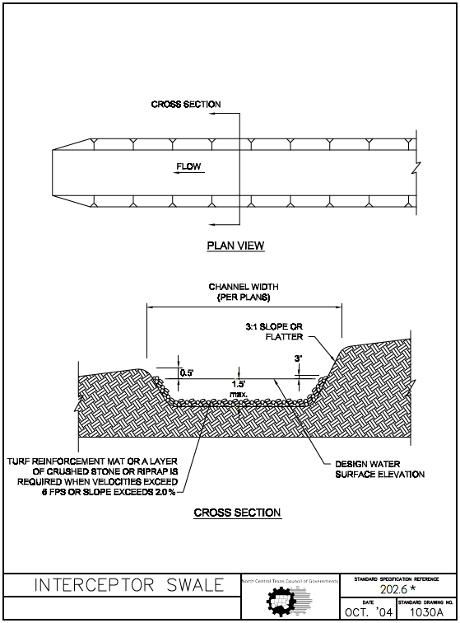
1030A
Longitudinal slope
Swale
max.
For swale material, see Note 6
Update Drawing Date

Slide 5
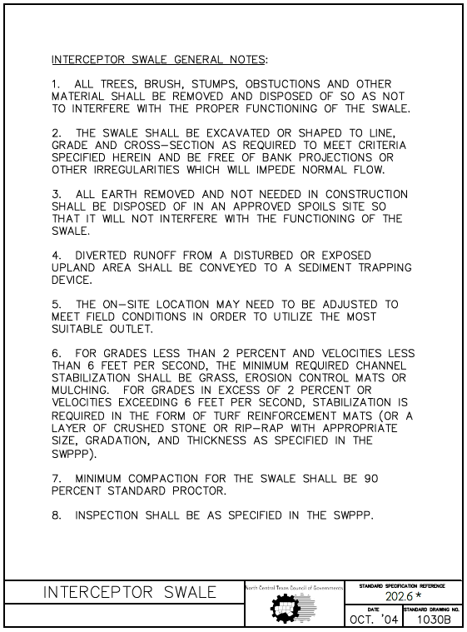
1030B
Replace “grades” with “longitudinal slopes”
swale
STABILIZED
RIP-RAP
SEE NOTES 9 AND 10.
PLANS
95
9. For temporary stabilization rip-rap; width, depth, and surface water elevation should be designed by owner or owner’s representative.
10. Refer to Drawing 1230A and B for turf reinforcement mat.
11. See integrated Stormwater Management Manual for more information on interceptor swale.
Update Drawing Date

Slide 6
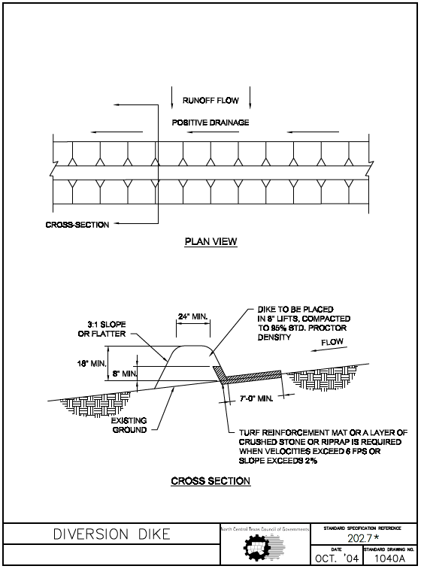
1040A
See Note 5
Update Drawing Date

Slide 7
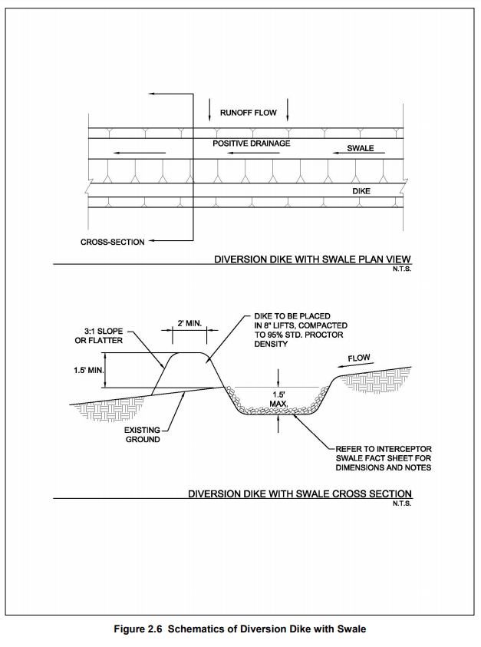
1040B
Arrows are upside down
STANDARD DRAWINGS 1030A AND 1030B.
Standard Specification Reference 202.7*
Date | Standard Drawing No. 1040B
New Drawing
Taken from iSWM manual to accompany 1040A

Slide 8
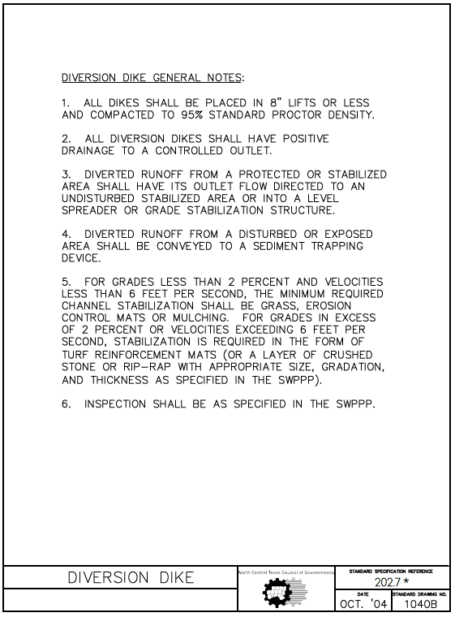
1040C
Refer to Item 202.7 in the Standard Specifications.
Replace “grades” with “longitudinal slopes”
swale
STABILIZED
RIP-RAP
PLANS
SEE NOTES 8 AND 9.
7. See integrated Stormwater Management Manual for more information on interceptor swale.
8. For temporary stabilization rip-rap; width, depth, and surface water elevation should be designed by owner or owner’s representative.
9. Refer to Drawing 1230A and B for turf reinforcement mat.
Update Drawing Date

Slide 9
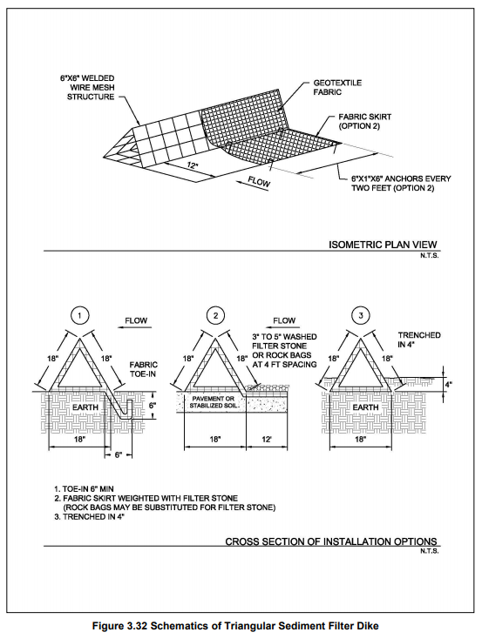
1050A
6” x 6” OR 4” x 4” WELDED WIRE MESH STRUCTURE
deep
Standard Specification Reference 202.8 *
Date | Standard Drawing No. 1050A
Replacing Original Drawing 1050A

Slide 10
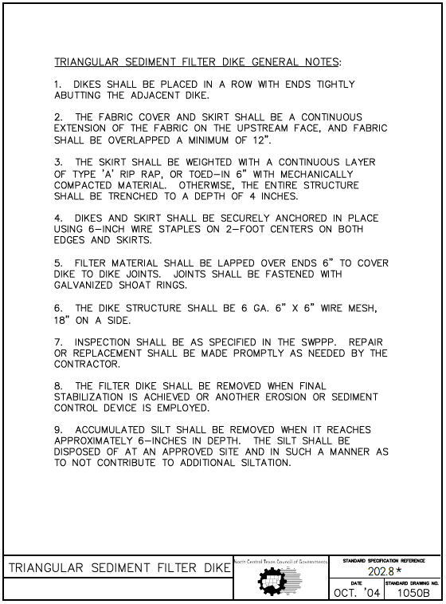
1050B
6” x 6” or 4” x 4” WELDED WIRE MESH
Update Drawing Date

Slide 11
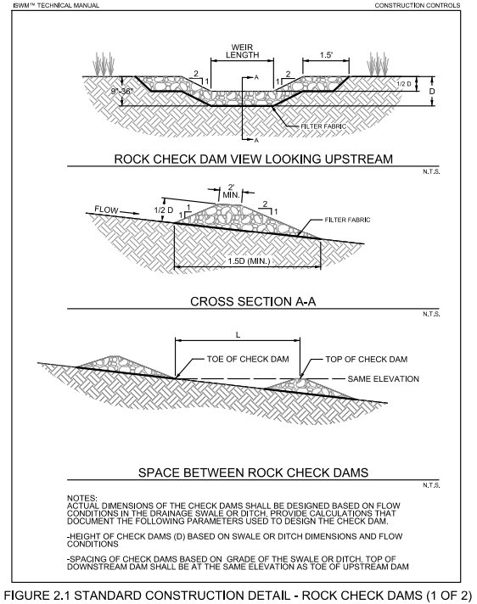
1060A
H
H
H
HEIGHT (H) AND SPACING (L) OF CHECK DAM AS PROVIDED IN PLANS BY OWNER OR OWNER’S REPRESENTATIVE. PROVIDE CALCULATIONS UPON REQUEST OF THE REVIEWING AGENCY.
Replacing Original Drawing 1060A

Slide 12
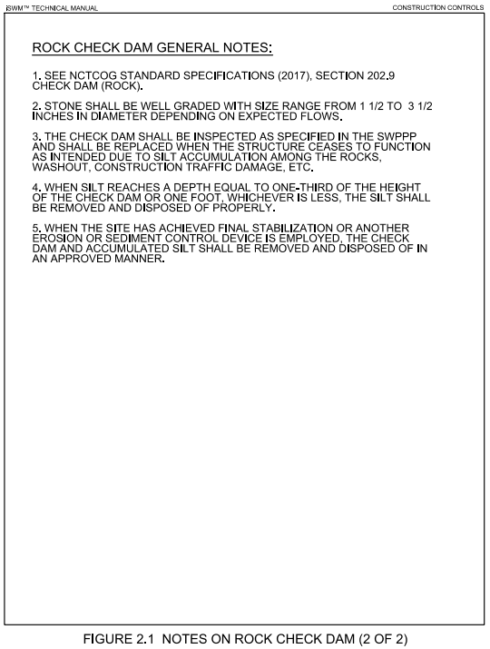
1060B

Slide 13
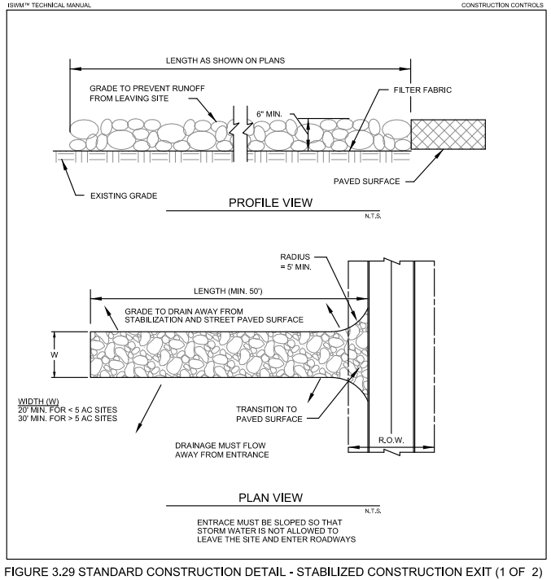
1070A
EXIT
Replacing Original Drawing 1070A

Slide 14
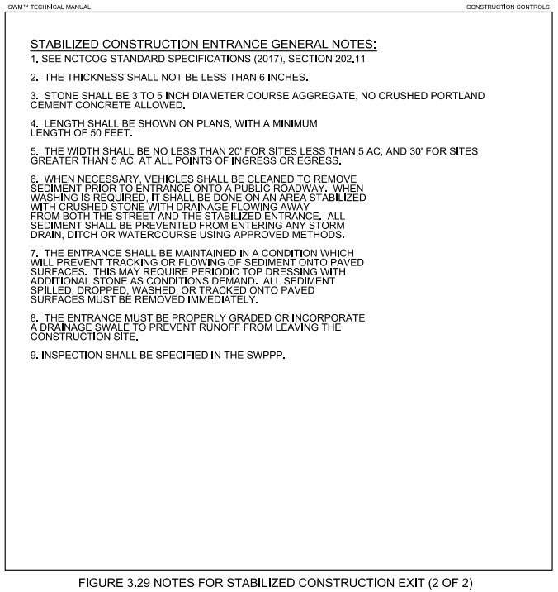
1070B
*REPLACE “ENTRANCE” WITH EXIT THROUGHOUT

Slide 15
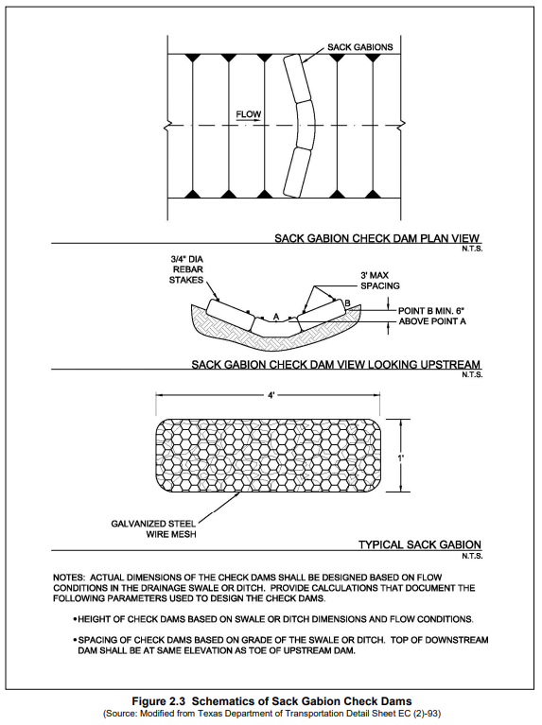
1080
HEIGHT (H) AND SPACING (L) OF CHECK DAM AS PROVIDED IN PLANS BY OWNER OR OWNER’S REPRESENTATIVE. PROVIDE CALCULATIONS UPON REQUEST OF THE REVIEWING AGENCY.
Replacing Original Drawing 1080A
Standard Specification Reference
Date | Standard Drawing No. New Drawing

Slide 16
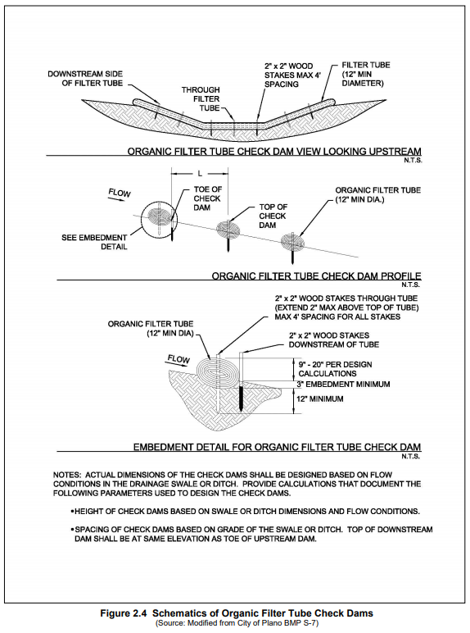
1090
HEIGHT (H) AND SPACING (L) OF CHECK DAM AS PROVIDED IN PLANS BY OWNER OR OWNER’S REPRESENTATIVE. PROVIDE CALCULATIONS UPON REQUEST OF THE REVIEWING AGENCY.
(H)
New Drawing
Taken from iSWM manual to accompany Figure 2.3/1080 replacement
Standard Specification Reference
Date | Standard Drawing No. New Drawing

Slide 17
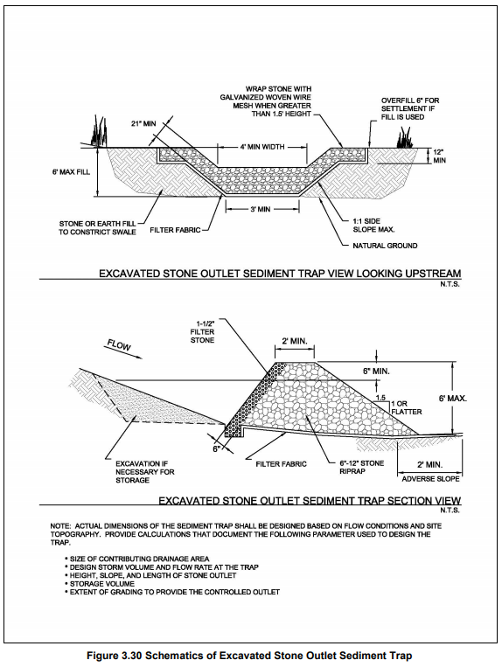
1100
Standard Specification Reference 202.12*
Date | Standard Drawing No.
Replacing Original Drawing 1090
NOTES:
ACTUAL DIMENSIONS OF THE SEDIMENT TRAP SHALL BE DESIGNED BASED ON FLOW CONDITIONS AND SITE TOPOGRAPHY.
PROVIDE CALCULATIONS UPON REQUEST OF THE REVIEWING AGENCY.
DESIGN OF VOLUME, HEIGHT, SLOPE, AND LENGTH AS PROVIDED IN PLANS PROVIDED BY OWNER OR OWNER’S REPRESENTATIVE.

Slide 18
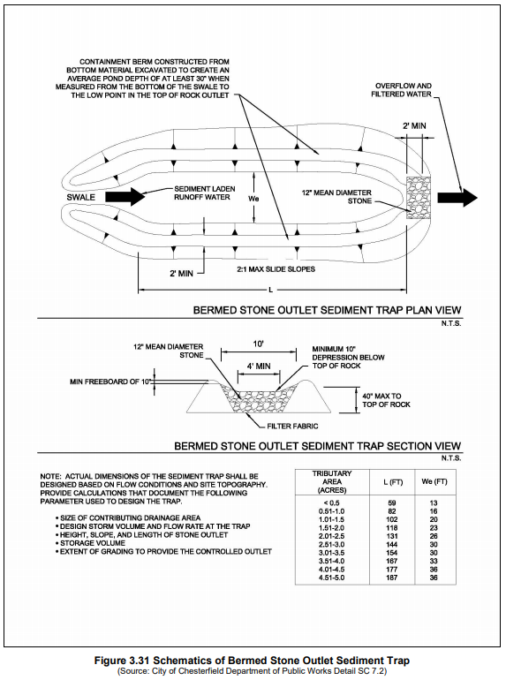
1110
SIDE
(move to this side)
Remove internal leader line
NOTES:
ACTUAL DIMENSIONS OF THE SEDIMENT TRAP SHALL BE DESIGNED BASED ON FLOW CONDITIONS AND SITE TOPOGRAPHY.
PROVIDE CALCULATIONS UPON REQUEST OF THE REVIEWING AGENCY.
DESIGN OF VOLUME, HEIGHT, SLOPE, AND LENGTH AS PROVIDED IN PLANS PROVIDED BY OWNER OR OWNER’S REPRESENTATIVE.
New Drawing
Taken from iSWM manual to accompany
Figure 3.30/1090 replacement
Standard Specification Reference 202.12*
Date | Standard Drawing No.

Slide 19
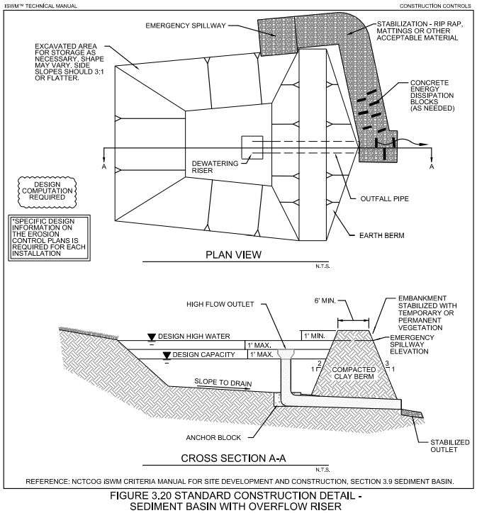
1120
FLOW
FLOW
PERFORATED RISER
Replacing Original Drawing 1100
Note:
Pipe size, rock size, and berm height as provided in plans by owner or owner’s representative
Optional: A collar of 1.5-3 inch, well graded gravel (not shown) may be placed around the perforated riser

Slide 20
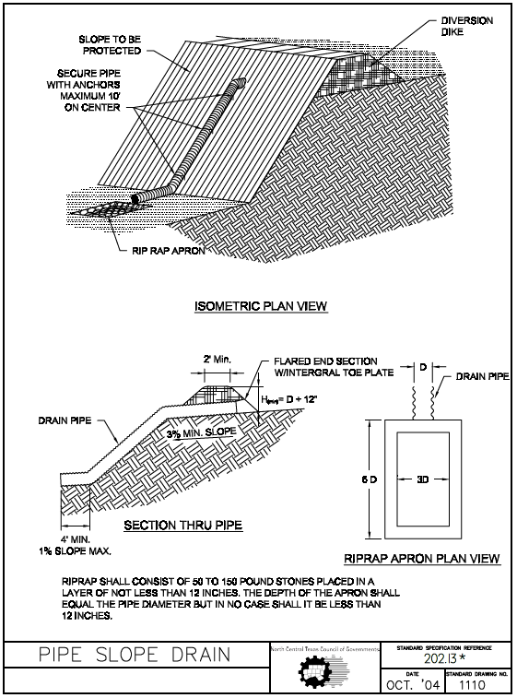
1130
ORIGINAL PWCS DRAWING

Slide 21
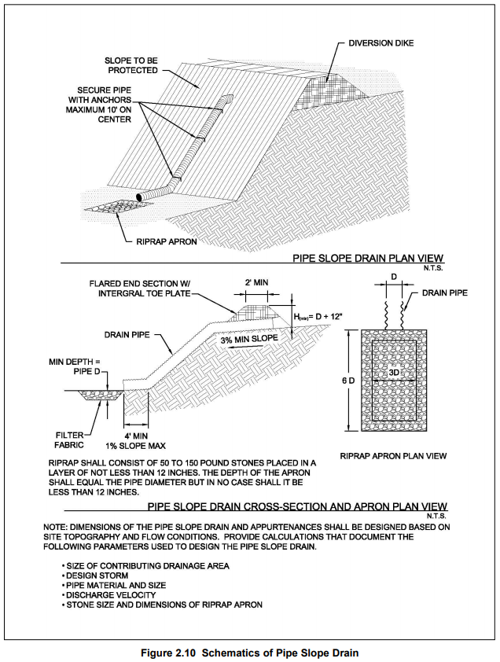
iSWM EQUIVALENT - 1110
Possible replacement for Original Drawing 1110

Slide 22
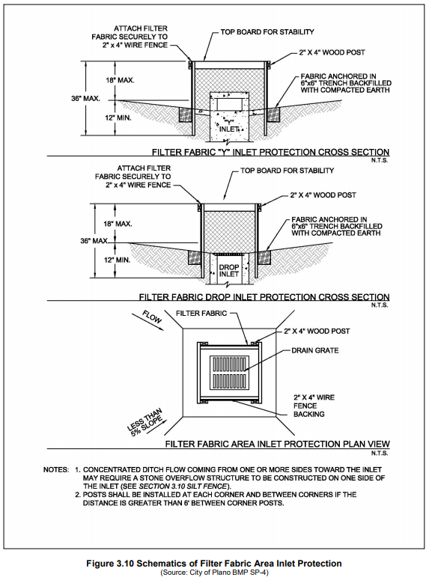
To Be Updated by Halff
Will replace Original Drawing 1120
1140

Slide 23
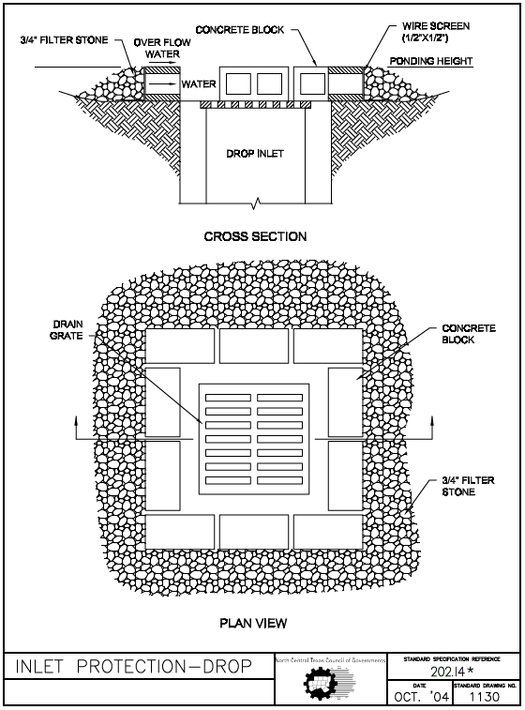
1150
BLOCK AND GRAVEL

Slide 24
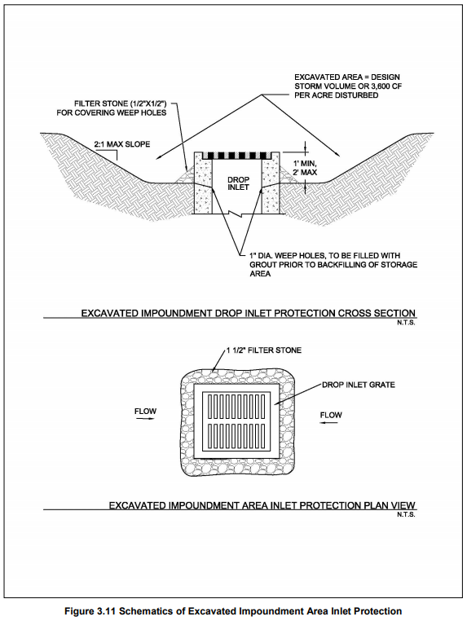
To Be Updated by Halff
Will replace Original Drawing 1150
1160

Slide 25
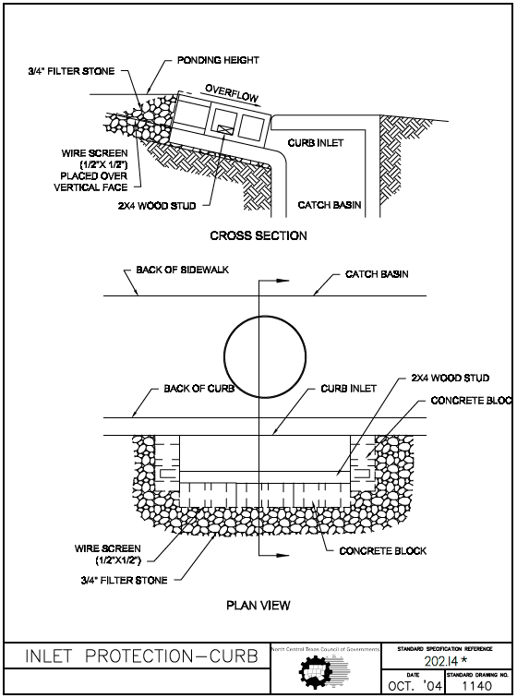
1170
ORIGINAL PWCS DRAWING
BLOCK AND GRAVEL

Slide 26
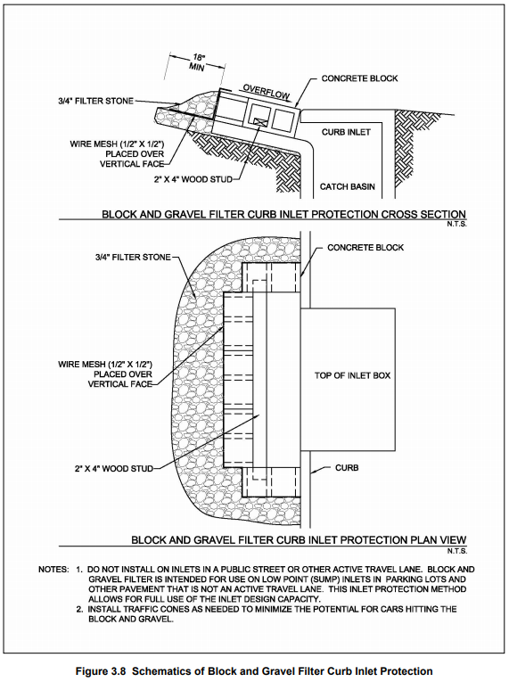
iSWM EQUIVALENT - 1140
Possible replacement for Original Drawing 1140

Slide 27
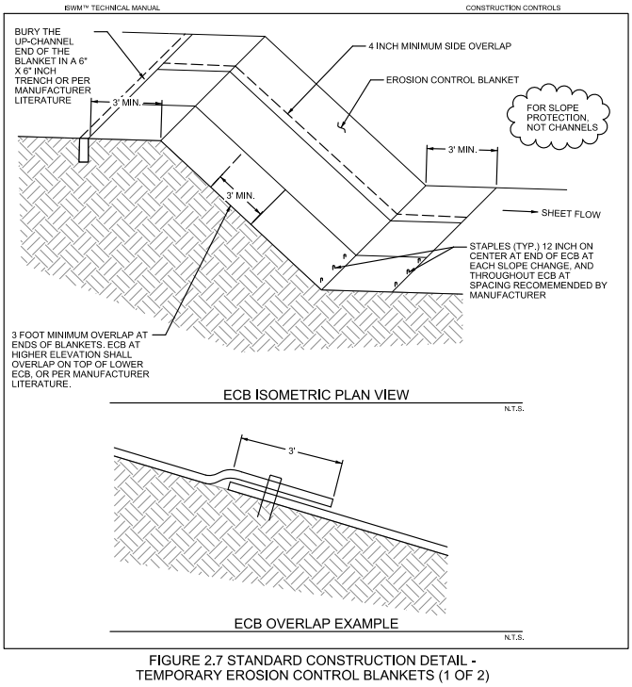
1180A
Replacing Original Drawing 1160A

Slide 28
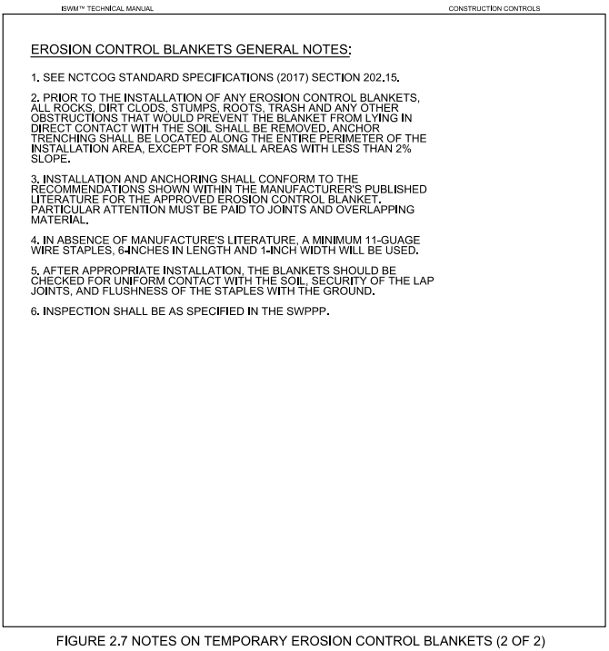
Replacing Original Drawing 1160B

Slide 29
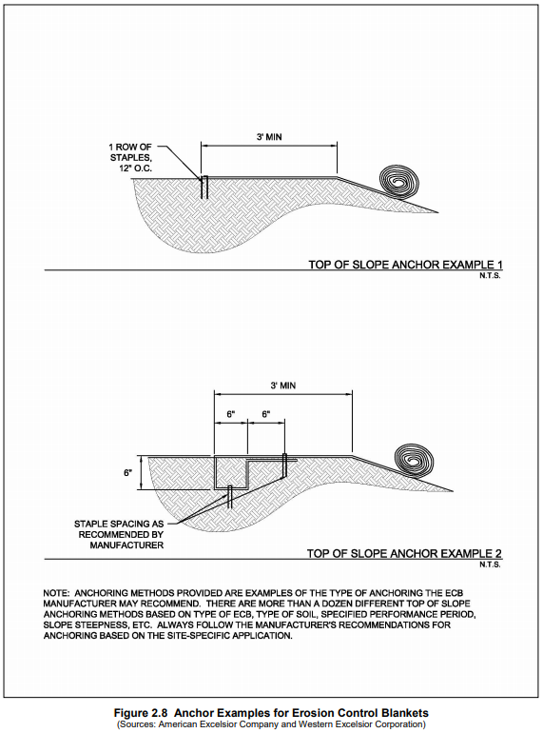
To Be Updated by Halff
Will accompany Figure 2.8
1180B
New Drawing
Taken from iSWM manual to accompany
Figure 2.7/1160 replacement

Slide 30
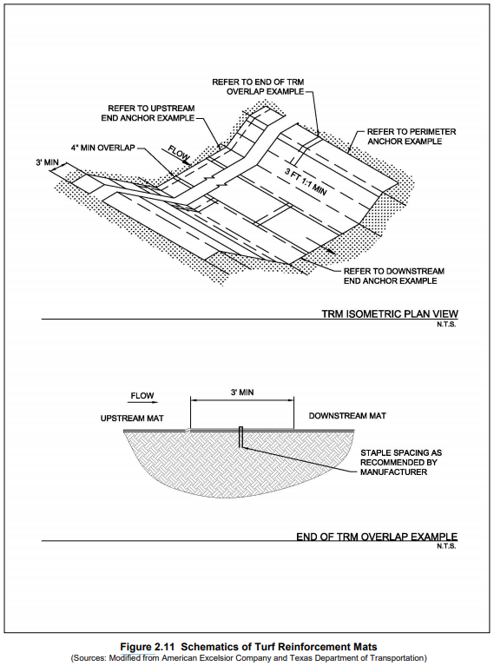
To Be Updated by Halff
New Drawing
1190A
New Drawing
Taken from iSWM manual

Slide 31
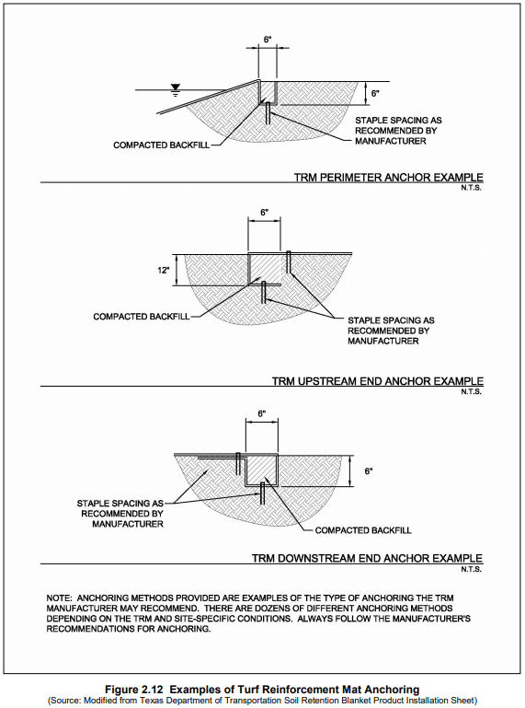
To Be Updated by Halff
New Drawing
1190B
New Drawing
Taken from iSWM manual

Slide 32
New Drawing
Grouted Rock Rip-Rap
Halff Associates 2018 Update
1200

Slide 33
New Drawing
Stream Trash Catch/Screen
Halff Associates 2018 Update
1210

Slide 34
Potential Additional Drawings
The following schematics were either updated by Halff Associates in 2017 or have been tasked to Halff Associates to update in 2018/2019

Slide 35
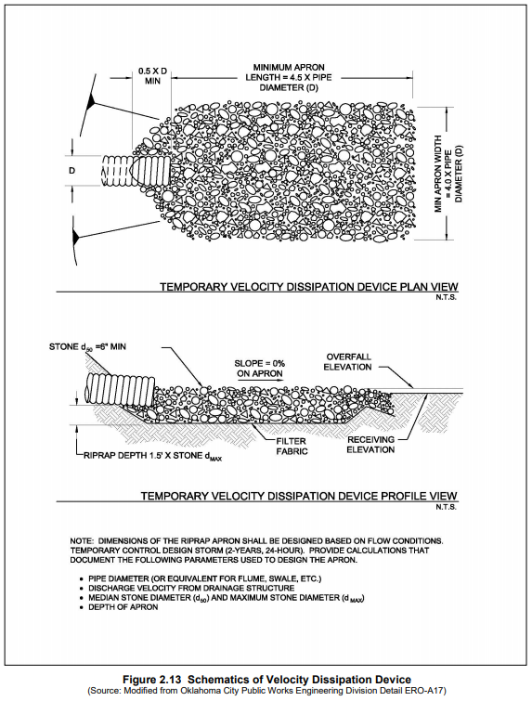
To Be Updated by Halff Associates in 2018/2019

Slide 36
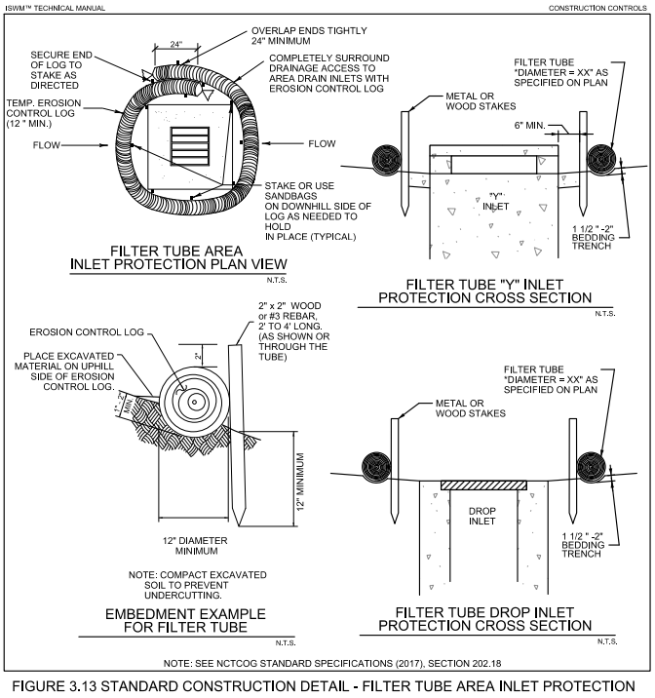
Updated by Halff Associates in 2017

Slide 37
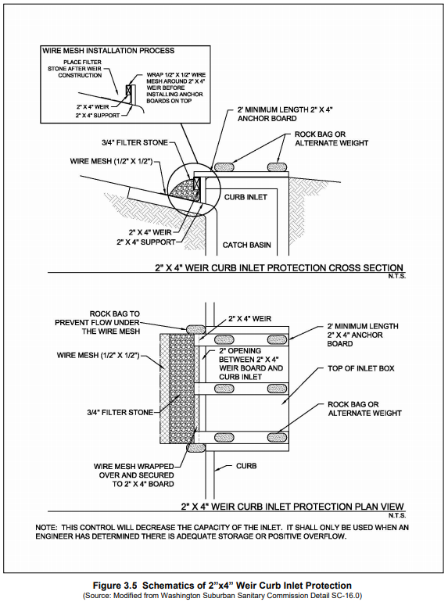
To Be Updated by Halff Associates in 2018/2019

Slide 38
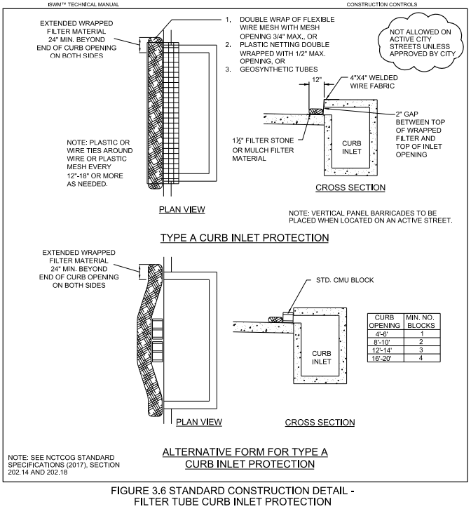
Updated by Halff Associates in 2017

Slide 39
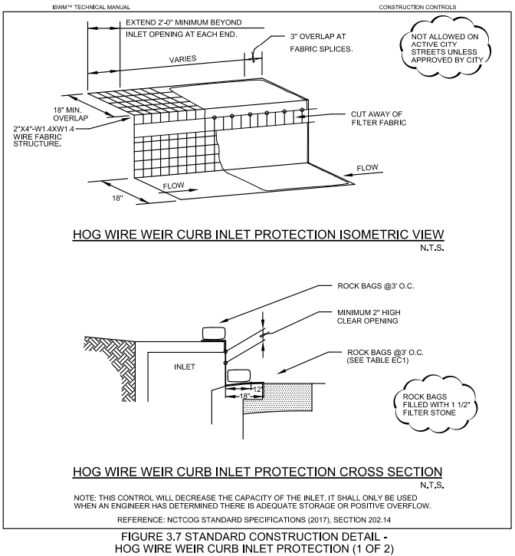
Updated by Halff Associates in 2017

Slide 40
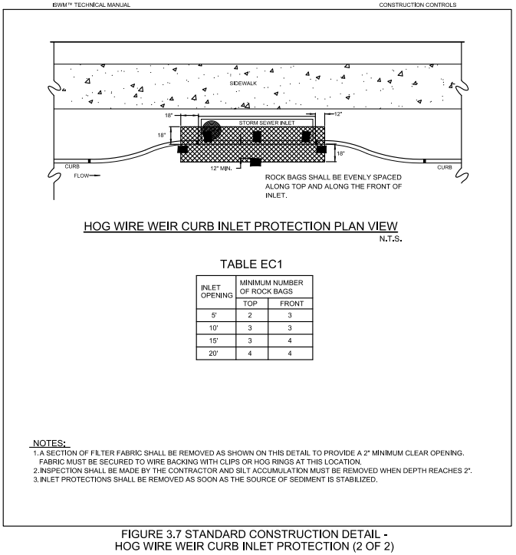
Updated by Halff Associates in 2017

Slide 41
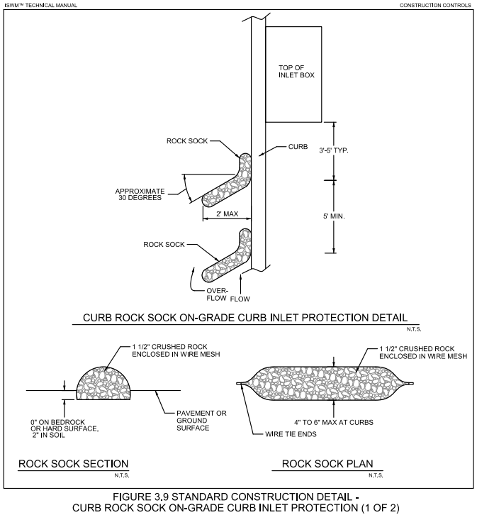
Updated by Halff Associates in 2017

Slide 42
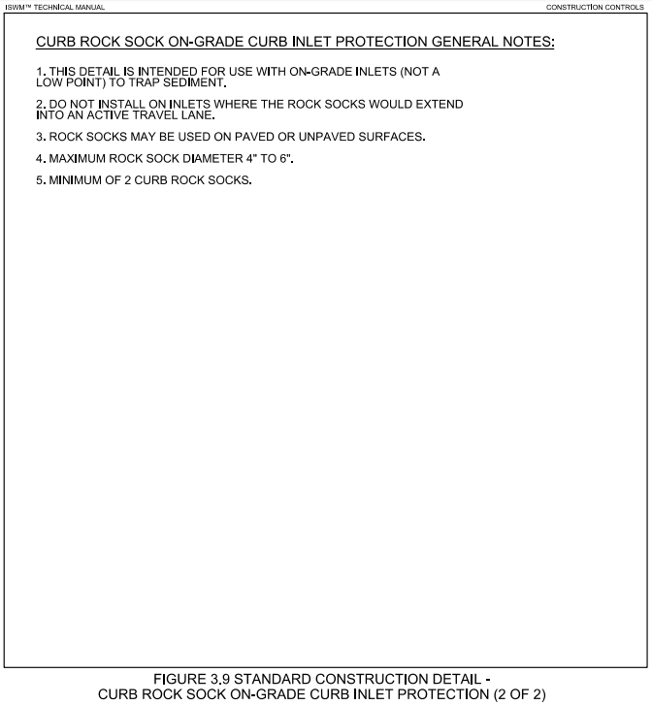
Updated by Halff Associates in 2017

Slide 43
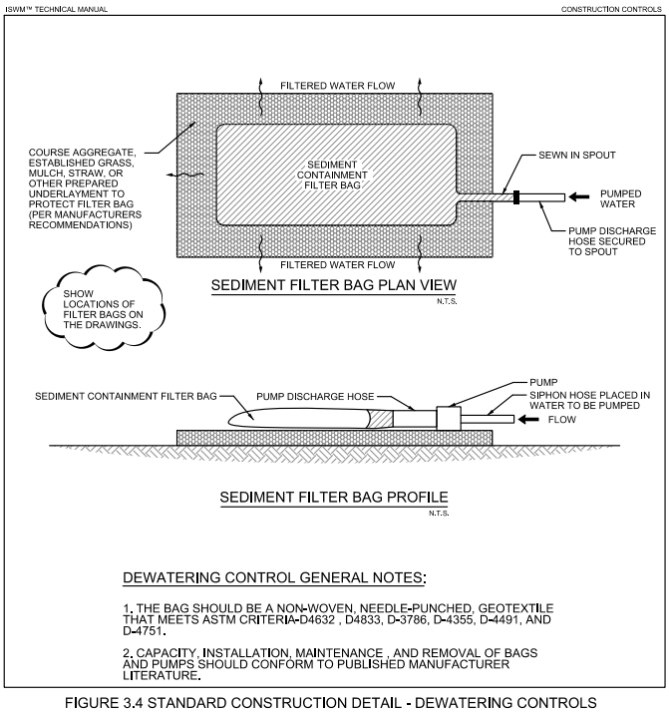
Updated by Halff Associates in 2017

Slide 44
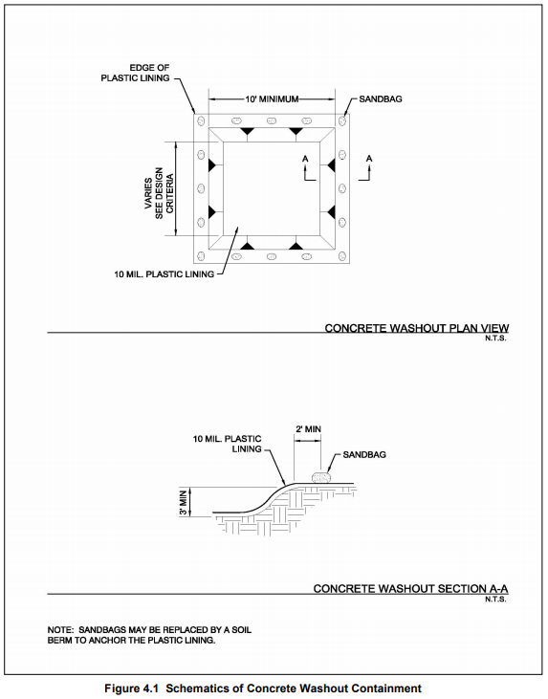
To Be Updated by Halff Associates in 2018/2019

