Slide 1



Zero Emissions Freight Update
Lori Clark
Senior Program Manager & DFW Clean Cities Director
Regional Freight Advisory Committee
May 12, 2026

Slide 2


Regional Importance of Zero-Emissions Freight
Current Ozone design value of 76 ppb* continues to exceed the EPA standard
Heavy-duty diesel vehicles have disproportionate impact on regional air quality
Industry trends put California and Texas at the top of the priority list for new deployments (both trucks and infrastructure)
  Vehicle Miles Traveled (VMT) Versus Nitrogen Oxides (NO_{X}) Contribution by On-Road Vehicle Type in Dallas-Fort Worth
  Analysis Year 2026
For more information on North Texas Air Quality, check out the 2025 AQ Handbook at: www.nctcog.org/airquality
*www.nctcog.org/ozone
Zero Emissions Freight Update
Notes:
Regional AQ
Industry Trends – e.g. comments from Tesla that YES everyone is still interested WHERE IT MAKES FINANCIAL SENSE. And it makes financial sense in Texas.

Slide 3


Rider 48 Report
Zero Emissions Freight Update

Slide 4
TxDOT Report: Evaluation of Medium-Duty and Heavy-Duty Vehicle Charging Infrastructure and Capacity
(aka Rider 48 Report)
Overview:
Released in September 2024
Prepared by an interagency task force of:
Regional partners
Utilities
State agencies
Industry representatives
Research organizations
Goal:
Evaluate how Texas can support the deployment of zero‑emission medium‑ and heavy‑duty vehicle charging infrastructure
Objectives:​
Assess how federal, state, and local laws affect development of medium‑ and heavy‑duty vehicle charging infrastructure
Identify opportunities to improve information exchange between utilities, stakeholders, and private entities on fleet charging and energy needs​
Evaluate how statewide oversight and collaboration can complement local and regional efforts​
Quantify the existing medium‑ and heavy‑duty electric truck fleet
Report Available: www.txdot.gov/content/dam/docs/division/gov/rider-48-report.pdf
Zero Emissions Freight Update

Slide 5
Benefits and Challenges to Freight Electrification in Texas
Benefits | Challenges
Access to Federal Funding and Incentives* | Infrastructure Readiness and Corridor Gaps
Regulatory Drivers Accelerating Market Transformation (e.g. EPA Phase 3 GHG Standards, Low-NO_{X} Rule)* | Grid Capacity and Utility Coordination Constraints (Deregulation of Market)
Improving Economics for Certain Freight Use Cases | Uncertain Technology Fit for All Freight Segments (Dwell times, range, payload flexibility)
Lower Texas Electricity Costs | Limited State‑Level Mandates and Incentives in Texas
Electric Alternative Fuel Corridor Designations | Lack of Exemption for Heavier EV Truck Weight
Manufacturing Investments | Federal Prohibition on Commercial Activities at Interstate Rest Areas
Business-Friendly Regulatory Environment
Electric Availability Across Range of Vehicle Types
Zero Emissions Freight Update
*Many have since been rolled back at federal level
Notes:
Broad scope of MHD EV application: freight, drayage, other short-range cargo handling equipment

Slide 6
Recommendations
Strategic
Comprehensive state plan
Private-public partnerships
Electric truck advisory committee
Standardized data reporting
Technical assistance
Policy
Uniform statewide standards for MHDV infrastructure
Enhance infrastructure funding and incentives
Dedicate state agency resources
Develop/adopt industry tools/methods for deployment
Collaboration
State/local/utility/ private entity partnerships for streamlining and best practices
Support regional pilot projects for innovative technology and approaches
Zero Emissions Freight Update
Notes:
-strategic P3s to leverage private innovation & funding

Slide 7
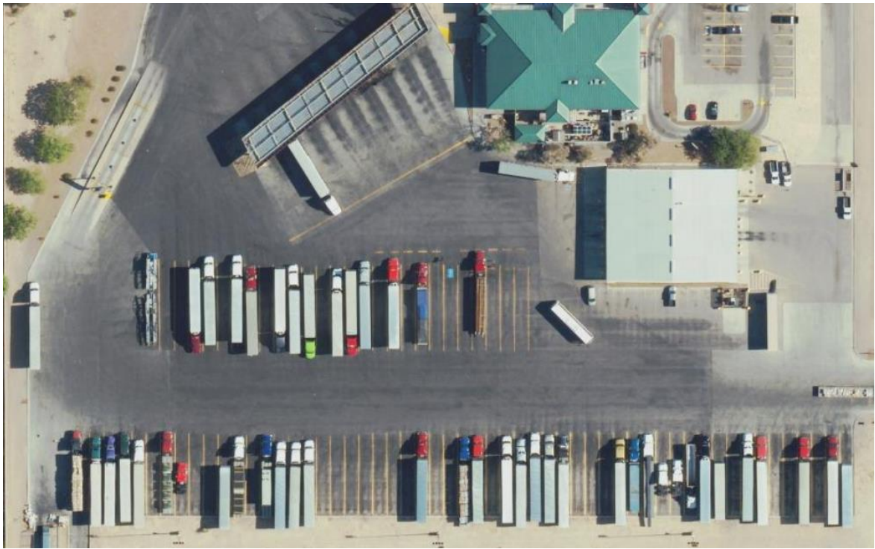
Conversion Estimate and Vehicle Details
Texas Electric Vehicle Registration Data*
248 Heavy-duty electric trucks
  89 in the NCTCOG region
5,044 Medium-duty electric vehicles
  2,370 in the NCTCOG Region
Current EV registration data available at: www.dfwcleancities.org/registration-data-and-maps​
Fleet Return on Investment (Battery vs Diesel Delivery Truck)
Texas: ~7-year payback (~$0.8/kWh)
U.S. Average: ~7.7-year payback (~$0.12/kWh)
Example Truck Stop Conversion
12 pull-through diesel pumps replaced with 12-megawatt (MW) capable Direct Current Fast Charge (DCFC)
12 MW (maximum power demand)
~$6M capital cost (stations, equipment, dispensers, etc.)
~$3M electrical substation/distribution network upgrade
*As of April 28, 2026
Zero Emissions Freight Update

Slide 8
Potential MHDV Charging Stops for Corridors that Enter DFW
From | To | Corridor | Corridor Length (Miles) | Potential MHDV Stops | Miles Between Stops
DFW | Houston | IH-45 | 230 | 3 | 58
DFW | El Paso | IH-20 | 605 | 5 | 101
DFW | Texarkana | IH-30 | 190 | 2 | 63
DFW | Shreveport | IH-20 | 195 | 2 | 65
San Antonio | DFW | IH-35 | 250 | 3 | 63
Total MHDV Charging Stops Needed: 15
Zero Emissions Freight Update

Slide 9
Texas Electric Vehicle Infrastructure Plan: Phase II
Zero Emissions Freight Update

Slide 10
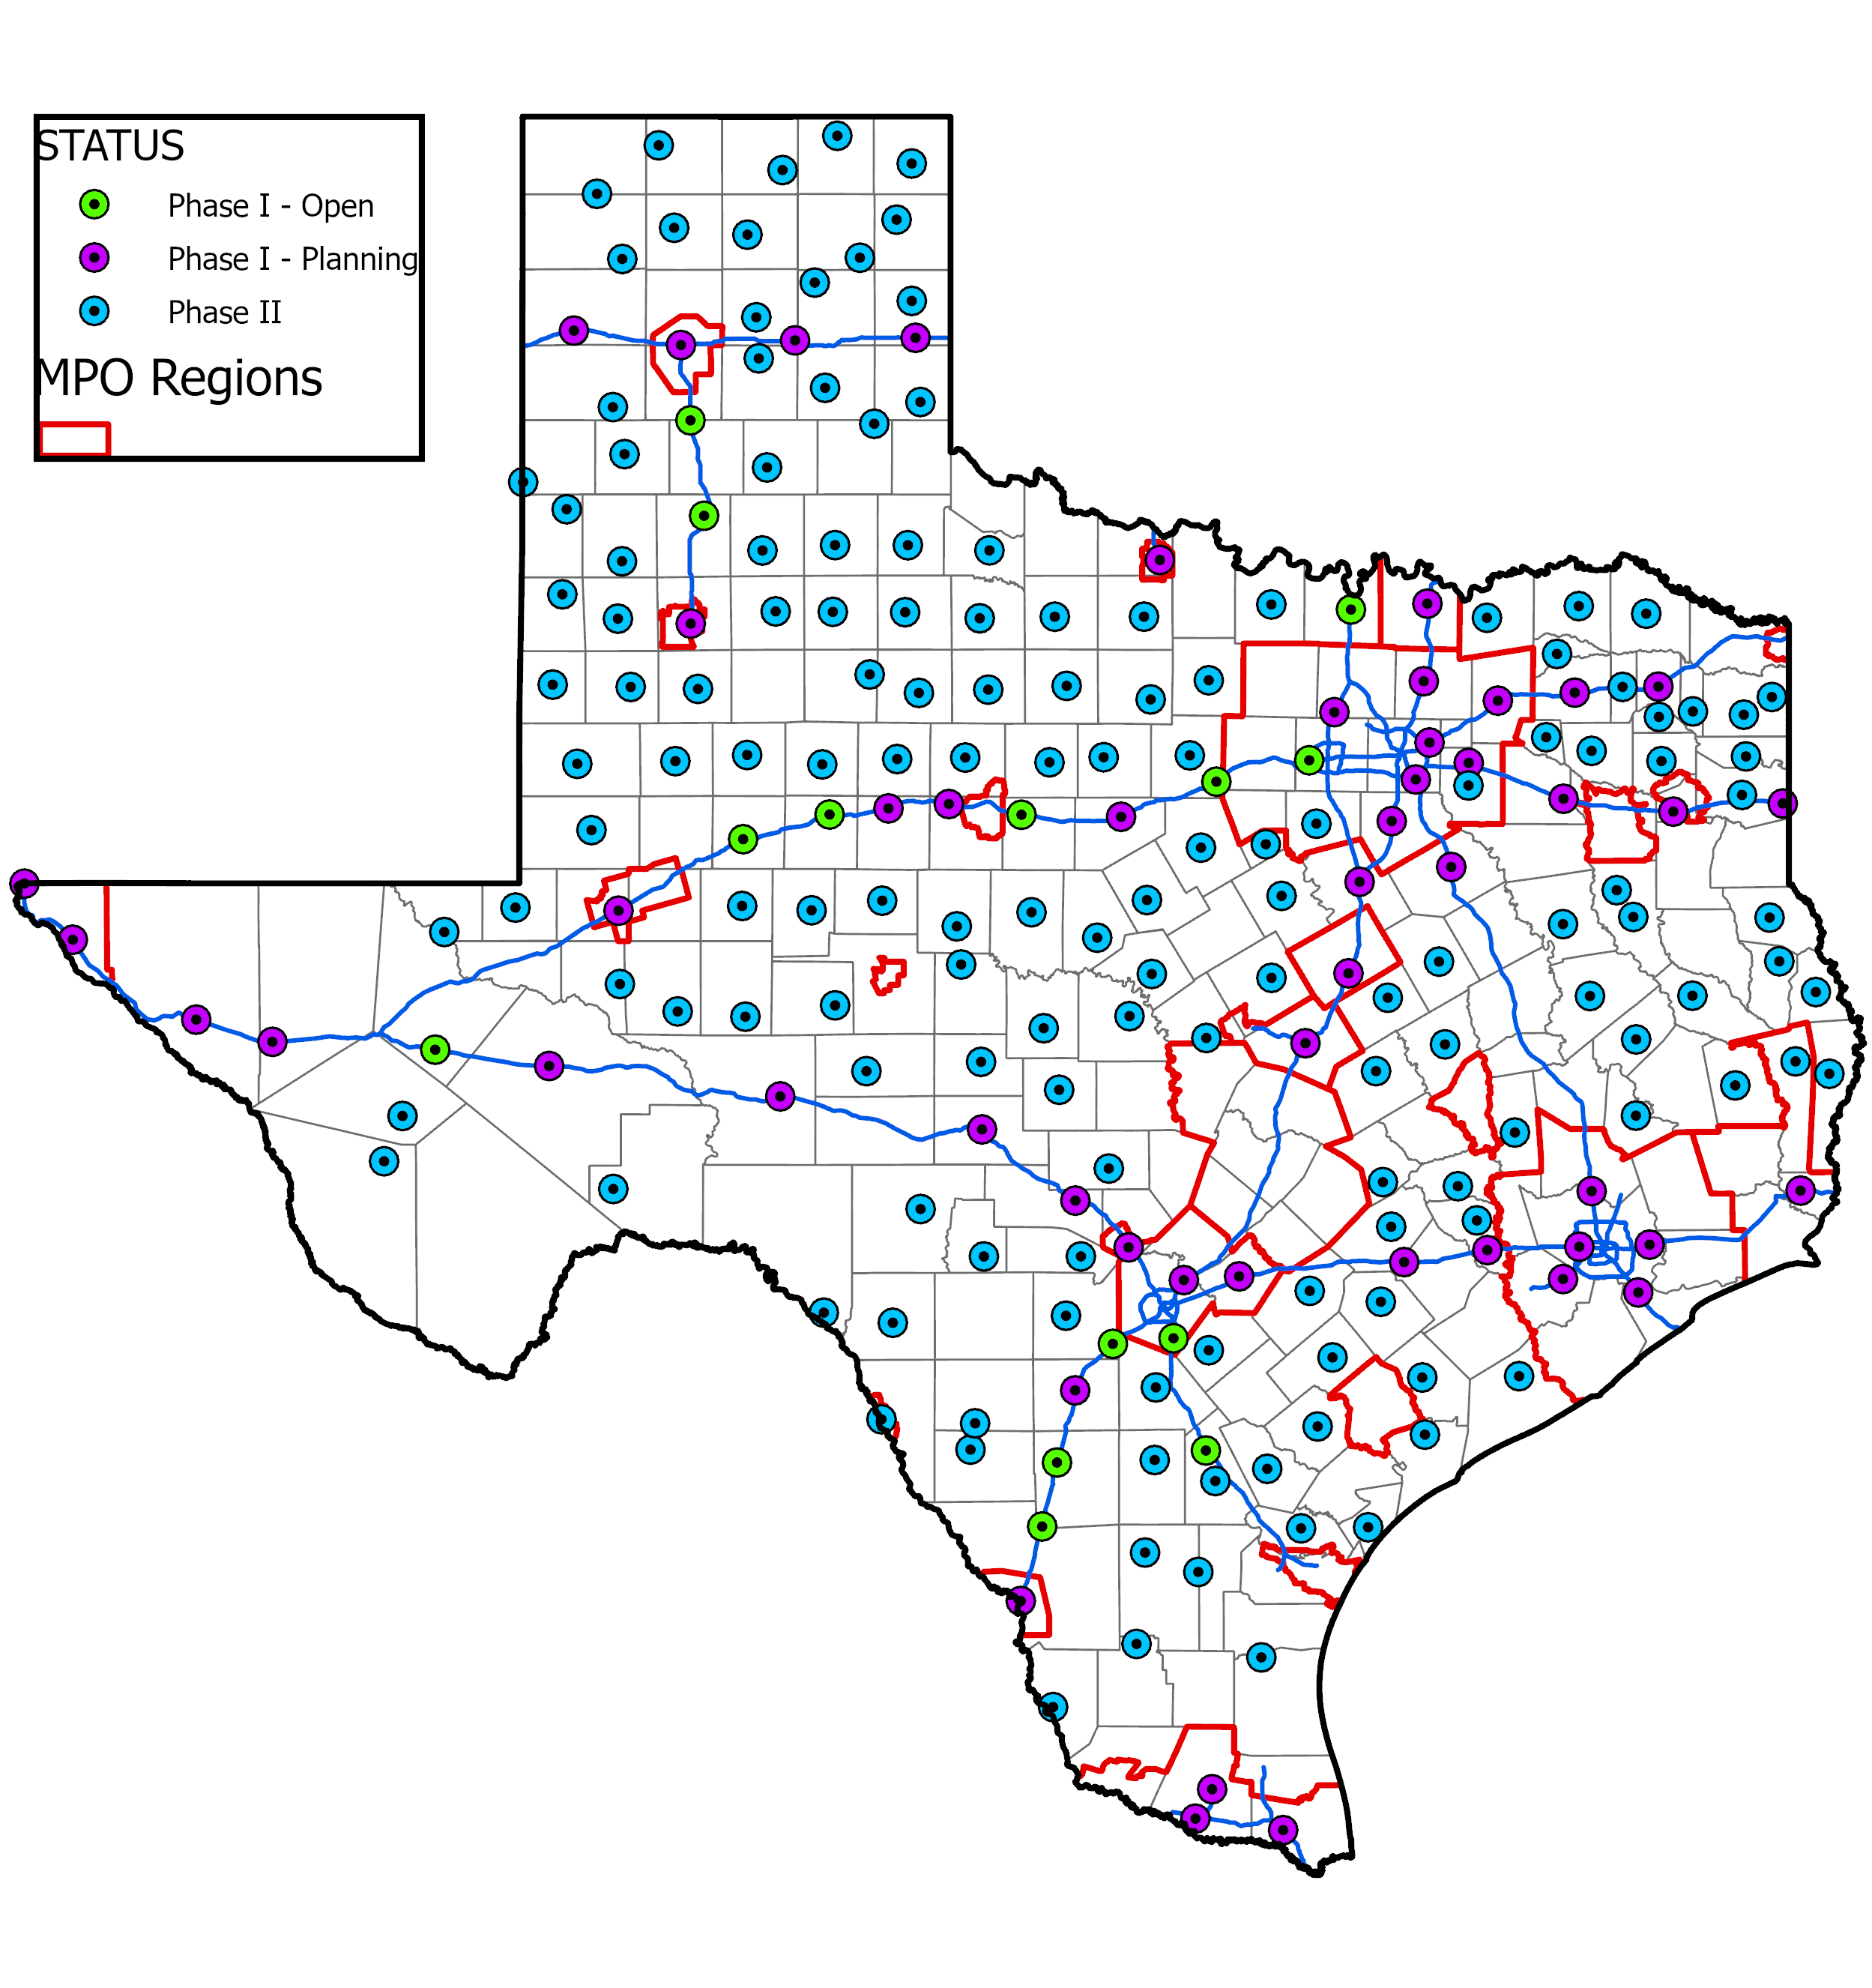
Texas Electric Vehicle
Infrastructure Plan
Texas plan to implement National Electric Vehicle Infrastructure (NEVI) funding
Phase I: Along Alternative Fuel Corridors (complete)
January 2026: FHWA certified that designated alternative fuel corridors are “fully built out”
  15 sites operational as of May 2026
Phase II: Advanced to Additional Location Types
(First round opened for applications on May 1, 2026)
Rural county seats
  NCTCOG counties potentially impacted: Erath, Johnson, Kaufman, Palo Pinto, and Somervell
Areas Recommended by Metropolitan Planning Organizations (MPOs)
Data as of May 2026
Source: TxDOT Statewide Planning Map
Zero Emissions Freight Update

Slide 11
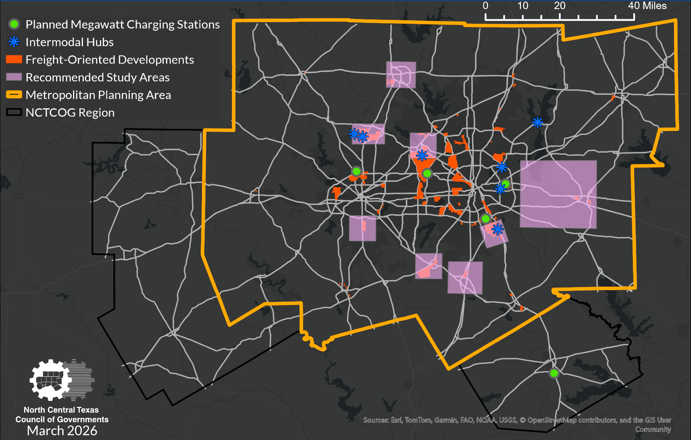
Texas Electric Vehicle Infrastructure Plan: Megawatt Charging Stations
  Criteria to identify study areas
  Locations of existing truck stops
  Truck traffic data around freight facilities and inland ports
  Corridors with high truck/trailer traffic
  Avoid announced charging hubs for medium- and heavy-duty EVs
  Goal: Provide a basic network to enable freight transition
  Recommendation: 8 study areas near major freight hubs
Zero Emissions Freight Update

Slide 12
North Texas Zero Emission Vehicle (NTxZEV) Project
Zero Emissions Freight Update

Slide 13
North Texas Zero Emission Vehicle (NTxZEV) Call for Projects Background
NCTCOG Project Scope
Overview: $60 million award from the Environmental Protection Agency (EPA) Clean Heavy-Duty Vehicles Grant
Purpose: Incentivize deployment of
Class 6 and 7 heavy-duty Zero-Emissions Vehicles (battery electric or hydrogen fuel cell electric)
Eligible Applicants: Public or Private Fleets
Must adopt a policy consistent with the RTC Clean Fleet Policy (www.nctcog.org/fleetpolicy)
Activity | Federal Funding | Match Requirement
Rebates to Replace Existing Vehicles with Zero Emissions Versions | $58.6 million | Provided by program participants
Workforce Development | $1.4 million | No match required
Training
Total Federal Funding: | $60 million
Zero Emissions Freight Update
13

Slide 14
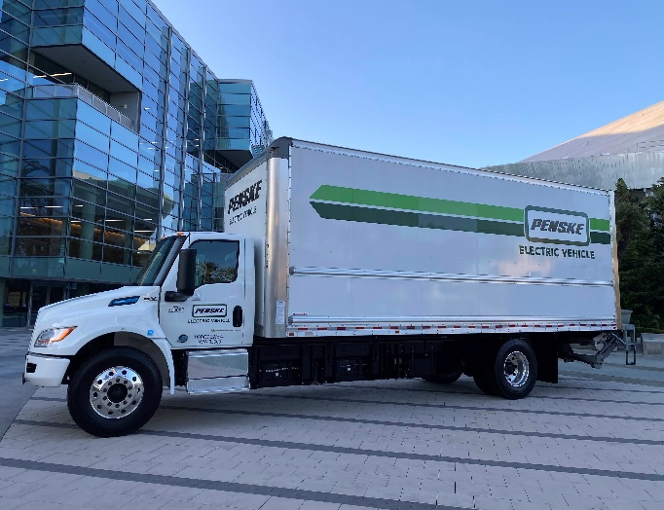
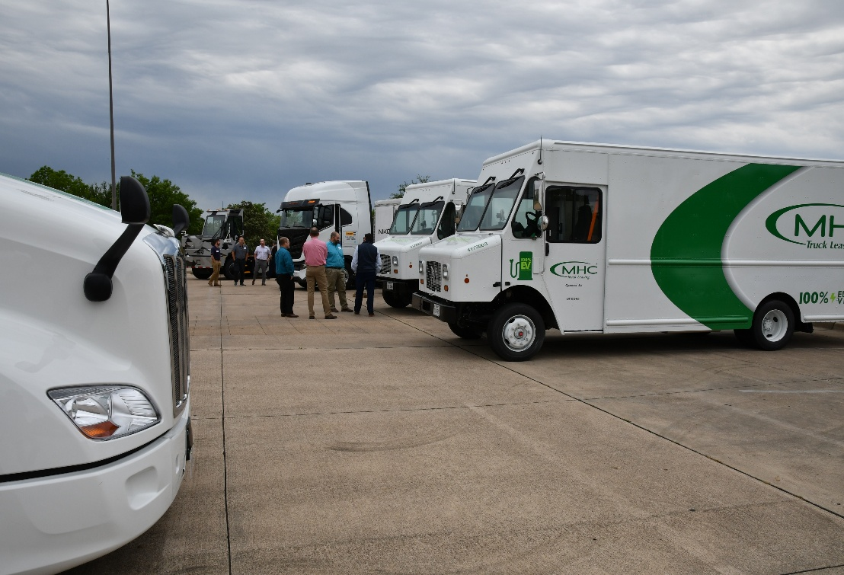
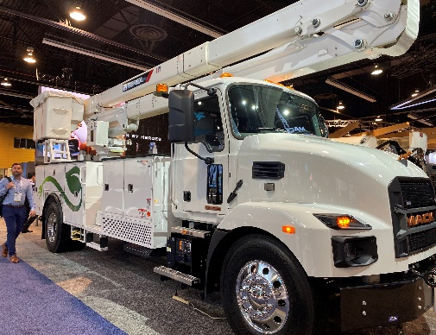
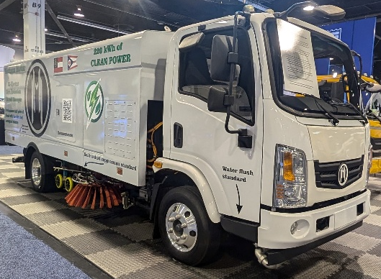
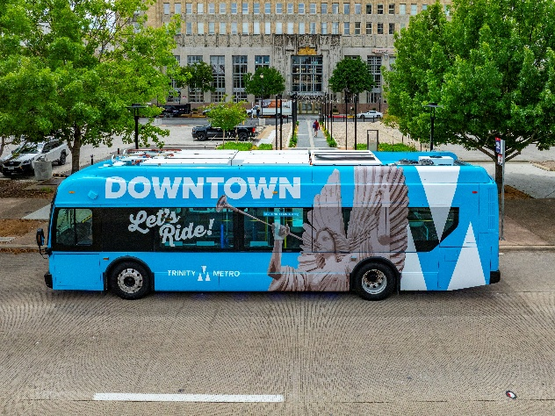
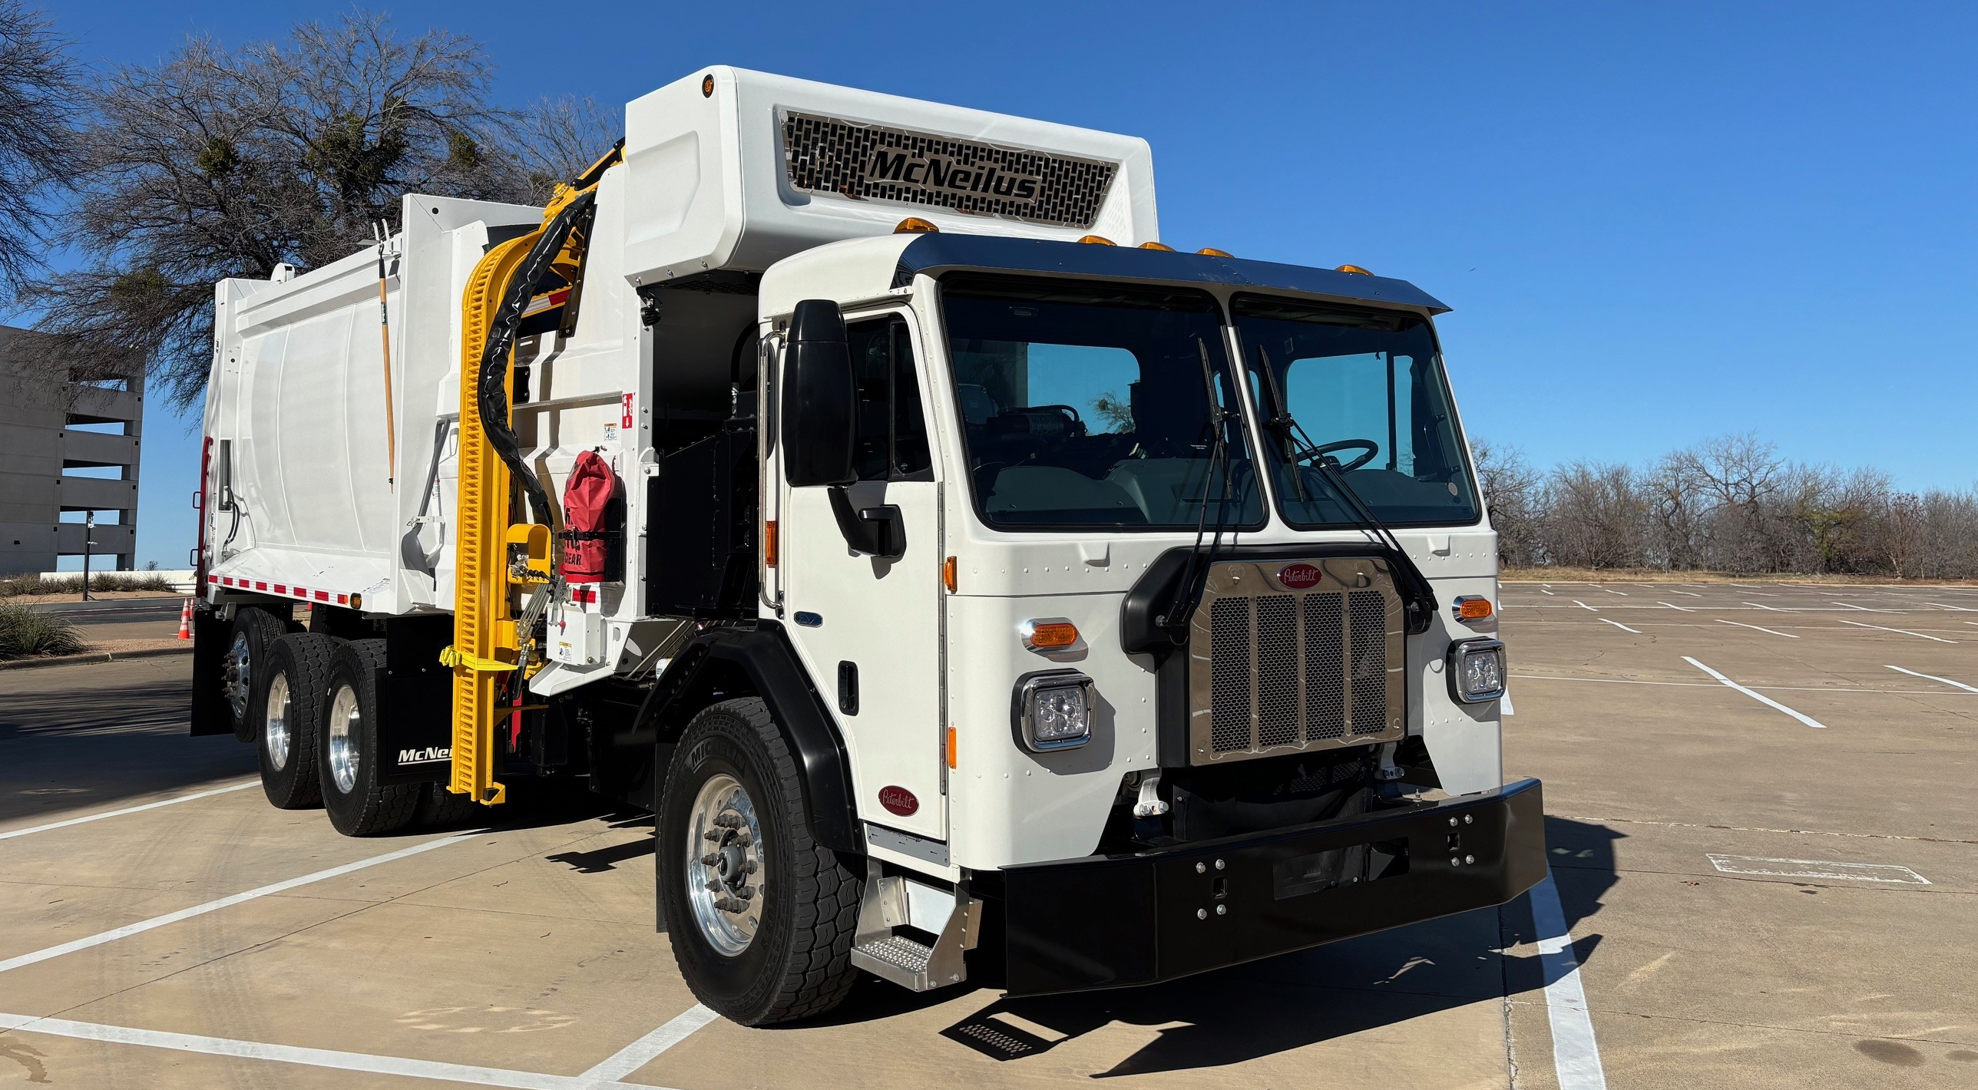
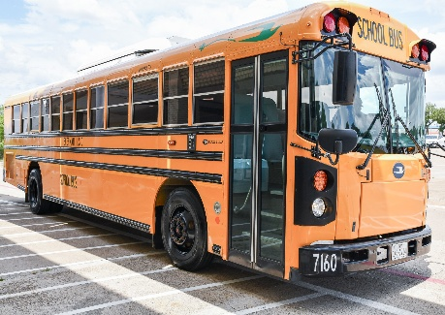
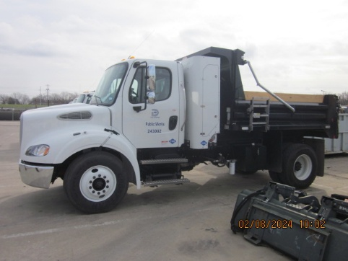
Project Scope and Eligibility
Rebates to Replace Class 6 or Class 7 “vocational vehicles” with zero-emissions trucks
Old truck: Any fuel type; can scrap OR potentially sell/donate
New truck: Either battery electric or hydrogen fuel cell electric
Can fund supporting charging/fueling infrastructure if needed
Both public and private sector fleets eligible
Example “vocational vehicles” include:
Straight/Box Truck
Step Van
Septic/Bucket Truck
Street Sweeper
Transit Bus
Refuse Hauler
Other Vocational Vehicles*
Photo Sources: NCTCOG
Photo Credit: NCTCOG/Trinity Metro
*School bus eligible only if NOT operated as a typical school bus as defined in Guidelines Appendix A
North Texas Zero Emissions Vehicles Call for Projects March 2026 Public Meeting

Slide 15
Eligible Funding Levels
Funding limited by cost share percentage or dollar funding cap, whichever is lower
Vehicle Type | Battery Electric Vehicles Maximum Funding
School Bus* | 75%, up to $280,000*
Straight/Box Truck | 65%, up to $190,000
Step Van | 65%, up to $160,000
Septic/Bucket Truck | 65%, up to $330,000
Other Vocation | 65%, up to $355,000
Refuse Hauler | 50%, up to $260,000
Street Sweeper | 50%, up to $315,000
Transit Bus | 33%, up to $265,000
Vehicle Type | Hydrogen Fuel Cell Electric Vehicles Maximum Funding
School Bus | N/A
Straight/Box Truck | 80%, up to $400,000
Step Van | 80%, up to $340,000
Septic/Bucket Truck | 80%, up to $670,000
Other Vocation | 80%, up to $720,000
Refuse Hauler | 70%, up to $600,000
Street Sweeper | 70%, up to $720,000
Transit Bus | 60%, up to $780,000
*ADA-compliant buses are eligible for an additional $20,000 per-vehicle funding cap
Zero Emissions Freight Update
Notes:
Transition -> Moving onto how much funding you may receive per project, which again may include the costs of the new vehicle and the supporting infrastructure.
Under this CFP, reiterate first bullet on slide
define cost share - aka "match" / portion of your project not funded by the rebate award
In the table below, see the cost share & per-veh funding caps set by EPA
Looking at the table -> two funding types (cost share & per-vehicle cap) are separated out categorized by two things 1) = vehicle type & 2) = fuel type (BEV or FCEV)
So, what is the difference between the maximum cost share percentage of the new vehicle and the per-vehicle funding cap?
The maximum amount of funding you can receive for the new vehicle (refuse hauler) = 50%,
If a refuse hauler costs $500,000, you could receive up to $250,000 in rebate funding (aka 50%)
However, notice the per-vehicle funding cap includes both the vehicle and the infrastructure and meaning under the cap limit, you could request up to $260,000, leaving you roughly $10,000 for infrastructure

Slide 16
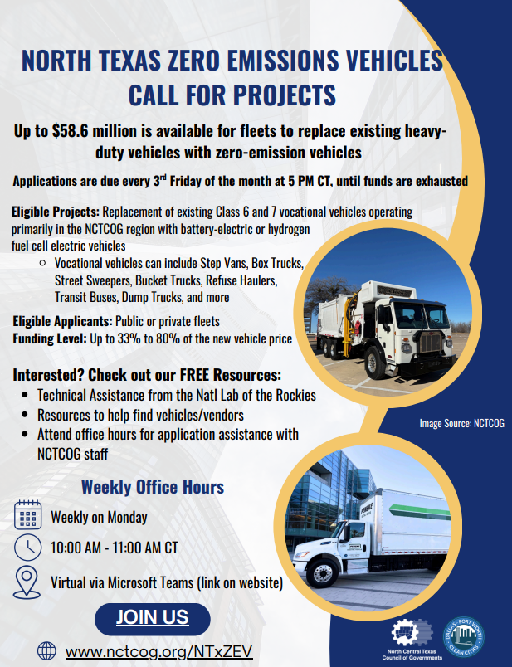
Applicant Resources
Weekly Virtual Office Hours on Mondays at 10:00am
Technical assistance from the National Lab of the Rockies
Resources to help identify vendors/vehicles
Call for Projects Workshop Recordings
All resources are FREE and available at www.nctcog.org/NTxZEV
Help spread the word! Share the NTxZEV CFP Flyer at meetings, newsletters, chambers, etc.;
NCTCOG staff available to support local events/outlets
Milestone | Date
Round 2 Deadline | Friday, May 15, 2026 Applications must be received in-hand by 5 PM Central
Subsequent Application Deadlines | 3rd Friday of every month until funds are exhausted Applications must be received in-hand by 5 PM Central
Deadline for all Project Reimbursement Requests | Friday, October 29, 2027
Zero Emissions Freight Update
Notes:
As mentioned on the previous slide, there is still an approximate of $55M funding available under this program, so we have several resources for fleets interested in applying for funding!
If you know of interested parties, or would like to help us spread the word, feel free to use the flyer available at our website to do so. Staff is also available

Slide 17



Contact Us
Lori Clark
Senior Program Manager & DFW Clean Cities Director
LClark@nctcog.org
817-695-9232
Savana Nance
Principal Air Quality Planner
Vehicle Initiatives
snance@nctcog.org
682-433-0488
Jared Wright
Principal Air Quality Planner
Infrastructure Initiatives
jwright@nctcog.org
817-608-2374
Stay Informed of Other Funding/Events Related to Alternative Fuel Vehicles: www.nctcog.org/stay-informed
Select “Dallas-Fort Worth Clean Cities” and “Air Quality Funding Update”
cleancities@nctcog.org

