Slide 1
Public Works Council
AUGUST 16, 2018

Slide 2
Action Items
2. Meeting Summary. The May 10, 2018 meeting summary is available online for review. Vote for approval.
3. FY 2019 Work Program. The Council will vote to approve the FY 2019 Regional Public Works Work Program.

Slide 3
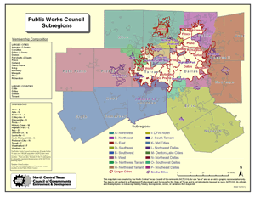
4. FY 2019 Public Works Council Membership Approval
SPECIAL REQUIREMENTS
The current PWC Structure has 21 seats for the 14 cities with populations over 100,000 (two seats each for the three largest cities) and the four largest counties with populations over 400,000. It has 16 seats for 16 subregions to adequately represent the remainder of the NCTCOG planning region. The PWC has 5 private sector seats.

Slide 4
FY 2019 Public Works Council
Membership Approval
Nominations for Chair and Vice Chair
Position | Nominee | City/County | Represents
Chair | Manny Palacios | City of Weatherford | West Subregion
Vice Chair | Keith Marvin | City of Lewisville | City of Lewisville

Slide 5
FY 2019 Public Works Council
Membership Approval
Public Sector Members
Nominee | City/County
Craig Cummings | City of Arlington
John Crawford | City of Carrollton
Mark Hines | Collin County
John Mears | Dallas County
Haytham Hassan | City of Dallas
Fred Ehler | Denton County
David Hunter | City of Denton
Nominee | City/County
John Kasavich | City of Fort Worth
Dan Franke | City of Frisco
Michael Polocek | City of Garland
Wayne Lee | City of Irving
Paul Sparkman | City of McKinney
Christina Hickey | City of Mesquite

Slide 6
FY 2019 Public Works Council
Membership Approval
Public Sector Subregional Representatives
Nominee | City/County | Represents
Bobby Clay | City of Quinlan | East Subregion
Caroline Waggoner | North Richland Hills | Mid-Cities Subregion
David Disheroon | Johnson County | Southwest Subregion
Alan Fourmentin | City of Celina | Northeast Subregion
Robert Woodbury | City of Cedar Hill | Southwest Dallas Subregion
George Marshall | City of Corinth | Denton/Lake Cities Subregion

Slide 7
FY 2019 Public Works Council
Membership Approval
Interim Representative
Nominee | City/County
Doug Stevens | Northwest Tarrant Subregion
Clayton Riggs | DFW North
Private Sector Member
Nominee | Firm | Represents
Lyndon Cox | Terracon Consultants | Texas Council of Engineering Labs/ Geoprofessionals Serving Texas

Slide 8
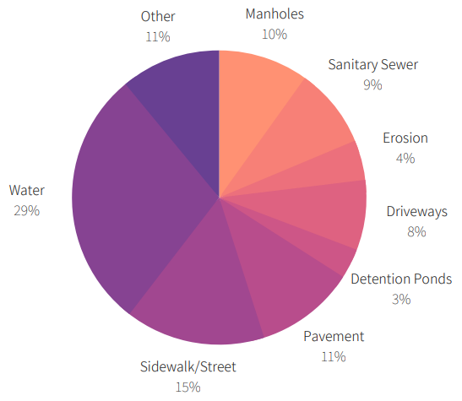
5. Design Guidelines Survey Results
Please list as many design guidelines that your entity receives high level of push back on as it relates to streets, drainage, sewer, and water.
Respondents = 16
Entries = 91

Slide 9


6. FY19 Commitment Response Forms
NCTCOG is now accepting Cost Share Commitment Response Forms electronically for the FY2019 Regional Public Works Program!
Cost shares for FY2019 remain the same as the FY2018 cost shares.
To access your cost share contract, please visit: https://www.nctcog.org/envir/pwcostshare
Please complete and submit the FY 2019 Commitment Response Form indicating your jurisdiction’s participation and support of these important regional initiatives.

Slide 10
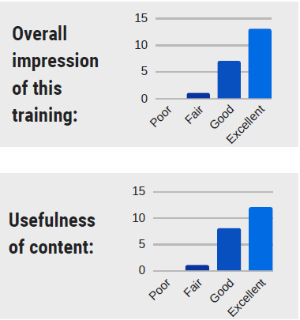
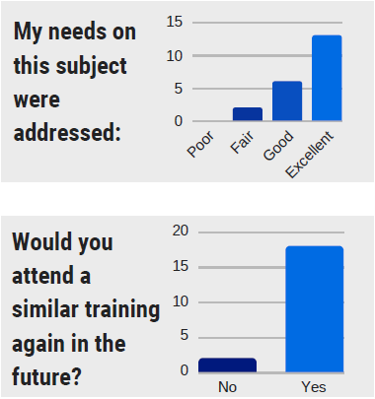
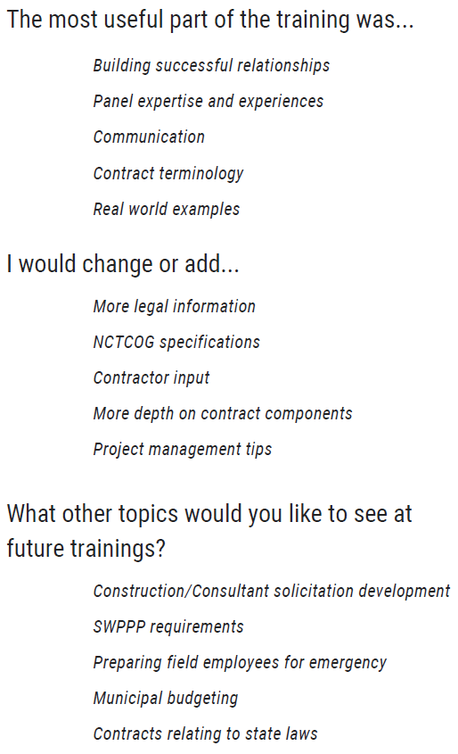
7. FY 2018 Work Program Update
Construction Contracts Training – August 14, 2018
13
13
7
6
2
1
Excellent – 13 responses (62%)
Good – 7 responses (33%)
Fair – 1 responses (5%)
Poor – 0 responses (0%)

Slide 11
Construction Contracts Training – August 14, 2018
12
8
1
Excellent – 12 responses (57%)
Good – 8 responses (38%)
Fair – 1 responses (5%)
Poor – 0 responses (0%)

Slide 12
Construction Contracts Training – August 14, 2018
18
2
Yes – 18 responses (90%)
No – 2 responses (10%)

Slide 13
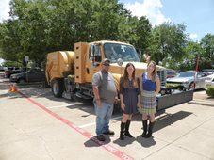
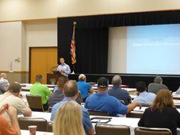
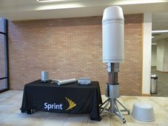
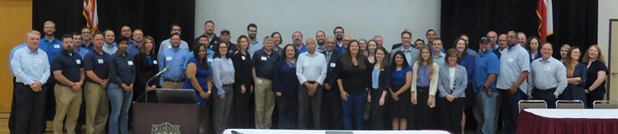
Public Works Roundup Debrief
The 19th Annual Public Works Roundup had 156 individuals in attendance.
Presentations and photos have been posted to our website.

Slide 14
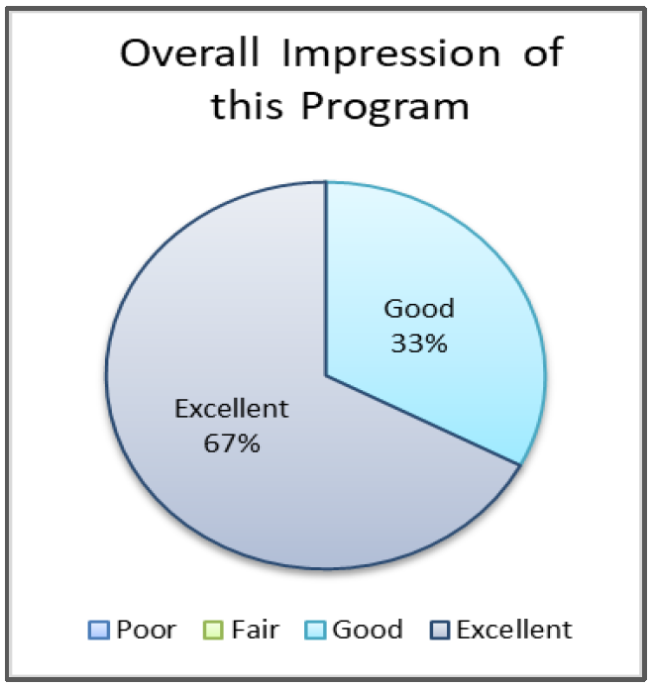
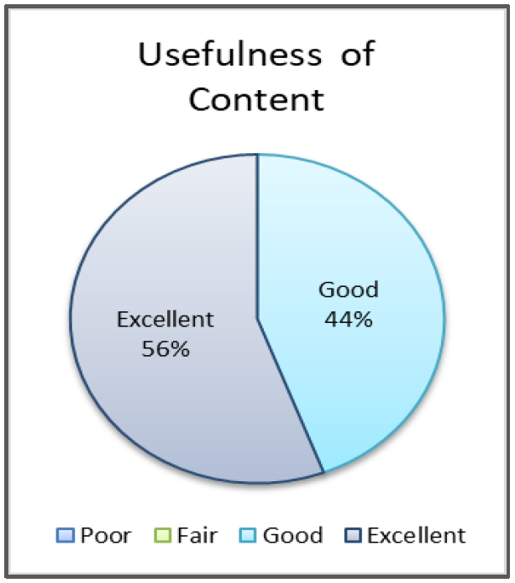
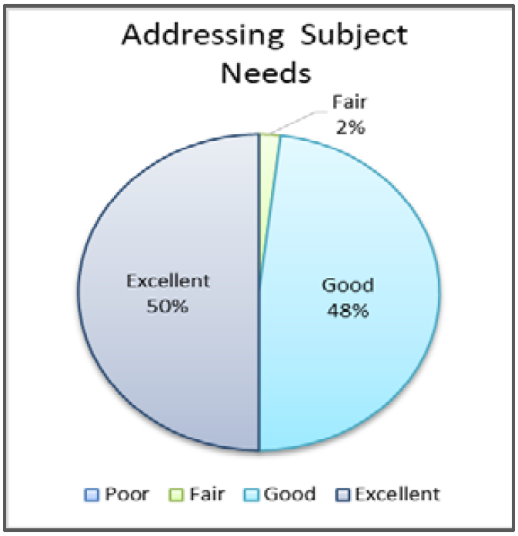
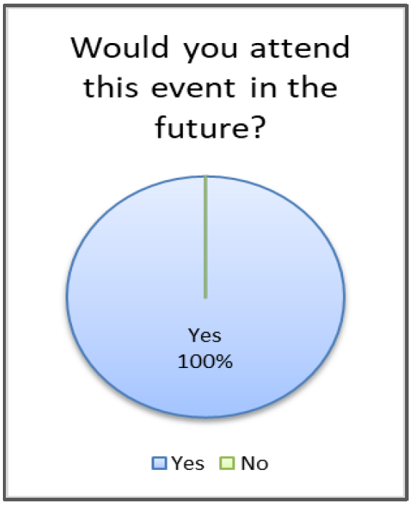
Public Works Roundup Debrief

Slide 15
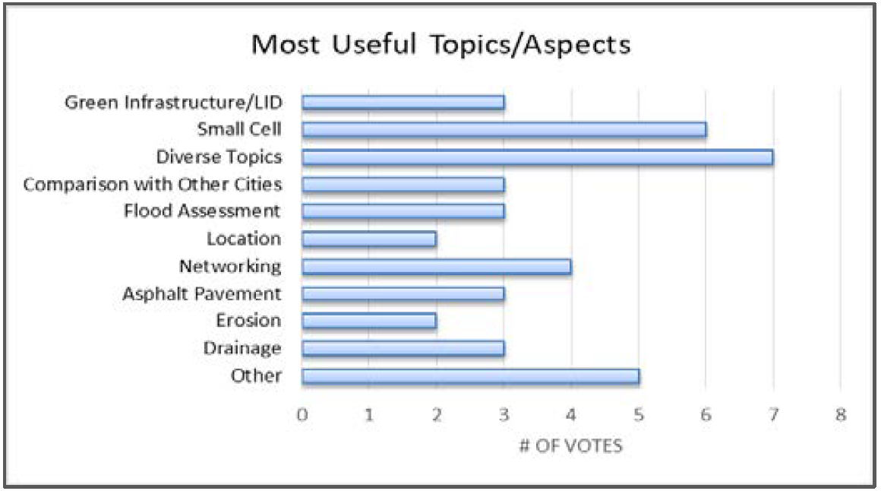
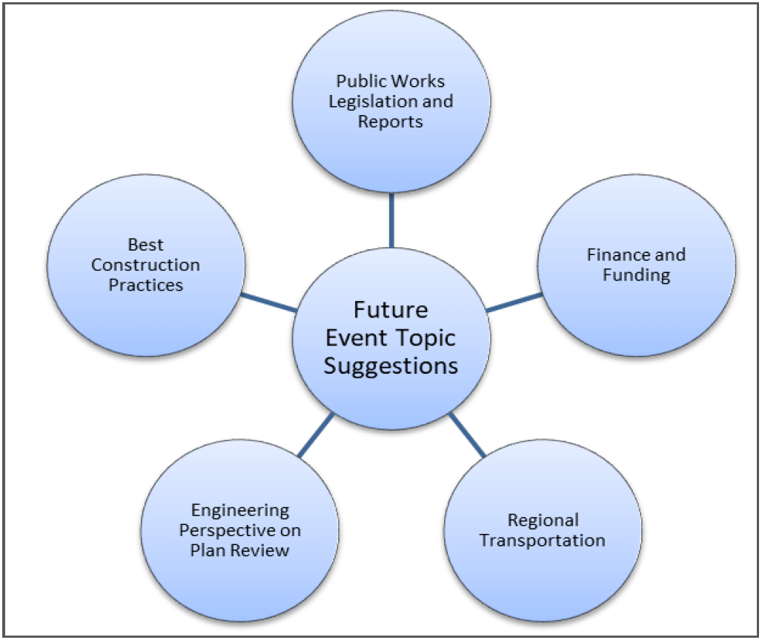
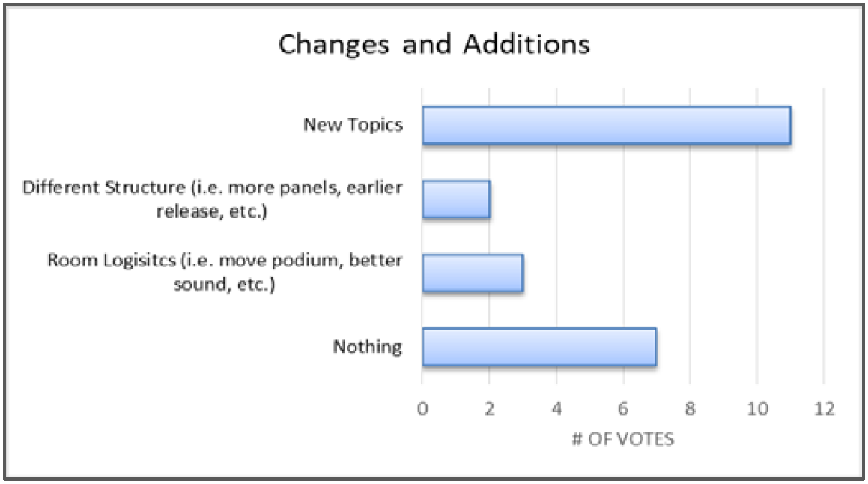
*Graphs are based upon only individuals that filled out the given sections and are not representative of all attendees

Slide 16

Standard Drawings Subcommittee Update
Presented by Keith Marvin
Subcommittee is currently reviewing and editing Division 1000 Erosion and Sediment Control Drawings
The Subcommittee is removing out-of-date drawings and identifying potential additional drawings.
Upcoming Meeting Dates:
  September 24, 2018 at 10 a.m., Pecan Conference Room
  October 22, 2018 at 10 a.m., Six Flags Conference Room
If interested in joining the Standard Drawings Subcommittee, please see Kate

Slide 17

Sustainable Public Rights of Way (SPROW)
Presented by Robert Woodbury
Met on July 9th
Roster is still open and needs representation from:
  Planners
  Public and Private Utilities
Committee discussed “hot button” issues in Public Rights of Way
Next Meeting:
  September 6, 2018 at 1 p.m., CP3
  Plan to meet quarterly starting this fall
If interested in joining SPROW, please see Kathleen

Slide 18
Legislative Update: Small Cells
The Streamlining The Rapid Evolution And Modernization of Leading-edge Infrastructure Necessary to Enhance Small Cell Deployment Act (STREAMLINE Small Cell Deployment Act) was introduced on June 28th. Key components of this bill include:
Time limits for states and municipalities to respond to collocation requests and other requests, or else permission is granted by default
States and municipalities can still: levy fees and regulate the placement, construction, and modification of small cells
States and municipalities cannot enforce higher environmental standards for radio frequency emissions than those required by the FCC

Slide 19

iSWM Program Updates
Halff Associates will create or update construction control schematics:
  Figure 2.8 Anchor Examples for Erosion Control Blankets
  Figure 2.11 Schematics of Turf Reinforcement Mats
  Figure 2.12 Examples of Turf Reinforcement Mats
  Figure 2.13 Schematics of Velocity Dissipation Device
  Figure 3.5 Schematics of 2”x4” Weir Curb Inlet Protection
  Figure 3.10 Schematics of Filter Fabric Area Inlet Protection
  Figure 3.11 Schematics of Excavated Impoundment Area Inlet Protection
  Figure 4.1 Schematics of Concrete Washout Containment
  (New Schematic) Grouted Rock Rip-Rap Detail
  (New Schematic) Creek Trash Screen/Catch Detail
Additional details for proprietary devices: research in progress
Guidance on maintenance and inspection: Post Construction Stormwater Management Training – October - Date and Location TBD

Slide 20

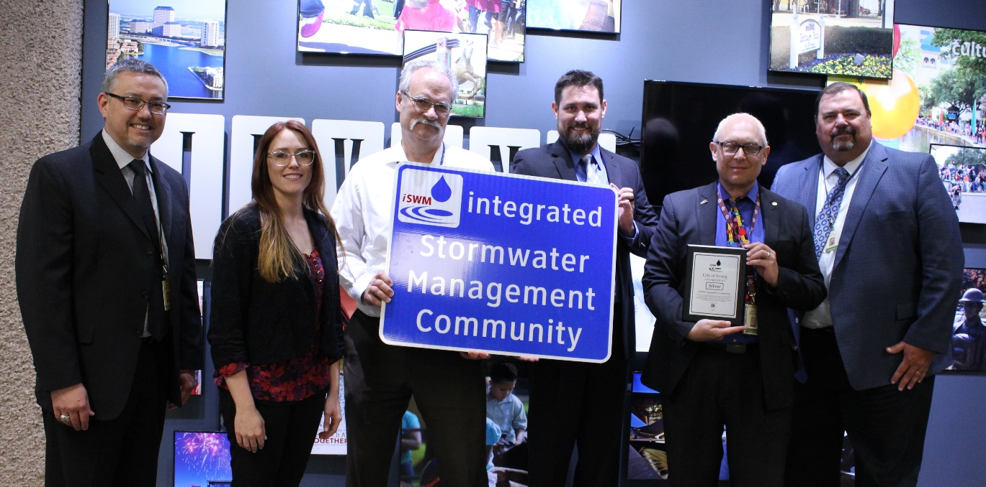
iSWM Program Updates
Announcing new iSWM Certified Community – City of Irving!
NCTCOG staff presenting the City of Irving iSWM Award at the City Council Work Session July 18, 2019

Slide 21
8. Other Program Activities
Cooperating Technical Partnership (CTP)
FY16
  East Fork Watershed Discovery
    Pre-Discovery webinars held June 26th and 28th. Recording is posted online.
    Outreach to communities is underway; Discovery Meeting will be scheduled for the fall.
  Flood Risk Identification
    McAnear Creek/West Buffalo Trib 1 (Cleburne): 38% complete as of end of quarter.
    Silver Creek (Tarrant County): 49% complete as of end of quarter.
FY17
  Richland-Chambers Watershed Discovery will begin later this year.
  Flood Risk Identification
    Kick-off meetings held for Town Creek in Weatherford and Stream CF-5 in Benbrook.
FY18
  Grant Application now complete for flood risk identification project on 17.5 miles of Marys Creek in Parker County. Awards will be announced by FEMA next month.
www.nctcog.org/envir

Slide 22
Community Rating System (CRS) Users Group
The Annual Combined CRS Users Group/Elected Officials Floodplain Seminar was held July 18th.
x
  About 50 attendees
  Guest speakers from USACE and FEMA Resilience Action Partners.
  x
Future CRS dates TBD.

Slide 23

Public Works Emergency Response Team (PWERT) Update
Contact Information:
Next PWERT Meeting:
September 2018, 9:30-11:00 (Date TBD)
  NCTCOG, Regional Forum Room
Manny Palacios, Chair
NCT PWERT
mpalacios@weatherfordtx.gov
Mistie Gardner, Vice Chair
NCT PWERT
mistie.gardner@cor.gov
Jessica Mason, NCTCOG Rep
NCT PWERT
JMason@nctcog.org
Image: www.nagincorporated.com

Slide 24

Texas Public Works Association
(TPWA) Update

Slide 25


Public Works Institute of Texas (PWITX)
The Public Works Institute of Texas (PWITX) continues an award winning tradition of providing members of the Texas Chapter of the American Public Works Association (APWA) with the highest quality in educational and professional development opportunities.
http://www.pwitx.org/

Slide 26



Slide 27


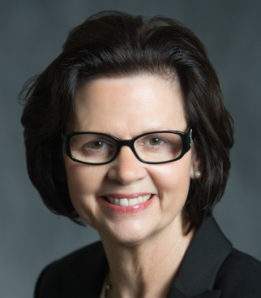




2018 One Day Seminar
Imagining Tomorrow
When: Thursday, November 15th, 2018— 8 am - 4 pm
Where: Richardson Civic Center/City Hall
Cost: $30 online registration
$35 onsite registration
– includes refreshments & lunch
http://www.nctx-tpwa.org/index.html
PDH Up to 5 hours
Thanks to our 2017 Sponsors
KEY NOTE SPEAKER
Kathleen Jackson was appointed to the Texas Water Development Board by Gov. Rick Perry in 2014, and reappointed by Gov. Greg Abbot in 2017.

Slide 28

9./10. Future Agenda Items & Roundtable Discussion

Slide 29
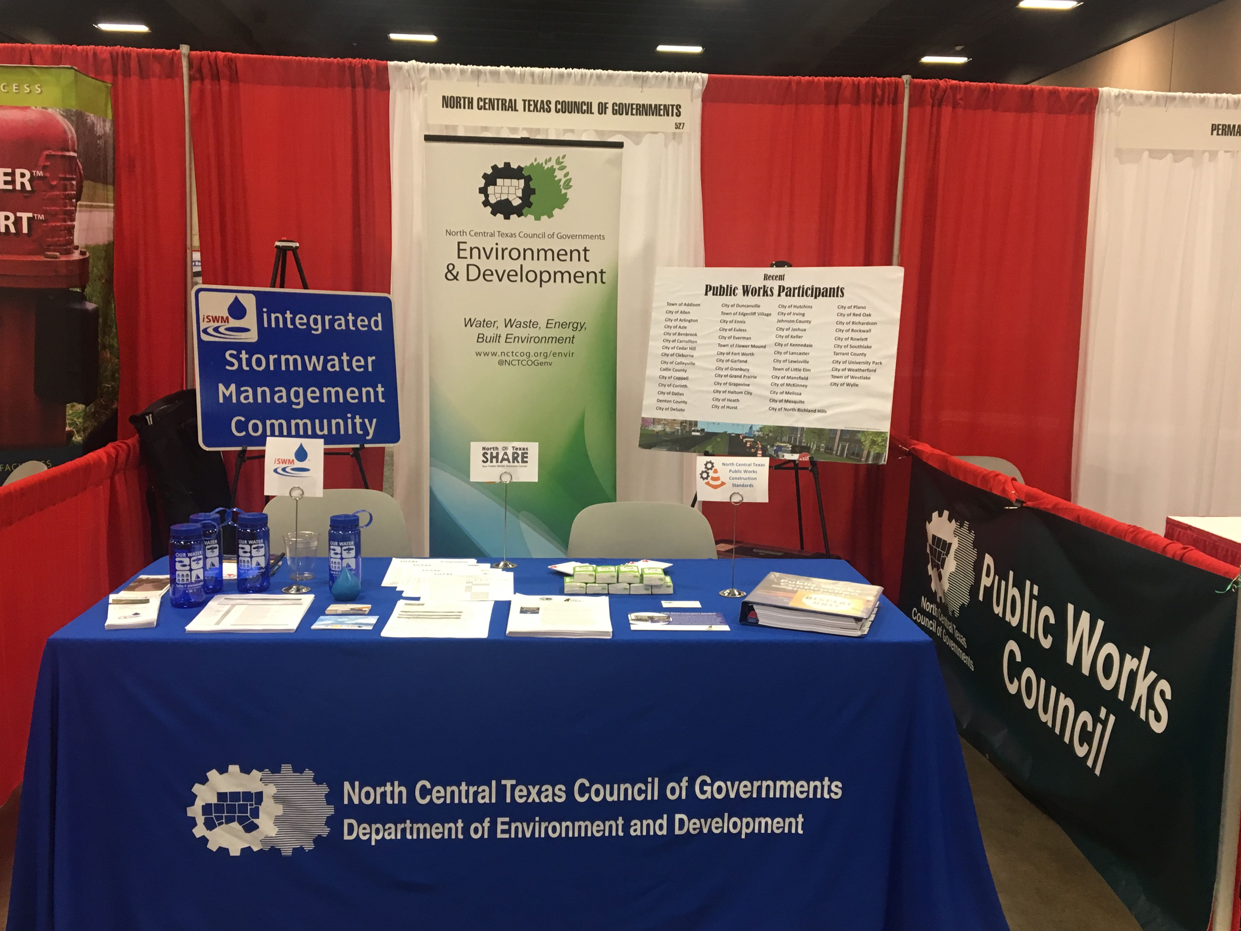
Save the Date!
Upcoming trainings and events in the region:
TFMA 2018 Fall Technical Summit – Aug. 28, San Antonio
TFMA G273: Managing Floodplain Development Through
the National Flood Insurance Program (NFIP), 4-Day
Course and CFM Exam – Sept. 10 - 13, Leon Valley, TX
Talking Top Tech: Geographic Information System (GIS)/Mapping – Sept. 13, APWA Webinar
Ground Water Production – Sept. 18 - 20, Texas Water
Utilities Association Webinar
Public Works Institute of TX Training: Oct. 17 - 19,
Cedar Hill, TX
Thank you to TPWA for allowing NCTCOG to host an exhibitor booth at their annual conference this June!

Slide 30

Save the Date
S.A.M.E. Infrastructure Forum
Imagine Future Infrastructure: Technology, Research, and People
December 14, 2018
University of Texas – Arlington

Slide 31
11. Next Public Works Council Meeting
The next PWC meeting is scheduled for:
Thursday, November 29, 2018
9:30 a.m. – 11 a.m.
NCTCOG’s Regional Forum Room

Slide 32
Public Works Staff
KATE POWERS
EDITH MARVIN, PE, CFM
PUBLIC WORKS, TxCDBG
KPOWERS@NCTCOG.ORG
(817) 695-9213
DIRECTOR
EMARVIN@NCTCOG.ORG
(817) 695-9211
TAMARA COOK, AICP
DERICA PETERS, CFM
@NCTCOGENV
SENIOR PROGRAM MANAGER
TCOOK@NCTCOG.ORG
(817) 695-9221
iSWM, DEVELOPMENT EXCELLENCE
DPETERS@NCTCOG.ORG
(817) 695-9217
MIA BROWN, CFM
KATHLEEN MYERS
CTP, CRS
MBBROWN@NCTCOG.ORG
(817) 695-9227
PUBLIC WORKS, SPROW
KMYERS@NCTCOG.ORG
(817) 695-9107
@NCTCOGENV

