Slide 1
Estimating the Emissions Benefits of the Clean Truck Check Program in EMFAC202Y
Sara Forestieri
Manager, California Air Resources Board

Slide 2

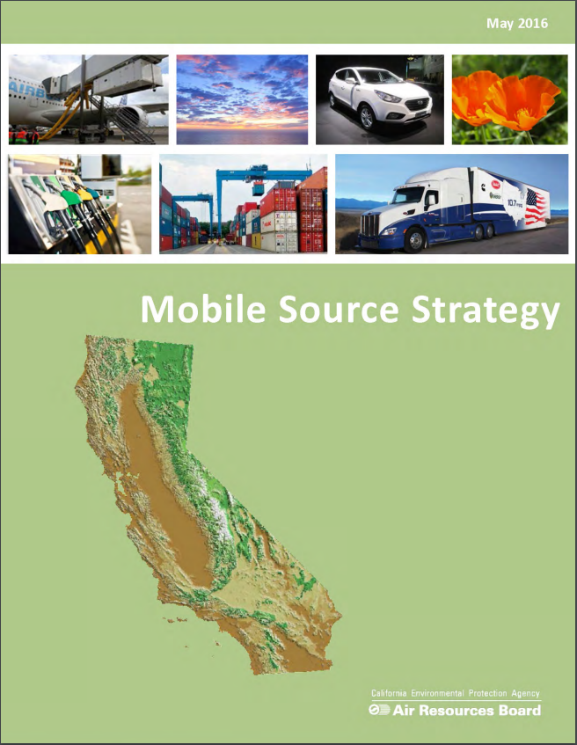



EMFAC Model Background
Scoping plan
State Implementation Plan
Transportation Conformity
Regulatory Development

Slide 3
EMFAC Model Background (cont.)
U.S. Environmental Protection Agency (EPA) approves California specific vehicle emission inventory model
  Updated with most recent emissions and fleet distribution data
  Reflects the latest California regulations
More than three decades of data collection and methodology refinement
Incorporates extensive laboratory and on-road emissions testing and vehicle activity
Reflects latest adopted regulations.

Slide 4
EMFAC Updates
Single Package
Reflects key regulations, e.g., Advanced Clean Cars
New web-based interface
Reflects key regulations, e.g., Advanced Clean Trucks
Approved by U.S. EPA in 2022
EMFAC2014
Released: 2014
EMFAC2017
Released: 2017
EMFAC2021
Released: 2021
EMFAC202Y
Release:
2025
An extension of the EMFAC2014 framework
Reflects key regulations, e.g., Phase 2 GHG standards
Latest fleet technologies
Reflecting regulations adopted before 2025
Incorporation of expanded PEMS data for heavy-duty diesel and gasoline categories.

Slide 5
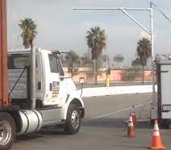
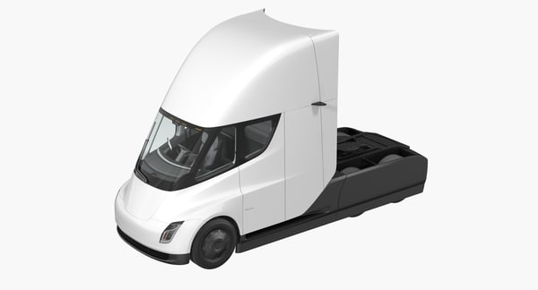
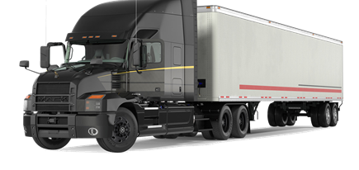
Recently-Adopted Heavy-Duty Vehicle Regulations (EMFAC202Y)
Clean Truck Check (CTC)
Federal Clean Trucks Plan
Advanced Clean Fleets

Slide 6
Clean Truck Check Background
Applies to nearly all diesel and alternative fuel heavy-duty vehicles with a gross vehicle weight rating (GVWR) over 14,000 pounds that operate on California public roads.
Clean Truck Check Compliance Requirements
  Jan 2023: High-emitter screening. Flagged vehicles required to submit OBD or opacity tests.
  Oct – Jan 2024: complete fleet and vehicle reporting requirements and pay 2023 compliance fee
  July 1 – December 31, 2024 – resolve all vehicle enforcement holds and pay 2024 compliance fee
  Jan 1 – June 30, 2025 – successful completion of periodic vehicle compliance tests, either with OBD or opacity.

Slide 7
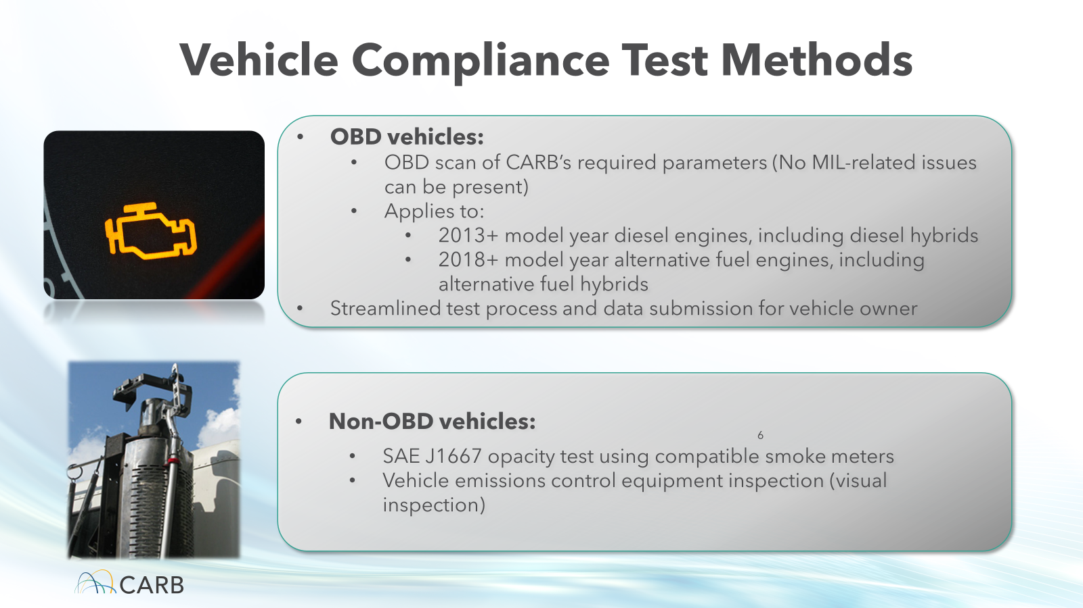
Vehicle Compliance Test Methods
OBD vehicles:
OBD scan as CARB’s required parameters (No MIL-related issues can be present)
Applies to:
  2013+ model year diesel engines
  2018+ model year alternative fuel engines
NOx and PM emissions benefits
Non-OBD vehicles:
SAE J1667 opacity test using compatible smoke meters
Vehicle emissions control equipment inspection (visual inspection)
PM emissions benefits only

Slide 8
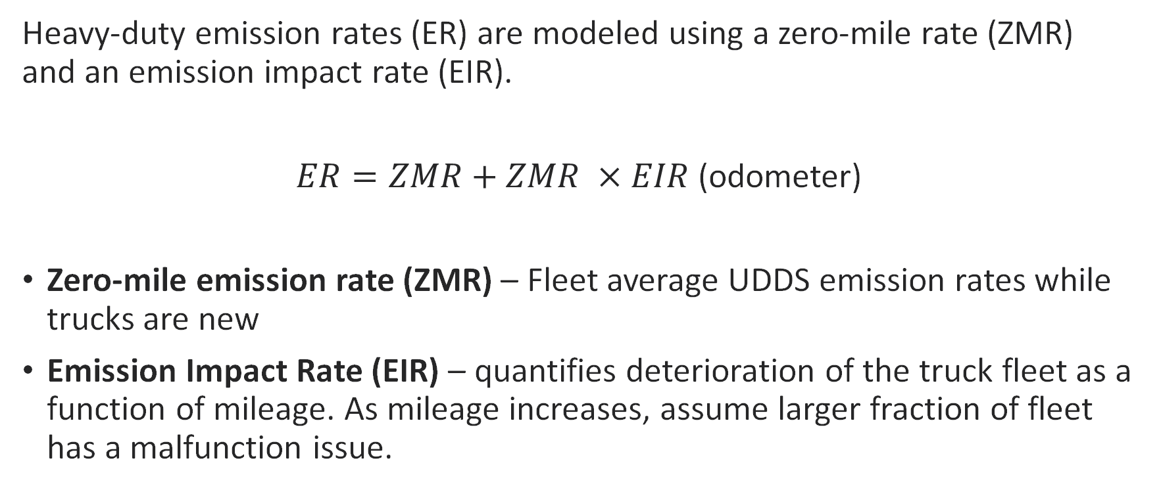
Deterioration Function in EMFAC
Heavy-duty emission rates (ER) are modeled using a zero-mile rate (ZMR) and an emission impact rate (EIR).
$ER=ZMR+ZMR ×EIR$ (odometer)
Zero-mile emission rate (ZMR) – Fleet average UDDS emission rates while trucks are new
Emission Impact Rate (EIR) – quantifies deterioration of the truck fleet as a function of mileage. As mileage increases, assume larger fraction of fleet has a malfunction issue.

Slide 9
Deterioration Function
Zero Mile Rate

Slide 10
Data Sources for Clean Truck Check (CTC) Analysis
Estimate baseline deterioration using in-use testing data from randomly selected trucks operating in California as a function of odometer.
Baseline MIL On rate from telematics data (N = ~180,000 trucks)
Modeled reductions in vehicles having MIL ON as a result of CTC requirements relative to the baseline.
Key modeling parameters:
  Repair rates
  Repair durability
  Inspection frequency
Scale deterioration function by MIL ON_{with CTC}/MIL ON_{baseline}

Slide 11


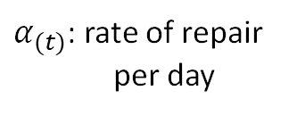


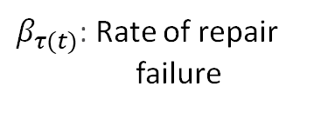
Simplified Model Description
(1)
Mal-maintained truck:
Repaired truck:
$α_{(t)}$: rate of repair
per day
$β_{τ(t)}$: Rate of repair
failure
Inspection Period
(2)
Inspection
day
$$β_{τ(t)}$$
(5)
$$β_{τ(t)}$$
Inspection
day
(4)
$$β_{τ(t)}$$
(6)
$$β_{τ(t)}$$
(7)
(3)

Slide 12
MIL On Adjustments with CTC Requirements
An Example of Class 8 Tractor Truck
with Model Year (MY) 2016 (NOx)

Slide 13
CTC Impact on Deterioration
Zero Mile Rate

Slide 14
CTC Impact on Overall Emissions*
* Baseline includes Advanced Clean Trucks, Heavy-Duty Omnibus, but not Advanced Clean Fleets or Federal Clean Trucks Plan

Slide 15
Approaches to Validate Initial Assumptions
Top-down
  In-use test data
    Advantage: provides emission rates over a wide range of test cycles
    Challenges: limited sample size
  PEAQS
    Advantage: large sample size
    Challenges: snapshot, no OBD information
Bottom-up
  Estimate deterioration using the frequency of MIL ON and tamper rates.
  Challenges: need accurate estimates of emissions increase for MIL On or tampered vehicles
Other ideas?

Slide 16
Next Steps
Implement initial rulemaking assumptions into EMFAC202Y.
EMFAC202Z (2028/2029 timeframe) – collect and analyze data to validate assumptions as the regulation is implemented.

