Slide 1
SPROW
Sustainable Public Rights Of Way
July 9th, 2018

Slide 2
Agenda
Welcome and Introductions
Overview of SPROW Program and Past Activities
Discussion of Future Direction of SPROW
Regional Public Works Program Update
NCTCOG Sustainable Development Update
Roundtable

Slide 3
SPROW: A (Brief) History
2003
NCTCOG Public Works Council develops “Public Right of Way Management Suggestions for Local Governments.”
2008
ASCE gives America’s infrastructure a “D” and roads a “D minus.” PWC takes action by creating locally-oriented group called Sustainable Public Rights Of Way.
2014
NCTCOG holds the first SPROW Education Forum. Educational events have been the primary work program item since 2014.
2009
SPROW begins work on the Roadmap to a Sustainable Public Right of Way. This document has been maintained periodically.
Notes:
“Public Right of Way Management Suggestions for Local Governments” shows that ROWs were an important topic in the region even long before the creation of SPROW.
The ASCE report and DFW’s high rate of increasing congestion led to an increased focus on roadways. As the MPO for the region, NCTCOG and the PWC felt that it was appropriate and necessary to address ROW improvements locally.
The Roadmap was SPROW’s first project. The interactive tool is no longer posted, but the document is still available and has gone through several iterations of hyperlink maintenance and general clean-up (most recently in fall 2017).
SPROW teamed with Roundup in 2013 to showcase SPROW topics and developed its stand alone Education Forum event the following year.
https://www.nctcog.org/envir/public-works/sustainable-public-rights-of-way

Slide 4
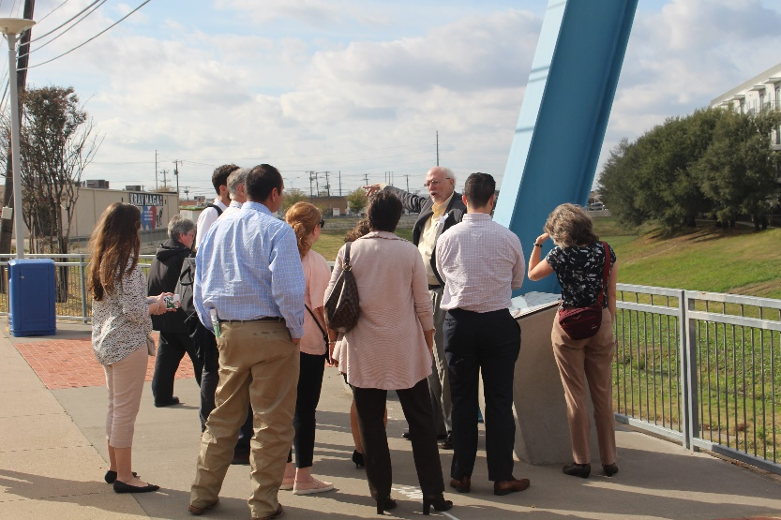
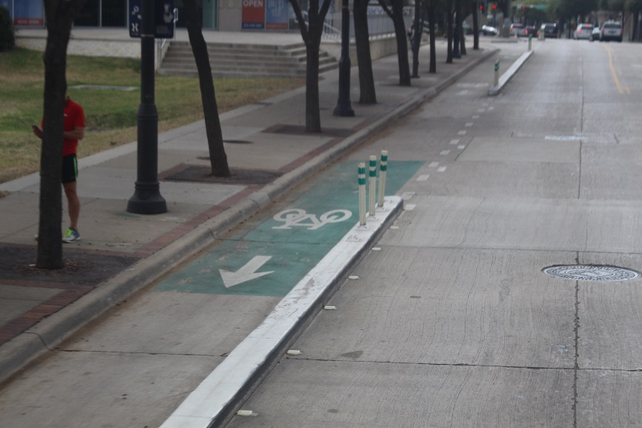
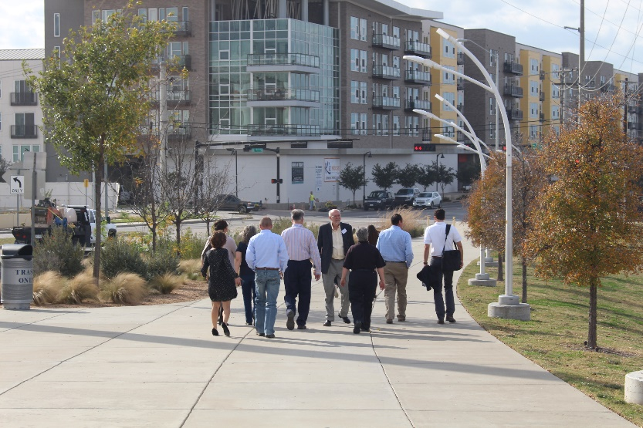
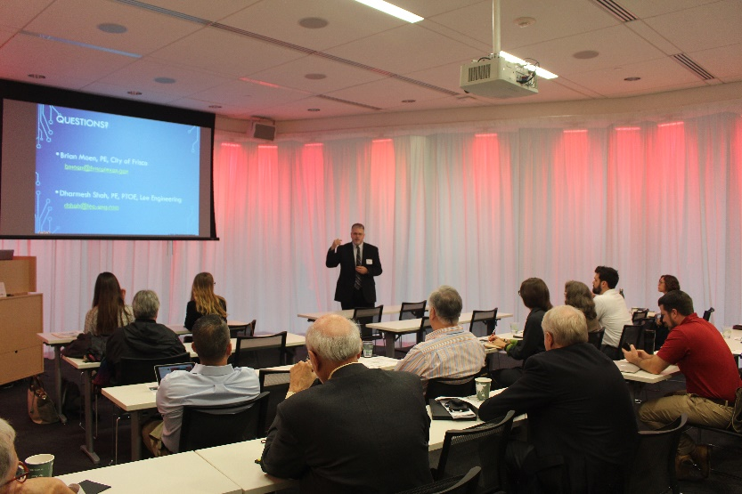
SPROW: Recent Activities
Education Forum
Notes:
For the last 4-5 years, SPROW has either hosted an Education Forum or combined SPROW-related topics with the Public Works Roundup. In 2017, SPROW combined its Education Forum event with a tour of SPROW sites throughout the City of Dallas. The SPROW subcommittee has not held a formal meeting since April 2016.

Slide 5
What is SPROW: Current Goals
Goals:
  To promote multi-modal forms of transportation
  Improve air and water quality
  Provide walkable communities
  Provide safer and healthier neighborhoods and improve quality of life
  Improve infrastructure life cycle and performance
  Streamline construction
  Ensure regulatory compliance
  Promote economic development
  Promote integration of rights of way and surrounding land use
  Promote context-sensitive design
  Balance environmental, scenic, aesthetic, cultural, and natural resources, as well as community transportation needs

Slide 6
What is SPROW: Future Directions
SPROW Goals:
  Is this list too long? Too short?
  Is anything missing?
  How do we want to define “sustainable”?
Structure:
  Do we need a co-chair?
  Meeting frequency
  Committee makeup (size, public vs private balance, etc.)
Project Goals:
  Continuation of Education Forums
  Other ideas: education, research opportunities, best practice resources, trainings
Notes:
Goals appear to have come from a 2016 conference call. This list is definitely on the table for discussion.
Some suggestions:
Create a shorter list of broader goals (no one is going to read past 3-5 goals or principles)
Sustainability means a lot of things depending on context… it might be helpful to define a scope for this word OR to focus on a different aspect each year. Examples:
LID/GI (stormwater, water quality focus)
Use of sustainably sourced materials (resource conservation, materials management)
Life cycle of SPROW infrastructures
Using SPROWs to encourage alternative transport (air quality, traffic mitigation, public health, placemaking)
Past meeting frequency ranges from 0-4 times/year
Get help from subcommittee to fill membership gaps – they should have more contacts than we do
Do we want to continue education focus? If so, is there a particular topic within our goals to initially focus on?
Where do you see this group with its varied areas of expertise filling a need in the region?
2015: Sustainable Public Rights-of-Way (SPROW) Activities. NCTCOG staff requests discussion and input on the vision and continued direction for SPROW (mission statement, roster, topics, speakers, etc.).
SPROW expressed that the new direction of the subcommittee should be focused on education and outreach. SPROW acknowledged that the website has been a great tool and would like to see the website analytics.
Project Ideas:
Continuation of Education Forums:
Half or full day?
Combine with Roundup?
Site Visits?
Frequency?
LID Competition Lite (may need to give brief background of LID competition here)
Might be able to fold this into a CLIDE category
Look to the roadway projects from the LID competition as a model
2012 ideas: Encourage and Look for Research Opportunities
Economic benefits of sustainable practices
Long term benefits and performance of best practices
* Work to Coordinate Connectivity
In thoroughfares, open spaces, parks and trails and utility corridors

Slide 7
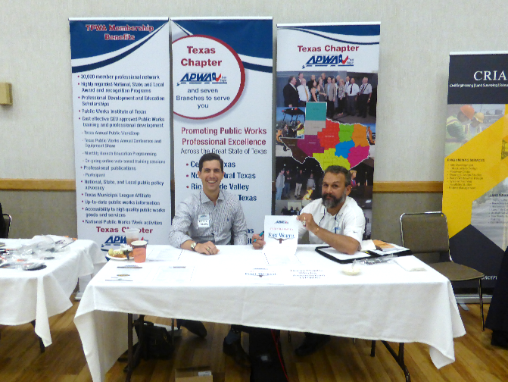
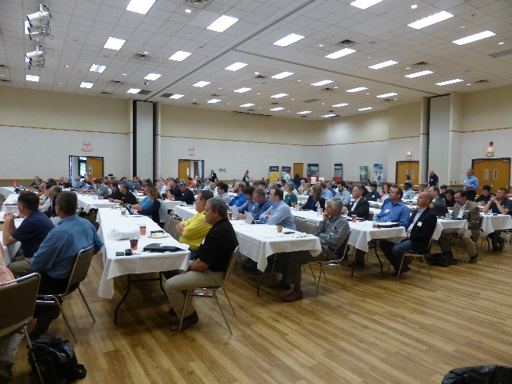
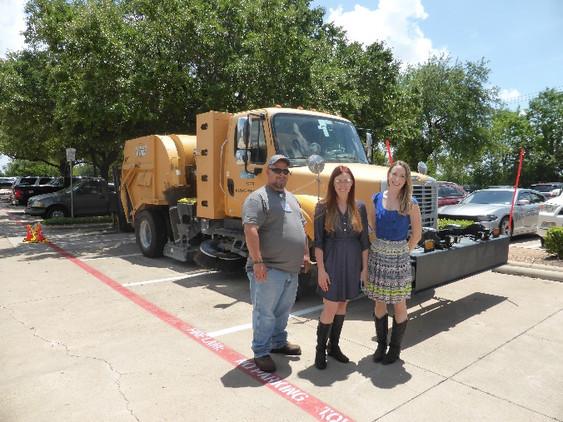
UPDATE: Regional Public Works
Upcoming Training
  Topic: Construction Contracts
  Instructor: Tim James
  Date: August 14th, NCTCOG offices
Standard Drawings Subcommittee
  Currently updating Division 1000 Drawings
Public Works Roundup
  May 23, 2018
  156 Participants and 11 Sponsors
Public Works Council
  Next Meeting: August 16th at 9:30 am, NCTCOG Offices

Slide 8
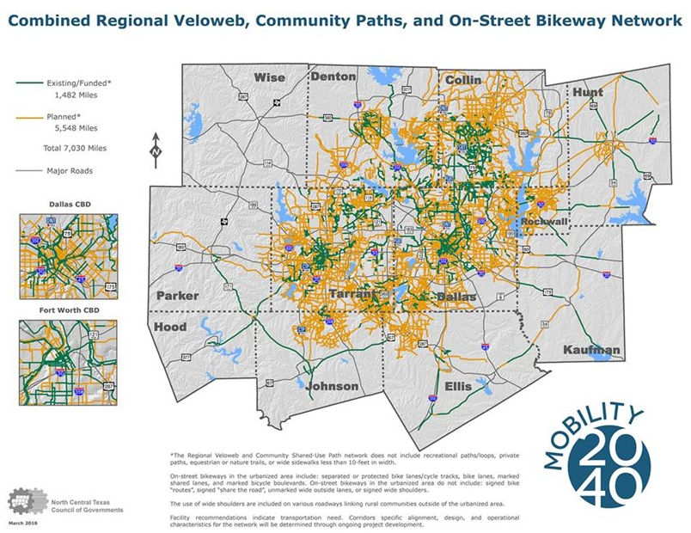
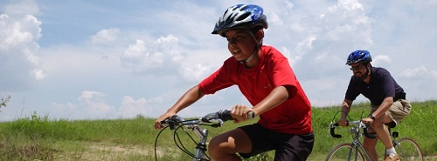
UPDATE: NCTCOG Transportation - Sustainable Development
Green-Grey-Blue Funding Program
Regional Pedestrian Safety Plan
Fort Worth Active Transportation Plan
SH 183 Corridor Master Plan
Green Infrastructure Training
FTA Grant – Transport Oriented Development Planning Pilot
Image: NHTSA

Slide 9

UPDATE: NCTCOG Transportation - Sustainable Development
Green Infrastructure Guidebook
This guide focuses transportation-relevant green infrastructure elements:
  Energy-efficient light-emitting diode (LED) and renewable-energy lighting
  Recycled construction materials in roadways and trails
  Cool pavements
  Green trail materials
  Green stormwater infrastructure (GSI) techniques such as permeable pavement and bioretention, and trees.
Developed local, state, and national case studies to examine:
  Long-term cost effectiveness
  Community improvement
  Environmental impacts
Image: NHTSA
www.nctcog.org/greeninfrastructure

Slide 10
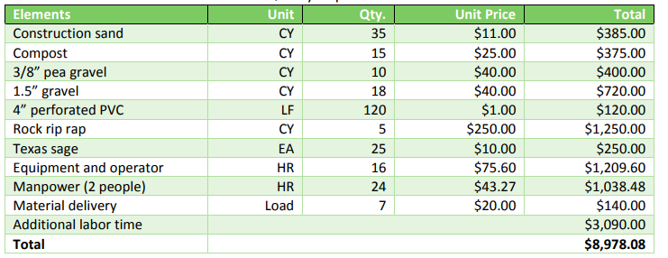
UPDATE: NCTCOG Transportation - Sustainable Development
Green Infrastructure Guidebook (cont’d)
Cost Matrix: breakdown of each case studies’ materials Green Feature Cost vs. Traditional Feature Cost
Construction and maintenance cost estimates
Image: NHTSA
www.nctcog.org/greeninfrastructure

Slide 11






Contact Connect
Derica Peters
Senior Environment and Development Planner
dpeters@nctcog.org
817.695.9217
Facebook.com/nctcogenv
Kathleen Myers
Environment and Development Planner
kmyers@nctcog.org
817.695.9107
@nctcogenv
nctcogenv
Tamara Cook
Manager, Environment & Development
tcook@nctcog.org
817.695.9221
youtube.com/user/nctcoged
EandD@nctcog.org
Edith Marvin
Director, Environment & Development
emarvin@nctcog.org
817.695.9211
nctcog.org/envir

