Slide 1

Stormwater
Public Education
Task Force
January 17, 2018

Slide 2
Agenda
Welcome and Introductions
FY19 Project Brainstorm
SmartScape Plant Sales
Other NCTCOG Business
March is Texas SmartScape
Month
Roundtable
Cooperative Purchase
Next Meeting Date
FY18 Project Update
Adjournment

Slide 3

Texas SmartScape
2018 Plant Sales
Quick count: who is planning on hosting a plant sale?
NEW: SmartScape Pinterest (still in development)
Suggestions welcome

Slide 4

March is Texas SmartScape Month

Slide 5
FY18 Project Update
Decription: Social Media Toolkit
Month-by-month text and visual templates for Facebook and Twitter. Some topics are repeated each month, while some are more season-specific.
Current Status
Finished through March. April is in progress.
Preference: email each time a month is ready or check the PETF web?
Social Media Survey
Please fill out the survey about social media accounts and usage on the back table. Comments?

Slide 6

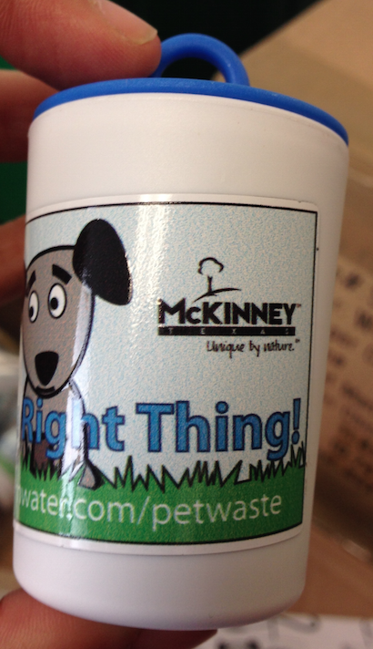



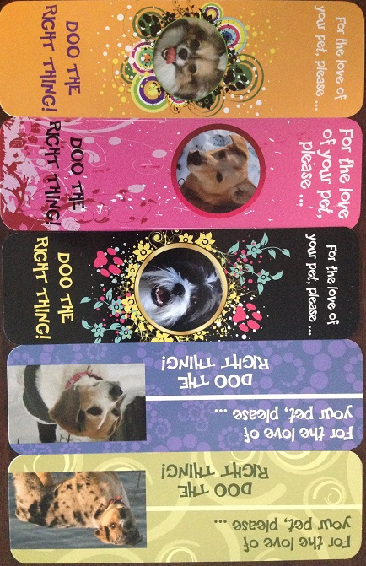

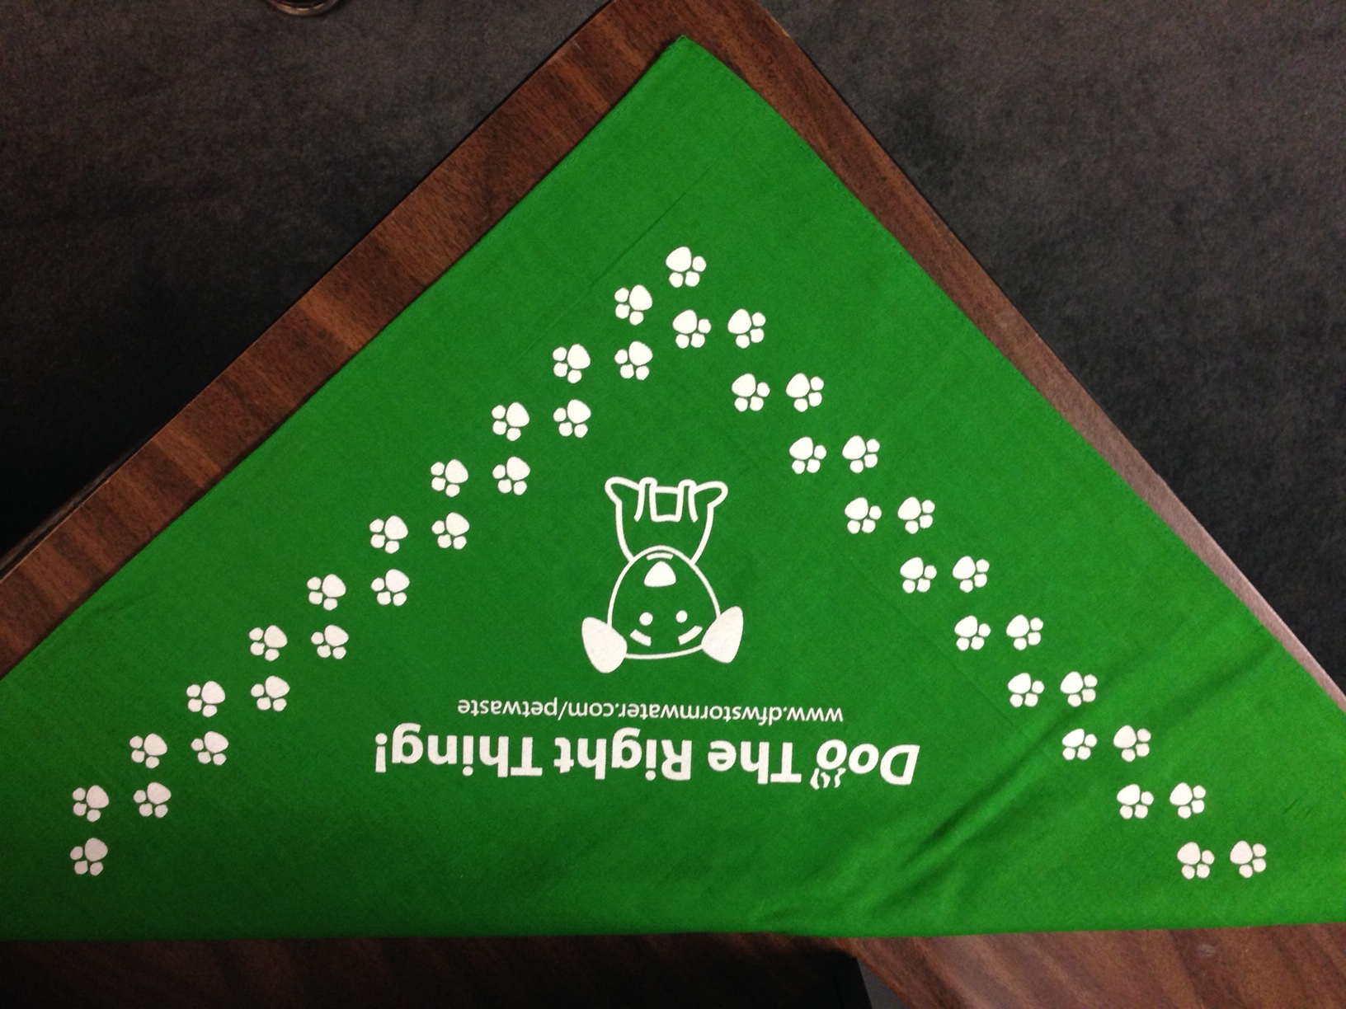
FY18 Cooperative Purchase
Order forms are due close of business TODAY. Please email completed forms to kmyers@nctcog.org.

Slide 7
FY19 Project Brainstorm
Videos: demo videos of Ed Toolbox activities, animated PSAs for social media, other ideas?
Educational pop-up displays to be rented for events
Update Yard Waste Brochures
Other ideas?

Slide 8
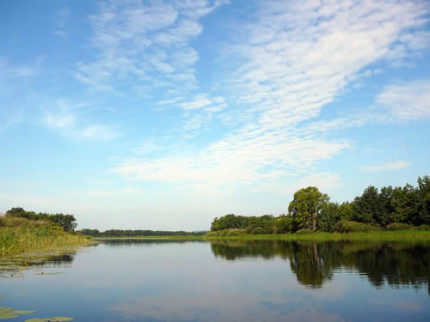
TMDL
NCTCOG is currently preparing the I-Plan annual status report
  Final draft by August 2018
303(d) Vision Coordinating Committee Meeting
  February 15, 2018 at 9:30am in the Regional Forum Room
The three TMDL technical subcommittees recently met
  Meeting summaries can be found on the NCTCOG TMDL website

Slide 9


WATER
Our WATER members have collected nearly 1,000 gallons of fats, oils, and grease as part of our 2017 Holiday Grease Roundup, which ran from November 27, 2017 to January 8, 2018
For our Defend Your Drains (DYD) social media campaign, our Cease the Grease outreach is winding down and we are now moving into the Med Take-Back portion of our campaign.
The WATER Group is in the process of choosing the subject matter for a regional training and forming a subcommittee tasked with aiding in training coordination.

Slide 10
Other Business/Reminders
Cooperative Purchase
Deadline:
TODAY, 1/17
TX SmartScape
Add your events to the webpage by emailing
info@txsmartscape.com
Public Education
Activity Reports
All should have received reports
Doo the Right Thing
Calendar
Files are available

Slide 11

Bonus: DFW Clean Cities
March 27th, 2018; Location TBD (Plano or COG)
CALL FOR SPEAKERS: Need presenters that bridge the gap between air quality and March is Texas SmartScape Month. This may include using low emission or alternative fuel equipment for landscaping, utilizing plants and techniques that don’t require such equipment.

Slide 12

Roundtable Discussion

Slide 13
Important Date To Remember
Next Meeting:
April
18
2018
Time: 9:30am
Location: Tejas Conference Room
Centerpoint III

Slide 14
Social Media
@nctcogenv
@nctcogenv
@nctcogenv
@nctcogenv

