Slide 1
Public Works
Standard Drawings Subcommittee Meeting
Monday November 12, 2018
Regional Forum Room

Slide 2
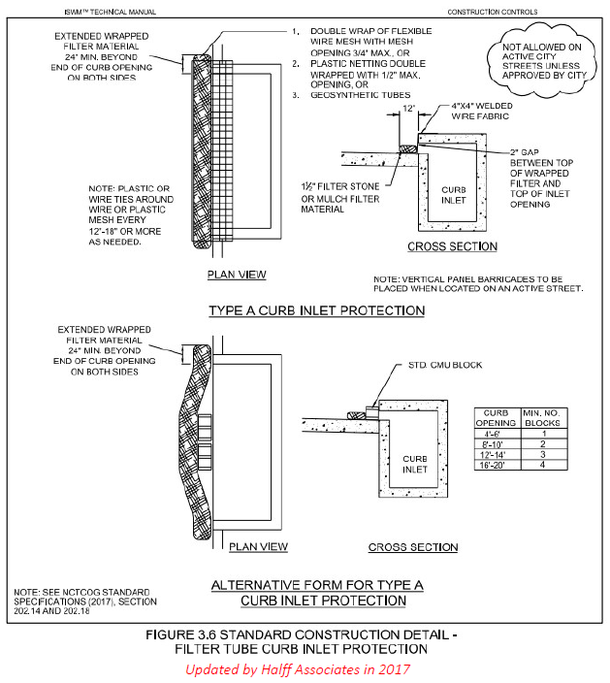

Slide 3
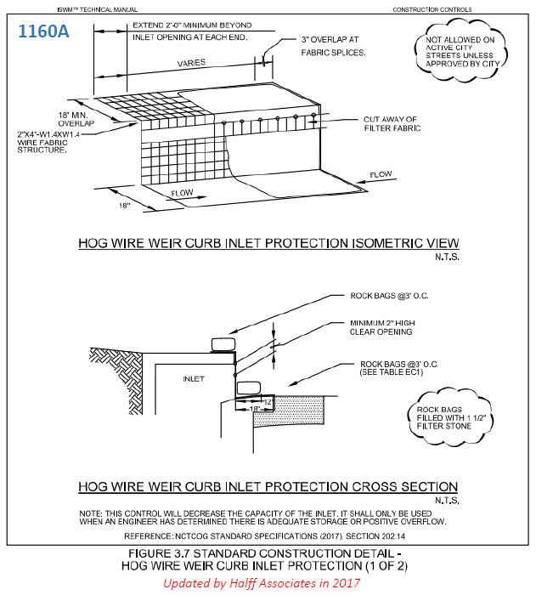
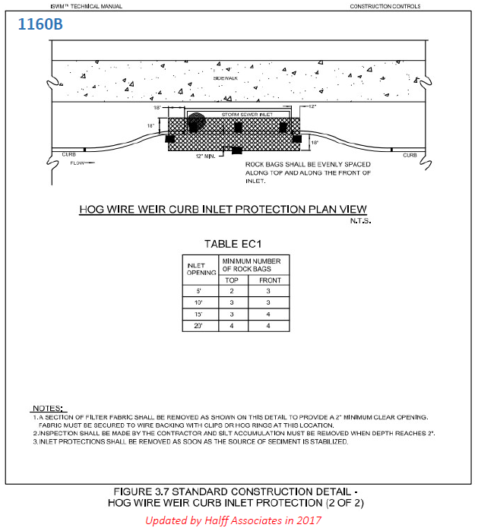

Slide 4
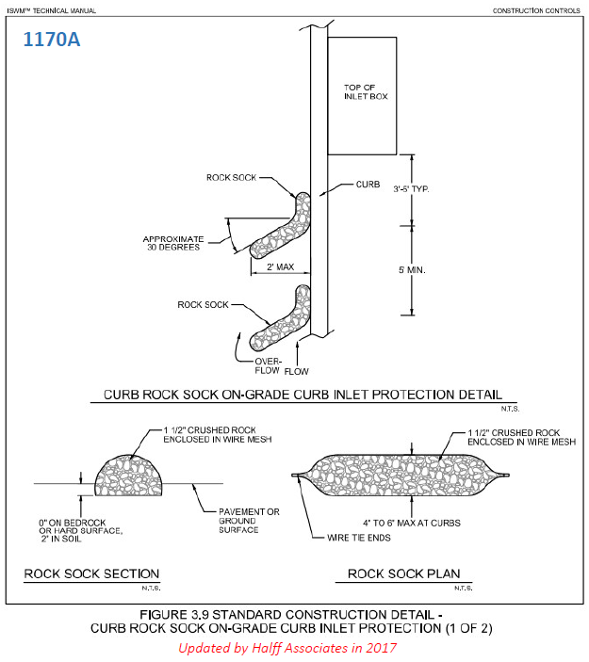
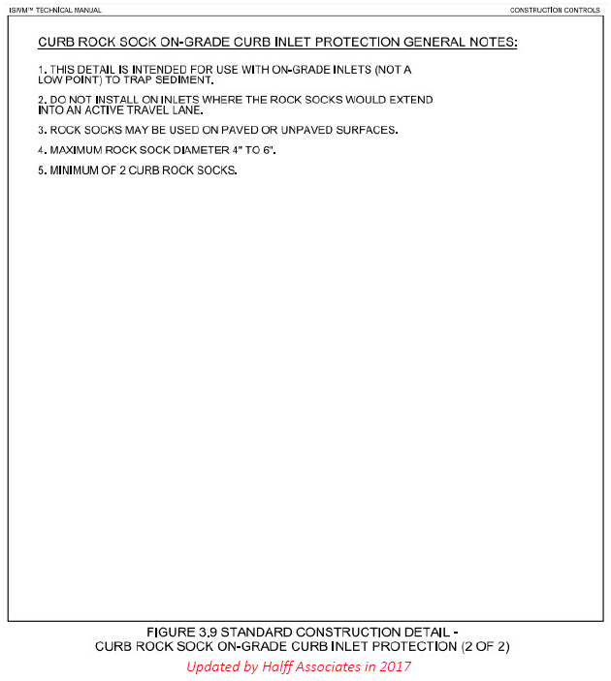

Slide 5
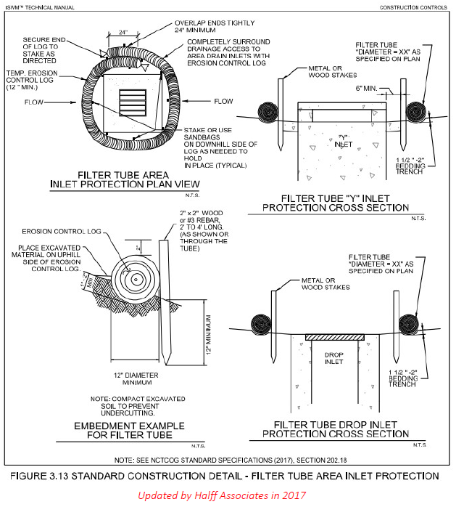

Slide 6
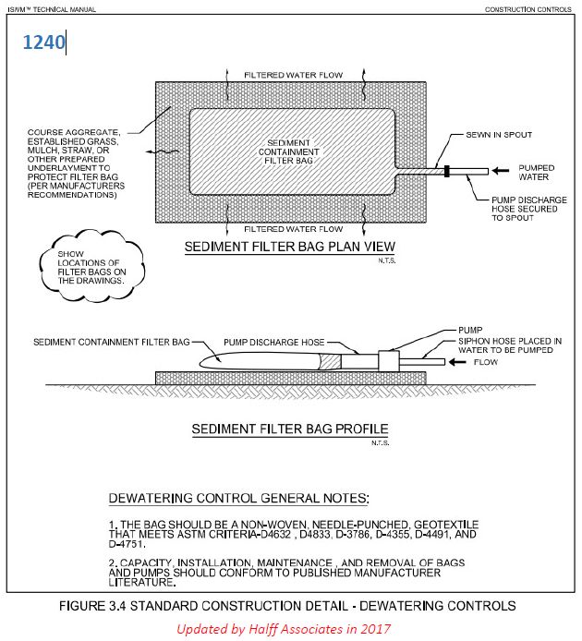

Slide 7
Standard Drawings Questionnaire
Date: November 2017 – January 2018
Responses: 47

Slide 8
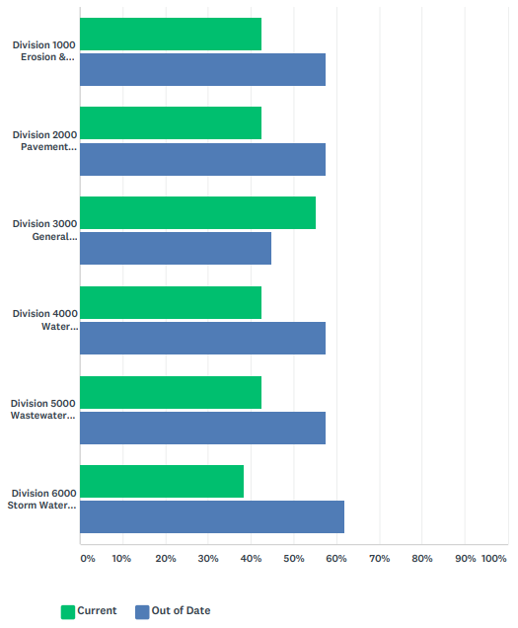
Please select which Division of Standard Drawings you believe to be current or out of date.
20
27
20
27
Division | Current | Out of Date
1000 | 20 (42.55%) | 27 (57.45%)
2000 | 20 (42.55%) | 27 (57.45%)
3000 | 26 (55.32%) | 21 (44.68%)
4000 | 20 (42.55%) | 27 (57.45%)
5000 | 20 (42.55%) | 27 (57.45%)
6000 | 18 (38.30%) | 29 (61.70%)
26
21
20
27
20
27
18
29

Slide 9
18
18
16
16
15
15
15
15
13
13
13
13
13
12
12
11
11
10
8
6
5
3
2
2

Slide 10
Additional Expertise, Additional Volunteers
Derek Light from the Texas Concrete Pipe Association (Divisions 3000, 4000, 6000) & additional representative for balance (e.g. Plastics Pipe Institute, PVC Pipe Association, etc.)
NCTCOG staff can solicit volunteers as needed, based on relevant background

Slide 11
Next Steps
Determine action items for subcommittee members and NCTCOG staff

Slide 12
Next Meeting scheduled for
Monday December 17, 2018 at 10 a.m.,
Metroplex Conference Room
Upcoming 2019 meetings:
  January 14 at 10 a.m., Six Flags Conference Room
  February 11 at 10 a.m., Regional Forum Room

