Slide 1


North Texas Regional Integration of Sustainability Efforts (RISE) Coalition
Public Meeting
January 11, 2021
RISE Coalition Website: https://www.nctcog.org/envir/development-excellence/rise-coalition
RISE Coalition Committee Page: https://www.nctcog.org/envir/committees/regional-integration-of-sustainability-efforts-ris

Slide 2
January 11, 2021
Meeting Agenda
Welcome
Discussion Items
RISE Coalition Program Update
RISE Educational Update
Information Items
4) Featured Roundtable Presentation
5) Participant Roundtable
Other Business
6) Next Meeting Date
7) Adjournment

Slide 3
2. RISE Coalition Program Update
Regional Greenhouse Gas (GHG) Emissions Inventory Program
Accomplishments:
  Developed webpage devoted to GHG mitigation efforts that includes the GHG Emissions Inventory Program
  Received $25,000 from BNSF toward purchase of ICLEI Regional Cohort and ClearPath tool
  Evaluated existing GHG emissions inventories from local cities and airport
  Developed draft schedule for regional and city inventories
  Established creation of technical working group
    Determined date for technical working group meeting
  Agreed to discuss cohort requirements to participate as a cohort
  Greenhouse Gas Emissions Inventory Program Call for Cohorts: March 1 – April 30, 2021
  ICLEI ClearPath tool demonstrations: Wednesday in March 2021

Slide 4

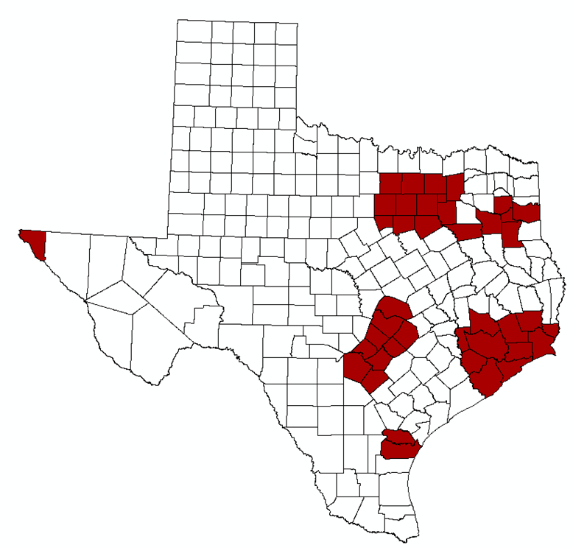
3. Educational Update
2020 Local Government Energy Reporting
Section 388.005 (c) Texas Health and Safety Code:
Purpose: Aid efforts to attain federal air quality standards by reducing demand for electricity generation
Who Reports: Political subdivisions including cities, counties, water districts, and other local government entities in 41 non-attainment or nearing non-attainment counties in Texas*
Requirements: Establish a goal of reducing electric consumption by at least 5% each state fiscal year for 7 years beginning September 1, 2019 and submit an annual report to SECO regarding the progress and efforts to meet the reduction goal
*Bastrop, Bexar, Brazoria, Caldwell, Chambers, Collin, Comal, Dallas, Denton, El Paso, Ellis, Fort Bend, Galveston, Gregg, Guadalupe, Hardin, Harris, Harrison, Hays, Henderson, Hood, Hunt, Jefferson, Johnson, Kaufman, Liberty, Montgomery, Nueces, Orange, Parker, Rockwall, Rusk, San Patricio, Smith, Tarrant, Travis, Upshur, Waller, Williamson, Wilson and Wise

Slide 5
3. Educational Update
2020 Local Government Energy Reporting
Number of Who Entities Who Submitted a 2018 and 2019 Report to SECO
Entities Who Submitted a 2019 Local Government Energy Report to SECO

Slide 6



3. Educational Update
2020 Local Government Energy Reporting
1. Working Group
2. Whitepaper - Texas’ Mandated Local Government Energy Reduction Goal - Challenges and Best Practices
NCTCOG brought together local governments to identify barriers preventing compliance to the local government energy reporting requirements and potential opportunities to improve their effectiveness.
Identified Challenges:
Adequate Resources to Complete Required Reporting
Falling Short of 5% Reduction Goal
Best Practices:
Create and Foster Interdepartmental Collaboration/Communication
Complete the Full LGER Annual Report, Including Optional Data, Notes and Comments, to Provide a Holistic Picture of Entity’s Energy Use

Slide 7
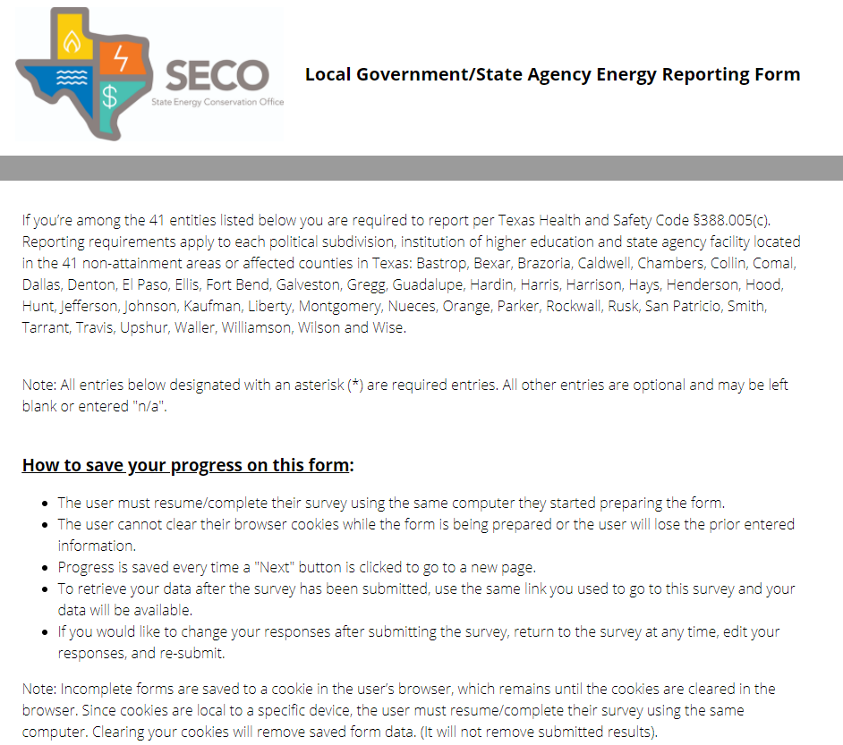

3. Educational Update
2020 Local Government Energy Reporting
Key Dates and Reminders
February 1, 2021 – Energy Reporting Deadline
Minimum Required Data Points Include
Reporting Timeframe (e.g., Calendar Year 2020)
Annual Electricity Consumption in Kilowatt Hours (kWh)
Gross Square Footage of All Entity Owned Buildings/Facilities
Submit Your 2020 Report TODAY!
Attend upcoming webinar, “Local Government Energy Reporting: 2020 Updates and Newly Developed Resources”.
Register here!

Slide 8
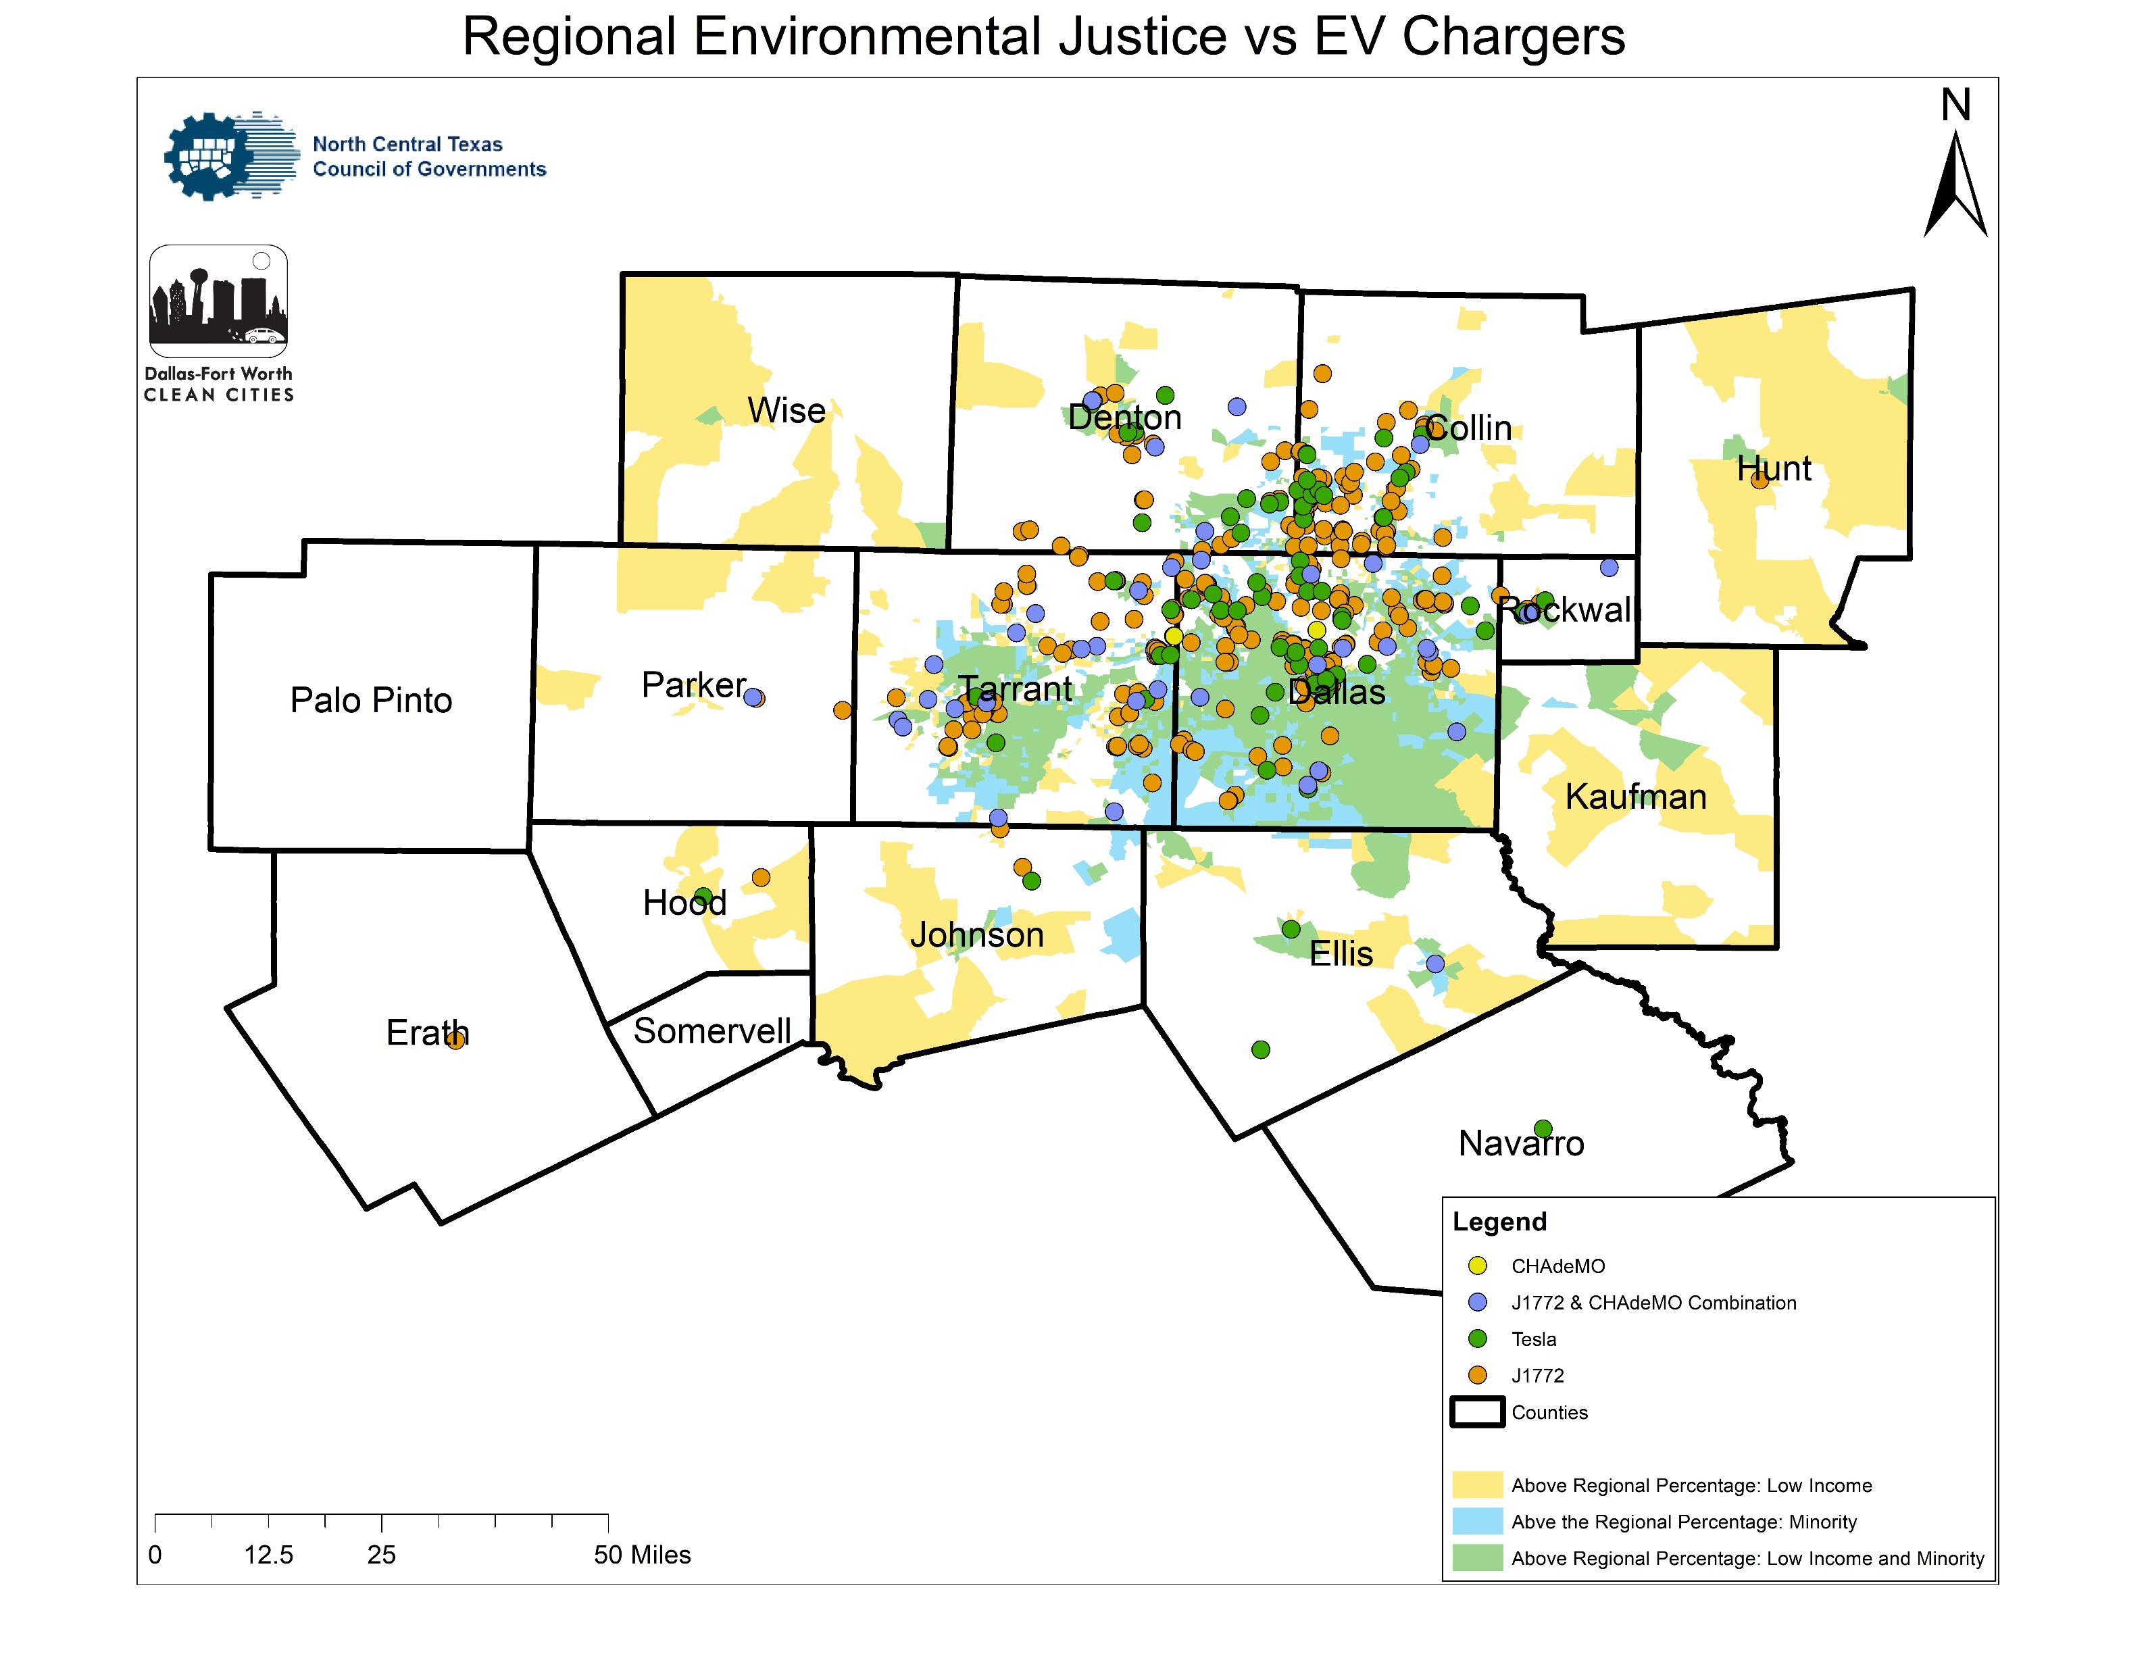
3. Educational Update
Electric Vehicle Charging
for Multifamily Housing
13,400
EV’s in North Texas as of
December 2020
~1,200,000 EVs projected in North Texas by 2040 if 30% EV forecast reached
Existing EV Stations & Environmental Justice Areas

Slide 9
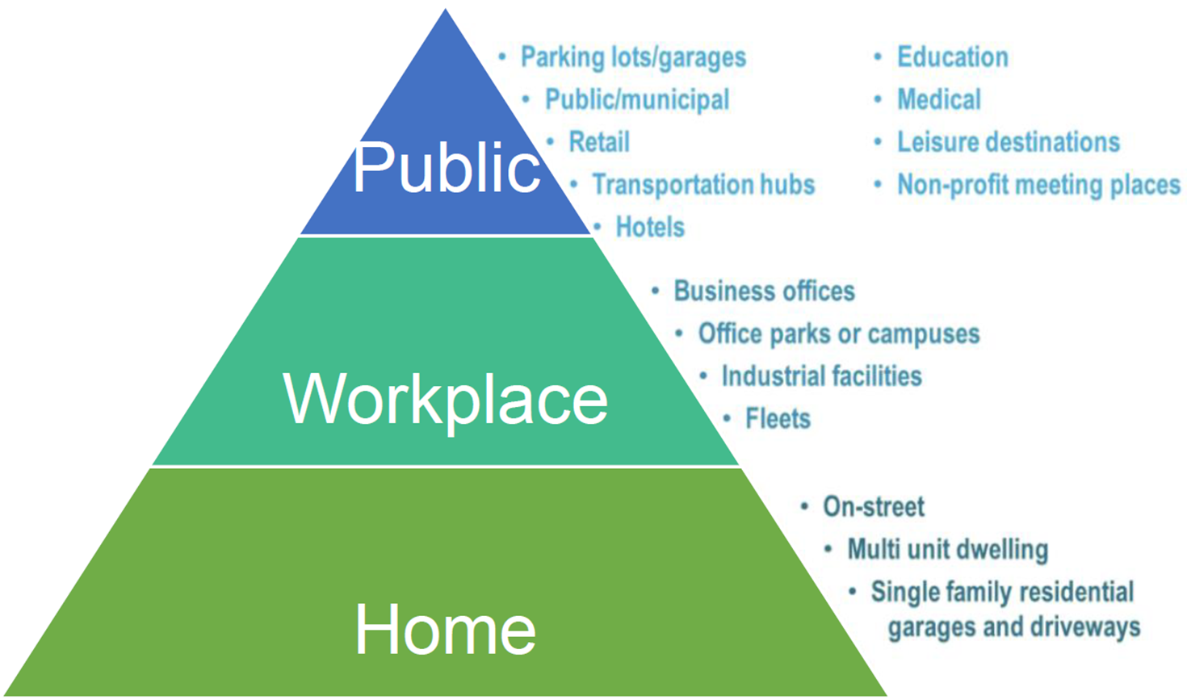
3. Educational Update
Electric Vehicle Charging for Multifamily Housing
EVSE Location Distribution Pyramid

Slide 10

3. Educational Update
Electric Vehicle Charging for Multifamily Housing
Volkswagen Settlement Texas Mitigation Plan: Zero Emissions Vehicle Infrastructure – NOW OPEN Funds: The purchase and installation of new light-duty electric vehicle Level 2 charging equipment $10.4 million in grant funding will be available for reimbursements of up to $2,500 per installation Grants will be awarded on a first-come, first-serve basis and may not exceed the following percentages of eligible costs: 70% for Publicly Available EV Chargers 60% for EV Chargers at a Workplace or Multi-Unit Dwelling
For a full list of available funding opportunities visit www.nctcog.org/aqfunding

Slide 11

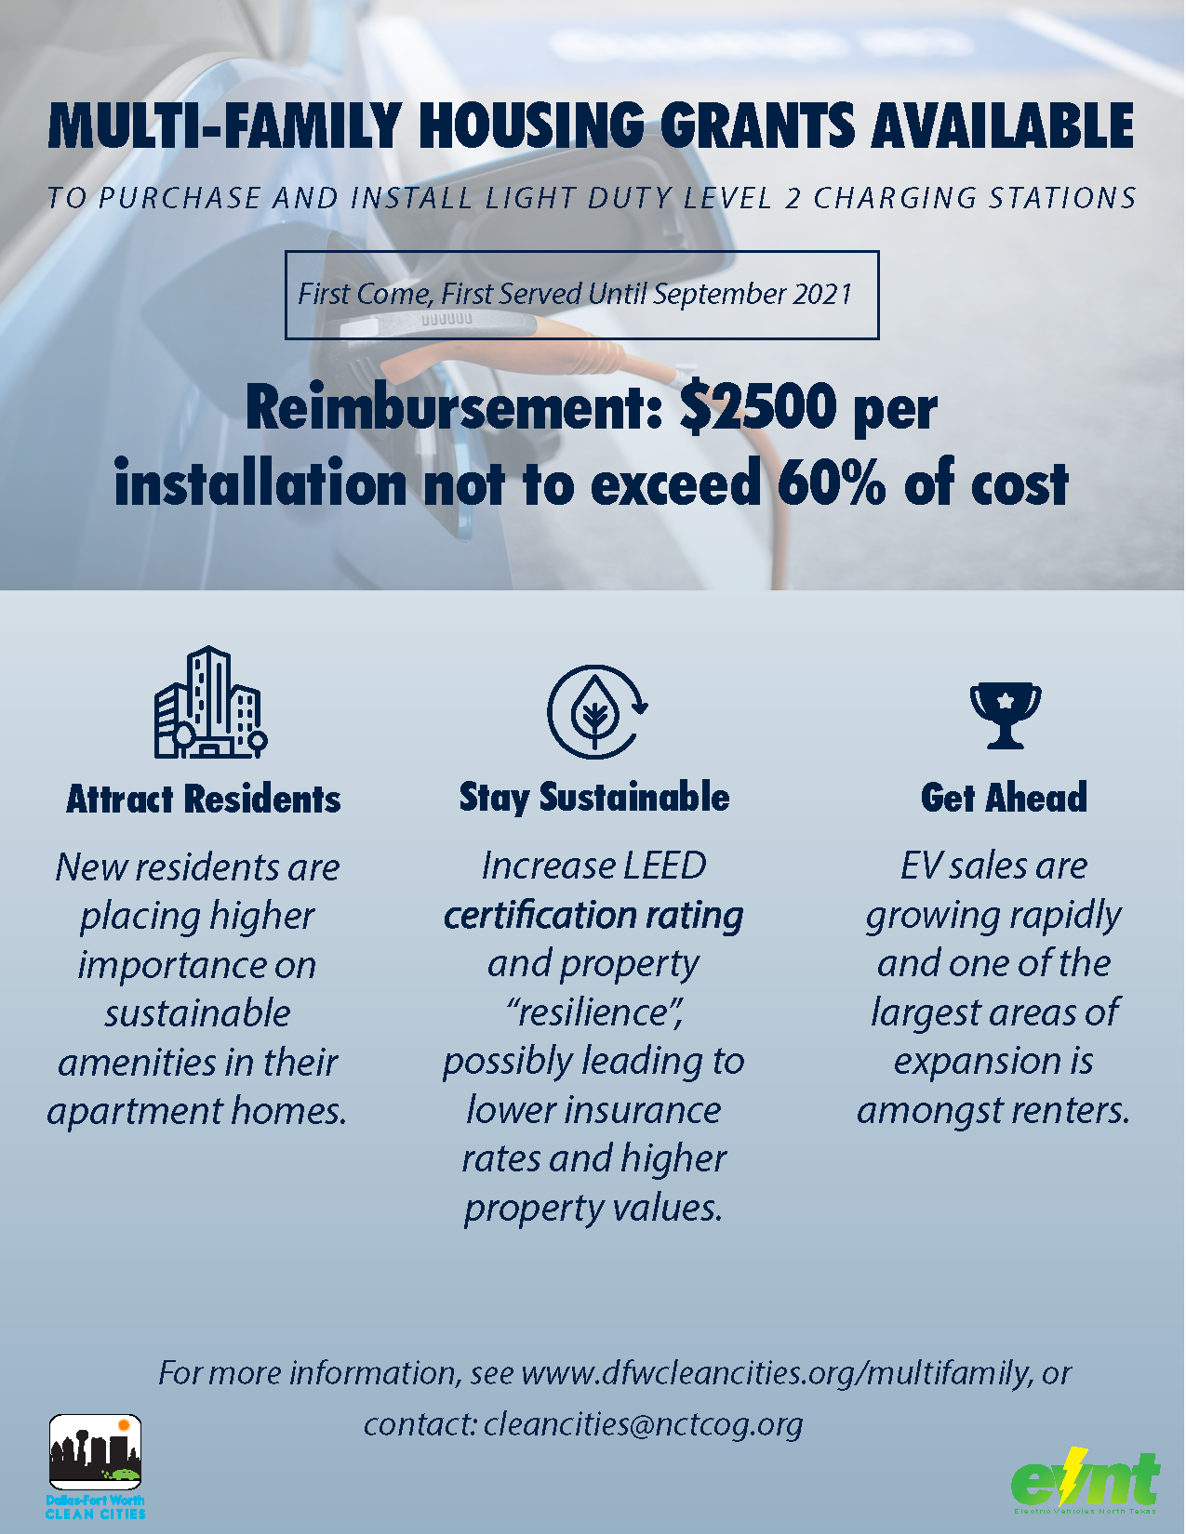




3. Educational Update
Electric Vehicle Charging for Multifamily Housing
Identify Local Multi-family Properties
Check Out Existing Public Charging Stations
Promote & Give Info to Property Managers
Attract/Retain Residents
Plan Ahead & Readiness
Earn LEED Points
Positive Marketing Image
BENEFITS TO MULTI-FAMILY PROPERTIES
Download our free multi-family flyer to distribute to properties to encourage taking advantage of available funding
www.dfwcleancities.org/multifamily

Slide 12
4. Featured Roundtable Presentation
The City of Plano’s Rocky Mountain Institute (RMI) & World Resources Institute (WRI) Residential Solar Cohort - Yarcus Lewis, City of Plano
PepsiCo Sustainability and Climate Initiatives - Ryan Spicer, PepsiCo

Slide 13
5. Participant Roundtable
Members and participants are asked to share what is happening in their communities/organizations to identify areas for collaboration and sharing.

Slide 14
6. Next Meeting Date
Friday, April 16, 2021
10:30 a.m. – 11:30 a.m.
Virtual Meeting
Committee Website and Public Meeting Materials:
https://www.nctcog.org/envir/committees/regional-integration-of-sustainability-efforts-ris

Slide 15
NCTCOG RISE Coalition Contacts
Tamara Cook, AICP
Senior Program Manager Environment and Development
817-695-9221
tcook@nctcog.org
Lori Clark
Air Quality Program Manager
Transportation
817-695-9232
lclark@nctcog.org
Jenny Narvaez
Program Manager
Transportation
817-608-2342
jnarvaez@nctcog.org
Brian Salvesen
Planner
Environment and Development
817-695-9220
bsalvesen@nctcog.org
Dorothy Gilliam
Air Quality Planner II Transportation
817-704-5675
Dgilliam@nctcog.org

Slide 16

Thank you!

Slide 17
6. Legislative Highlights
Tracking bills on both the state and federal level on topics of climate, sustainability, resilience, GHGs, air quality, environmental justice, and others.
Introduced State bills of interest:
  HB 714 – Relating to the establishment of the Texas Environmental Justice Advisory Council
  HB 884 – Relates to local government regulations based on utility service type. Prohibits regulations by political subdivisions on types of utility services when issuing building permits.
  SB 170 – Relating to a study regarding the feasibility of implementing certain renewable energy standards
  SB 243 – Relating to energy efficiency goals for electric utilities
  H.B. 176 – Plastic Bag Regulation: would delete the provision in the Texas Health and Safety Code that the Texas Supreme Court held preempts city plastic bag regulations
Pending Federal bills of interest:
  H.R. 7330 "Green Act of 2020" – Amends the I.R.C. of 1986 to provide incentives for renewable energy and energy efficiency, and for other purposes.
  S. 4484 "America's Clean Future Fund Act" – Amends the I.R.C. of 1986 to establish a carbon fee to reduce greenhouse gas emissions, and for other purposes. Establishes, in the executive branch, an independent agency, to be known as the “Climate Change Finance Corporation” (“C2FC”), which shall finance clean energy and climate change resiliency activities.
Additional reading from the House Select Committee on the Climate Crisis’ Majority Staff Report: Solving the Climate Crisis: The Congressional Action Plan for a Clean Energy Economy and a Healthy, Resilient, and Just America
Notes:
Thank Susan Alvarez for making us aware of HB 884.
S. 4484 is quiet interesting in its full scope and worth taking a look at. This is just a very brief synopsis.

Slide 18
6. Legislative Highlights
H.R. 133 "Consolidated Appropriations Act, 2021" a.k.a. “COVID Relief Bill”
General Highlights:
  Provides for the regulation of hydrochlorofluorocarbons (HFCs) used in appliances as refrigerants. Has a production and consumption phase down.
  Reduces industrial energy use and GHGs through research and development of efficient industrial technologies, technical assistance, and the development of a national smart manufacturing plan.
  Authorizes a smart buildings program, energy and water-saving pilot programs, an energy-saving information technology plan, coordination of assistance for retrofits in schools, rebates for efficient motors and transformers, and other programs.
Highlights of Energy Act of 2020 Section (Begins on pp H.R. 133-1237):
  Directs DOE to, depending on the topic, produce assessment reports, operate research, development, and demonstration projects through grant programs and national laboratories, and even to build new focused facilities.
  Renews or increases funding for renewable electricity including hydroelectric, wind, and solar generation. Following on last year’s DOE report on geothermal potential, funding is specifically directed to advanced geothermal (which applies lessons from oil and gas fracking) and ground-source heat pumps.
  Solar and wind research also includes a focus on recycling, of increasing importance as older installations get retired or retrofitted.
  The act addresses the permitting process for renewables on public lands.
  Includes a broad range of programs for electricity storage options on varying timescales, battery recycling, grid architecture modeling, and smart connections with buildings that have their own generation or have flexible loads.
  Building efficiency efforts get a boost. Spending is directed toward energy- and water-efficiency renovations in federal buildings and data centers. Any projects that meet the criteria by paying for themselves should get the green light.
  The bill modernizes the federal Weatherization Assistance Program (WAP) to help address health and safety issues in homes, add solar cells, and test innovative approaches to expanding weatherization. The WAP provides grants for energy-efficiency projects for low-income households and gets reauthorized through 2025, with about a 10% bump in funding.
  Carbon dioxide capture and storage pops up everywhere. There is funding for capture from smokestacks as well as “Direct Air Capture” technologies that simply pull carbon from ambient air. There is funding for underground storage projects and “carbon utilization” research for turning captured CO2 into other useful forms. Separately, a joint program with the Dept. of Agriculture would fund projects for other forms of carbon capture, including forestry, agricultural practices, and rock weathering.
  Major renewable energy tax credits were extended:
    The offshore wind tax credit was extended for five years, while the onshore-wind-production tax credit stays alive through 2021.
    The federal tax credit for installing solar had dropped from 30 percent to 26 percent this year on its way to ending in 2022, but that is now delayed with two more years at the current rate.
    No extension to the electric vehicle tax credit.
Notes:
Thank Susan Alvarez for making us aware of HB 884.
S. 4484 is quiet interesting in its full scope and worth taking a look at. This is just a very brief synopsis.

Slide 19
6. Legislative Highlights – Biden Administration 1st 100 Days
Climate Change Policy Objectives:
Plans to put U.S. on a path to achieve net-zero emissions by 2050.
Will create millions of jobs needed to build modern, sustainable infrastructure and deliver an equitable clean energy future.
Will invest in engines of sustainable job creation - new industries and re-invigorated regional economies spurred by innovation from our national labs and universities.
Plans to rejoin the Paris Agreement and encourage every major country to ramp up the ambitions of their domestic climate targets.
*These policy highlights were taken directly from the Biden-Harris website, www.BuildBackBetter.gov. To see the incoming administration's full policy plans, please visit: https://buildbackbetter.gov/priorities/climate-change/.

Slide 20
6. Legislative Highlights – Biden Administration 1st 100 Days
Infrastructure | Transit | Power Sector | Buildings | Innovation | Agriculture & Conservation | Envir. Justice | Auto | Housing
"Create millions of good, union jobs rebuilding America’s crumbling infrastructure – from roads and bridges to green spaces and water systems to electricity grids and universal broadband – to lay a new foundation for sustainable growth, compete in the global economy, withstand the impacts of climate change, and improve public health, including access to clean air and clean water." | "Provide every American city with 100,000 or more residents with high-quality, zero-emissions public transportation options through flexible federal investments with strong labor protections that create good, union jobs and meet the needs of these cities — ranging from light rail networks to improving existing transit and bus lines to installing infrastructure for pedestrians and bicyclists." | "Move ambitiously to generate clean, American-made electricity to achieve a carbon pollution-free power sector by 2035. This will enable us to meet the existential threat of climate change while creating millions of jobs with a choice to join a union." | "Upgrade 4 million buildings and weatherize 2 million homes over 4 years, creating at least 1 million good-paying jobs with a choice to join a union; and also spur the building retrofit and efficient-appliance manufacturing supply chain by funding direct cash rebates and low-cost financing to upgrade and electrify home appliances and install more efficient windows, which will cut residential energy bills." | "Drive dramatic cost reductions in critical clean energy technologies, including battery storage, negative emissions technologies, the next generation of building materials, renewable hydrogen, and advanced nuclear – and rapidly commercialize them, ensuring that those new technologies are made in America." | "Create jobs in climate-smart agriculture, resilience, and conservation, including 250,000 jobs plugging abandoned oil and natural gas wells and reclaiming abandoned coal, hardrock, and uranium mines — providing good work with a choice to join or continue membership in a union in hardhit communities, including rural communities, reducing leakage of toxics, and preventing local environmental damage." | "Ensure that environmental justice is a key consideration in where, how, and with whom we build — creating good, union, middle-class jobs in communities left behind, righting wrongs in communities that bear the brunt of pollution, and lifting up the best ideas from across our great nation — rural, urban, and tribal." | "Create 1 million new jobs in the American auto industry, domestic auto supply chains, and auto infrastructure, from parts to materials to electric vehicle charging stations…" | "Spur the construction of 1.5 million sustainable homes and housing units."
*These policy highlights were taken directly from the Biden-Harris website, www.BuildBackBetter.gov. To see the incoming administration's full policy plans, please visit: https://buildbackbetter.gov/priorities/climate-change/.

Slide 21
6. Legislative Highlights
TML Legislative Updates
  Link to Legislative Information: https://www.tml.org/319/Legislative-Information
  City-Related Bills Filed (as of 12/18/20): https://www.tml.org/DocumentCenter/View/2402/City-Related-Bills-121820
  Legislative Update - https://www.tml.org/579/Legislative-Update
Discussion Topics

