Slide 1

North Central Texas Council of Governments
Automated Transportation Systems
Bryce McMeans
Regional Freight Advisory Committee
May 12, 2026

Slide 2
Automated Transportation Systems Defined
Automated Transportation Systems (ATS):
Automated vehicles operating on fixed routes
  Could operate in mixed traffic or on elevated guideways
The Basis of ATS:
  Flexible vehicle technology to adjust for changing needs/demand
  Future-proof systems design for future technology advances
  Vehicle automation and advancing battery technology to minimize operational costs while maximizing service
NCTCOG Goods Movement Planning Program

Slide 3
Automated Transportation Systems (ATS)
NCTCOG ATS Goals:
NCTCOG is looking to address first/last mile connectivity to supplement the broader transit network
Other technologies/systems have previously filled this roll
  Automated People Movers
  As these systems age, they become more difficult and more expensive to maintain
More real-world deployments of Automated Vehicle technology in recent years
Recent NCTCOG Efforts:
NCTCOG study on the issue culminates in Automated Transportation Systems
  Dallas Midtown Autonomous Transportation System and Shared Parking Feasibility Study (2019)
  NCTCOG Automated Transportation System Development Study (2023)
NCTCOG Goods Movement Planning Program

Slide 4
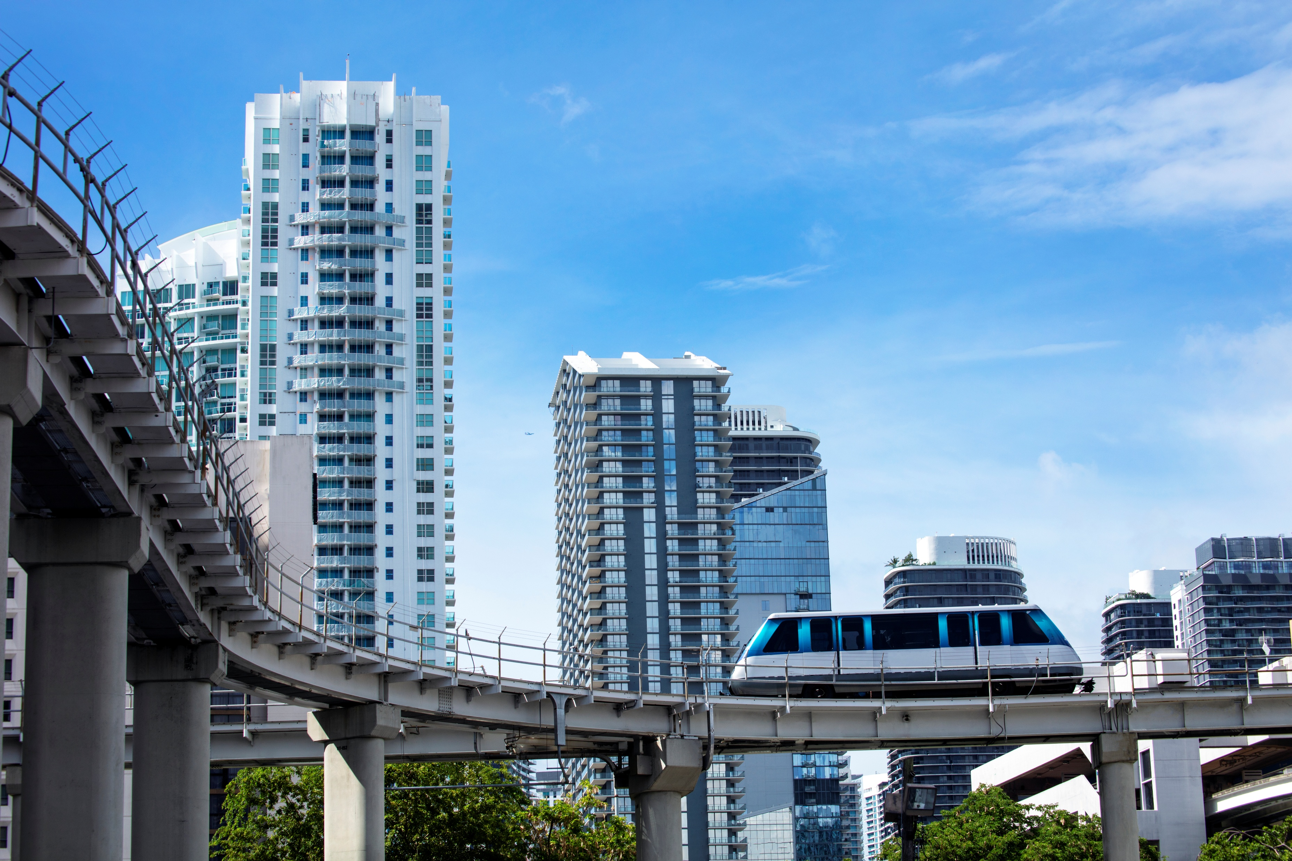
Automated People Movers
Rail-Based Systems:
  Higher speeds
  Proprietary parts
Elevated Guideways:
  Unrestricted by traffic
  Expensive maintenance
Examples:
  DFW Skylink
  Irving Las Colinas APT
ADD IMAGE HERE
Courtesy of NCTCOG
NCTCOG Goods Movement Planning Program

Slide 5
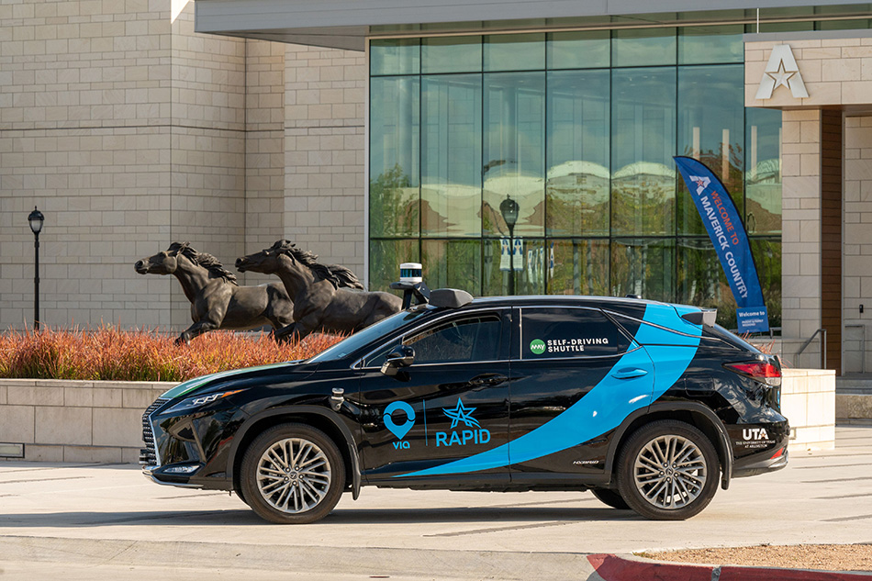
Automated Vehicles
Rubber-Tired Systems:
  Easier maintenance
Mixed Traffic or Dedicated Paths:
  Reduced capital investment
  in infrastructure
Examples:
  Waymo
  May Mobility (Arlington RAPID)
    Fixed-route service
ADD IMAGE HERE
Courtesy of NCTCOG
NCTCOG Goods Movement Planning Program

Slide 6
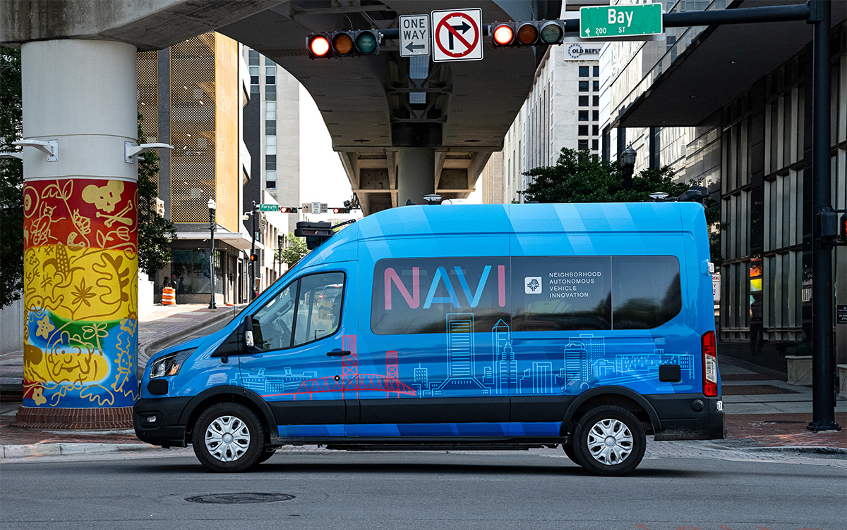
Current ATS Examples
Circulation within a district, campus, airport, etc.
  District:
    Jacksonville – Skyway & The Ultimate Urban Circulator (U2C)
    Las Vegas – Zoox
  Campus:
    West Virginia University – Morgantown PRT
  Airport:
    DFW Airport – Skylink
Courtesy of JTA
NCTCOG Goods Movement Planning Program

Slide 7
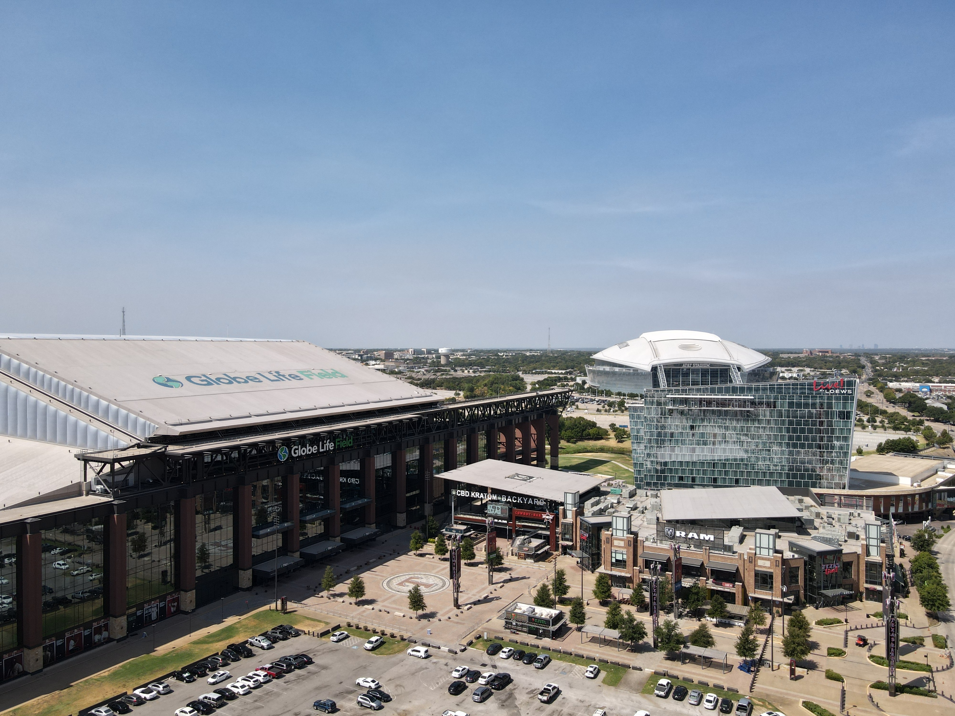
Potential Applications
First and last mile travel for specific transportation corridors
  District:
    In conjunction with remote parking garages
    Reduce SOV use, parking needs
  Freight:
    Freight movement within work campus
    Connection to broader freight network
ADD IMAGE HERE
Courtesy of NCTCOG
NCTCOG Goods Movement Planning Program

Slide 8
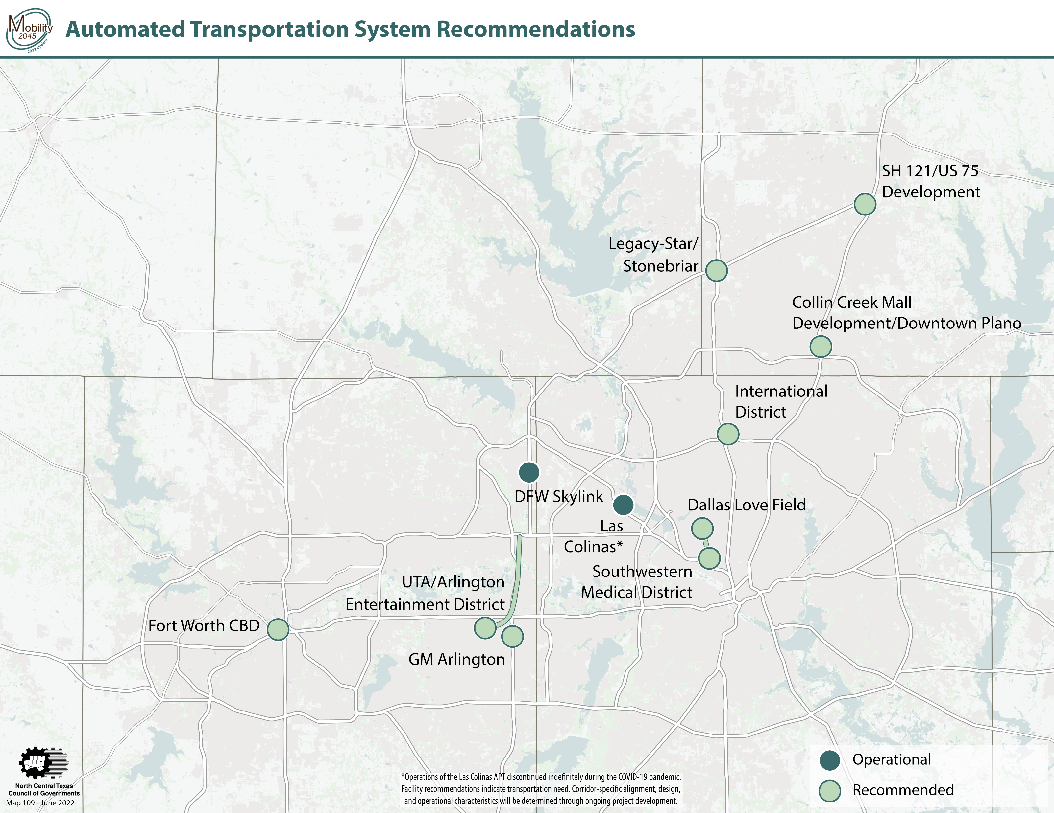
NCTCOG Current ATS Efforts
Legacy West Automated Transportation System:
Develop the planning, design concepts, and feasibility for an Automated Transportation System in the Plano Legacy Area
Request for Proposals coming soon
ADD IMAGE HERE
Courtesy of NCTCOG
NCTCOG Goods Movement Planning Program

Slide 9
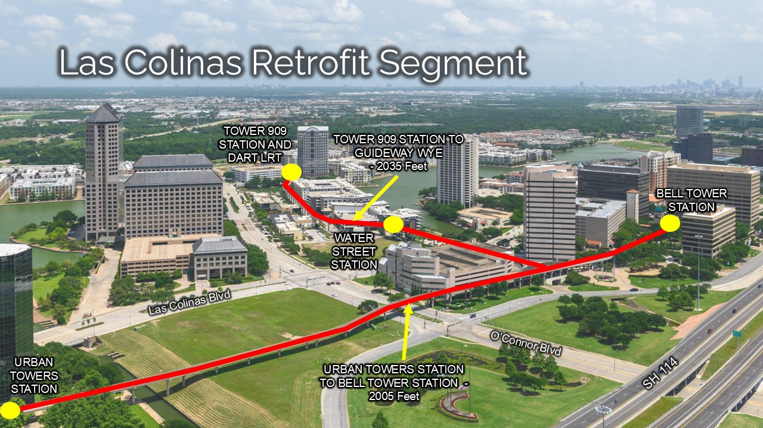
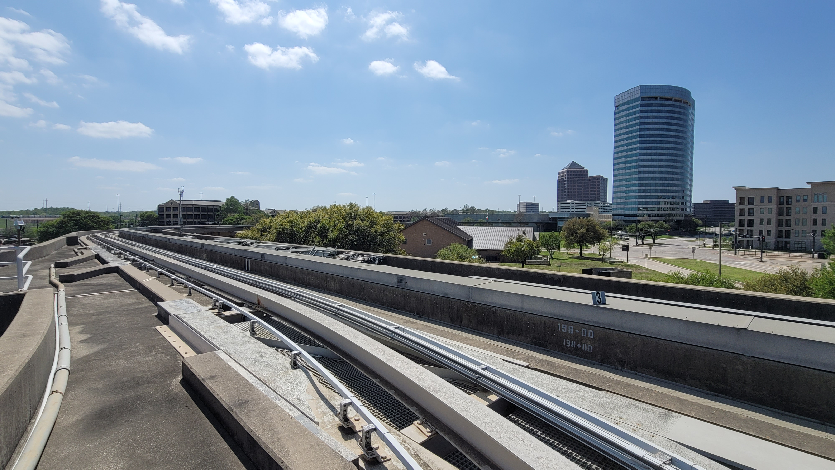
NCTCOG Current ATS Efforts
Las Colinas Automated Transportation System Retrofit:
Engineering for a retrofit of the guideway to create an Automated Transportation Systems test platform
Replacing rail system with flat paved surface
Adding method for vehicle access
Began February
To be completed in December
ADD IMAGE HERE
Courtesy of NCTCOG
NCTCOG Goods Movement Planning Program

Slide 10
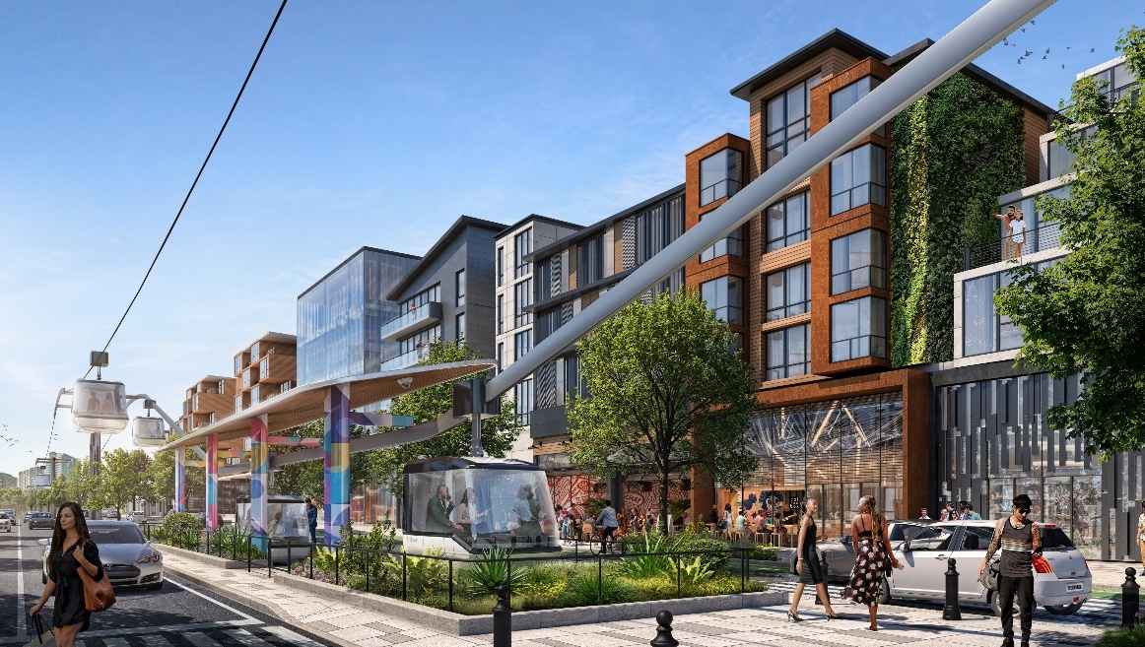
Certification of Emerging and Reliable Transportation Technology
Certification of Emerging and Reliable Transportation Technology
Bring technology providers and municipalities together to meet long-range transportation needs
  J-Pods: Automated pods on elevated guideway for first/last mile and local transportation
  Swyft Cities: Elevated pod/modern gondola for Personal Rapid Transit
ADD IMAGE HERE
Courtesy of Swyft Cities
NCTCOG Goods Movement Planning Program

Slide 11
Questions?

Slide 12
CONTACT US
Jeff Hathcock
Program Manager
jhathcock@nctcog.org | 817-608-2354
Savannah Briscoe
Transportation Planner
sbriscoe@nctcog.org | 817- 608-2347
Mike Johnson
Principal Transportation Planner
mjohnson@nctcog.org | 817-695-9160
Valerie Alvarado
Transportation Planner
valvarado@nctcog.org | 817-640-4428
Bryce McMeans
Transportation Planner
bmcmeans@nctcog.org | 817-695-9240

