Slide 1

NCTCOG PRESENTATION
FY2027-2029 MANAGEMENT, OPERATIONS, AND AIR QUALITY PROGRAM
Regional Transportation Council| December 11, 2025

Slide 2
BACKGROUND
The Regional Transportation Council (RTC) typically considers extending existing and funding new Management and Operations projects/programs every three years.
  Includes many legacy projects that the RTC has funded for several years such as the Vanpool Program, Mobility Assistance Patrol, etc.
The last full review occurred in 2022 and projects were funded through Fiscal Year (FY) 2026.
Now, recommending funding for FY2027-2029 projects and programs

Slide 3
PURPOSE OF THE PROGRAM
Provides funding in addition to Transportation Planning Funds (TPF) to conduct operations, planning, and implementation activities
  Funds items ineligible for TPF
Assigns resources for RTC priorities and air quality initiatives
Ensures existing programs and projects can be continued without interruption in FY2027-2029
Surface Transportation Block Grant (STBG), Congestion Mitigation and Air Quality Improvement Program (CMAQ), and regional funds will be proposed for the FY2027-2029 program
Ensures CMAQ and STBG funding is obligated in a timely manner

Slide 4
PROGRAM AND PROJECT TYPES
Management & Operations (M&O)
(Mobility Assistance Patrol, Work Zone Data, etc.)
NCTCOG-Implemented
(Project Tracking, Planning Efforts, Data Collection, etc.)
Regional/Air Quality Projects and Programs
(Aviation, Employer Trip Reduction, Regional Traffic Signal Retiming, etc.)

Slide 5
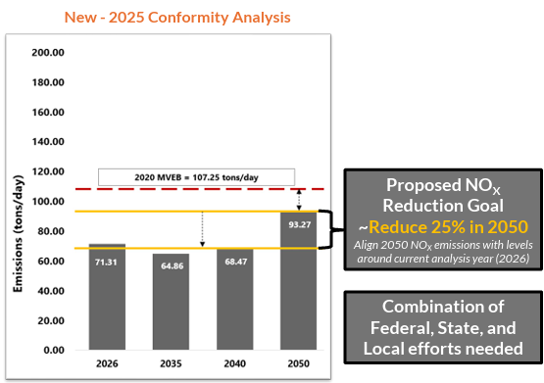
IMPORTANCE OF REGIONAL AIR
QUALITY AND M&O PROJECTS
Air Quality Conformity test results must be below EPA’s Motor Vehicle Emission Budget (MVEB).
Previous RTC air quality projects and programs have allowed region to stay below the budget.
As we work towards long-range air quality targets, these programs can help tip the scales.

Slide 6
M&O FUNDING SUMMARY FOR THREE YEARS
($ IN MILLIONS)
Category | RTC Share
Implementation/Operations Activities (e.g., Auto Occupancy, Special Events, Mobility Assistance Patrol) | $44.60M
Air Quality Initiatives (e.g., Education, Regional Strategies, Signal Retiming) | $18.57M
Planning Activities, Data Collection, and Engineering Activities | $15.77M
Travel Demand Management/Transit (e.g., Employee Trip Reduction and Vanpool Program) | $5.96M
Total | $84.90M

Slide 7
Details on Proposed Funding (THREE YEARS)
A portion of the requested funding is to be used by NCTCOG staff to implement regional projects and programs.
The balance will be passed through to other agencies in the region for pass-through
  Direct pass-through
  Indirect pass-through
~66% of funding will be pass-through to transportation entities
Category of Expenditure | M&O Funding Amount
NCTCOG-Implemented (staff time for three years) | $28.47M
Pass-Through | $56.43M (66%)
Direct Pass-Through (e.g., Vanpool, Signal Retiming) | $39.69M
Indirect Pass-Through (e.g., Travel Survey, GoCarma) | $16.74M
Total | $84.90M

Slide 8
TIMELINE
Meeting/Task | Date
RTC Information | November 13, 2025
Public Involvement | November 2025
STTC Action | December 5, 2025
RTC Action | December 11, 2025

Slide 9
REQUESTED ACTION – FUNDING FOR 2027-2029 MANAGEMENT, OPERATIONS, AND AIR QUALITY PROGRAM
RTC approval of:
  Proposed projects and programs listed in Electronic Item 6.3
  Administratively amending the Transportation Improvement Program (TIP)/Statewide Transportation Improvement Program (STIP) and updating any administrative and/or planning documents as needed to incorporate these changes
RTC Action Item – December 11, 2025

Slide 10


CONTACT US
Cody Derrick, Senior Transportation Planner
cderrick@nctcog.org | 817-608-2391
Brian Dell, Program Manager
bdell@nctcog.org | 817-704-5694
Christie Gotti, Senior Program Manager
cgotti@nctcog.org | 817-608-2338

