Slide 1

Wastewater And Treatment Education Roundtable (WATER)
February 8, 2017
A program of the North Central Texas Council of Governments

Slide 2
Agenda
Welcome and Introductions
FY2017 Work Program Discussion
Holiday Grease Roundup Update
Regional Training Development – Field Technician Training
Roundtable
Next Meeting Date
Adjournment

Slide 3
Welcome and Introductions

Slide 4
FY2017 Work Program
  Current Committed Funding Level: $44,100
  We are still accepting commitment forms for the FY2017 Work Program
  The FY2017 Work Program is posted online and available for review.

Slide 5

2016 Holiday Grease Roundup
  Date range: Nov. 28 – Jan 9
  Participants: Addison, Arlington, Bedford, Coppell, Dallas Water Utilities, Duncanville, Fort Worth, Garland, Lewisville, Upper Trinity Regional Water District, Mansfield, McKinney, North Richland Hills, Red Oak, Richardson
  Marketing Materials:
          City-specific flyer template
          Half-page flyer
          Press release template
          Email blast template
          Social media post template
          Web banners and tiles
          http://www.ceasethegreasentx.com/
          http://www.defendyourdrainsnorthtexas.com/news.html

Slide 6
Roundup Collection Statistics
Organization | Gallons Collected
 | 2014 | 2015 | 2016
Addison | 20 | 40 | 30
Arlington | 100 | 70 | 250
Bedford | --- | 30 | ---
Carrollton | --- | --- | 60
Coppell | 95 | 250 | 250
Dallas Water Utilities | 241 | 1020 | 2009
Duncanville | --- | 150 | 200
Fort Worth | 315 | 1033 | 1180
Garland | 13 | 29 | 78
Lewisville & Upper Trinity Regional Water District | --- | --- | 47
Mansfield | 200 | 84 | 238
McKinney | --- | 67 | 581
North Richland Hills | --- | --- | 388
Red Oak | --- | --- | 100
Richardson | --- | --- | 40
Total | 984 | 2773 | 5373

Slide 7
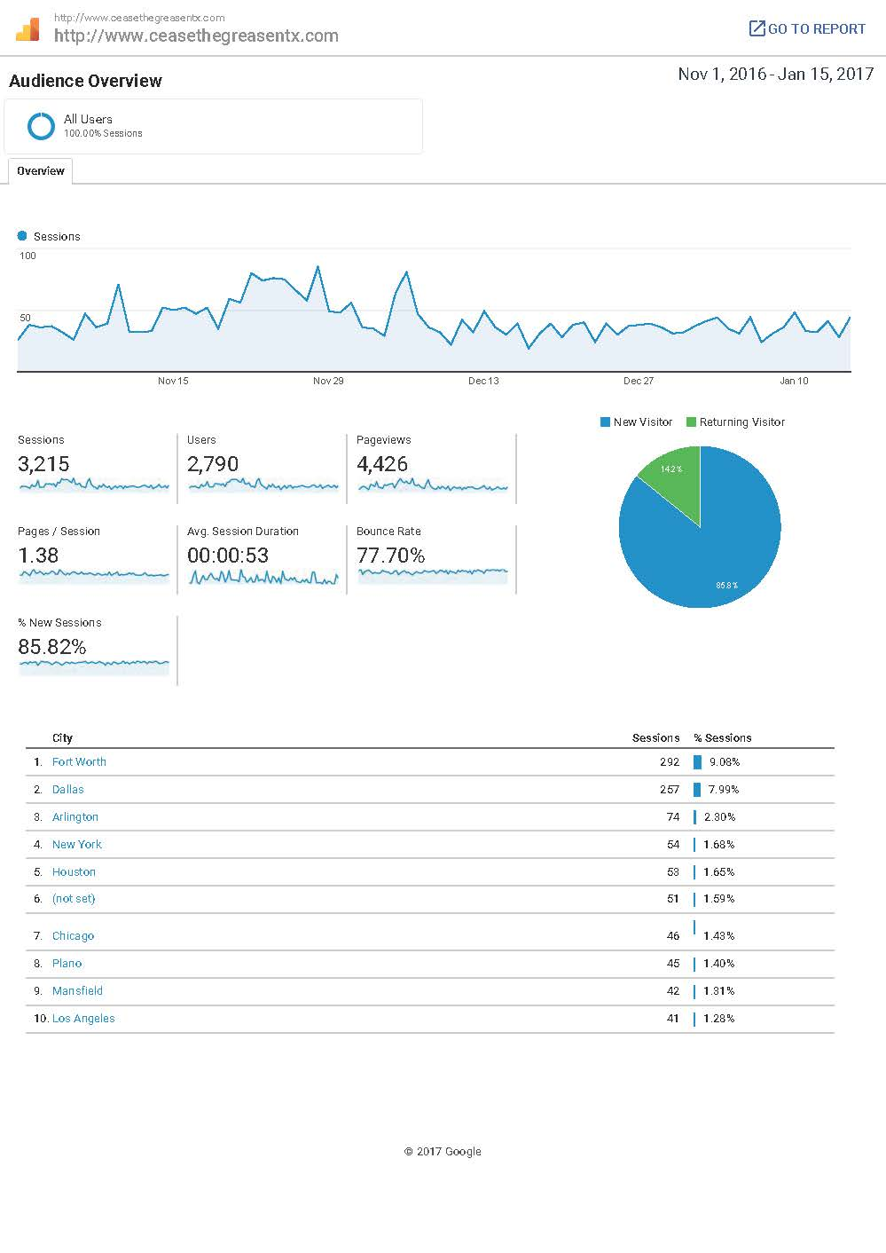
Roundup Website Analytics
          Sessions: 3,215
          Users: 2,790
          Pageviews: 4,426
          New Visitor: 14.2%
          Returning Visitor: 85.8%

Slide 8
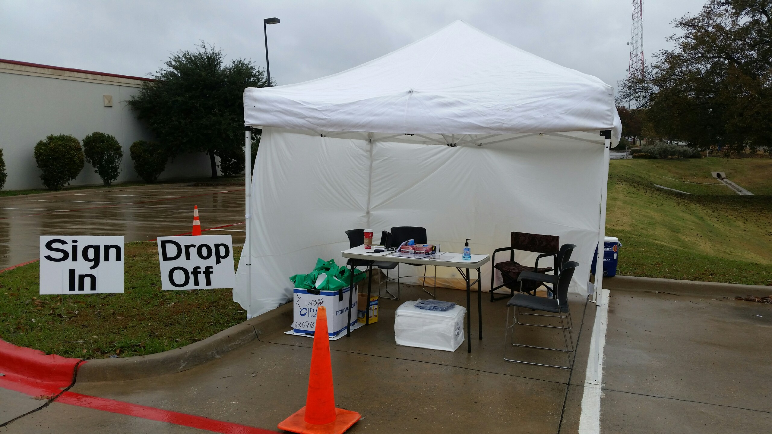
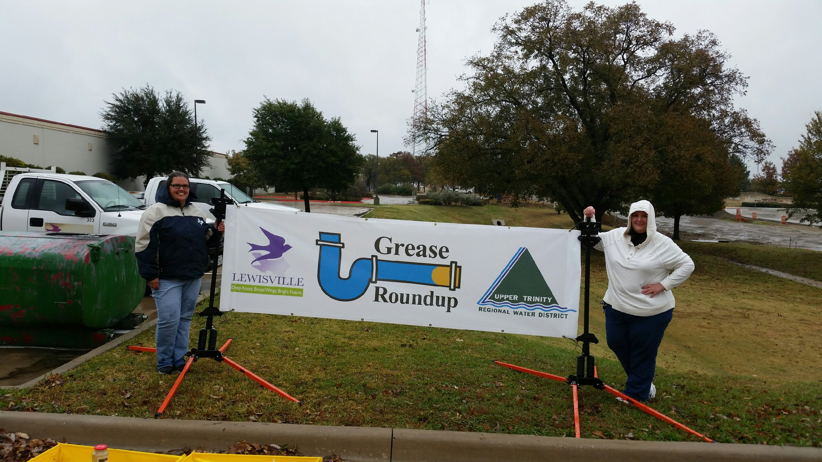
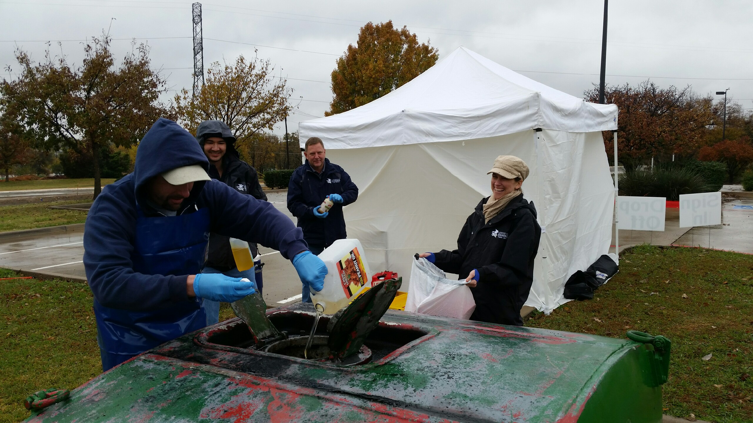
Roundup Photos

Slide 9
2016 Roundup Feedback
          Feedback on this year’s date range?
          General thoughts on how to improve?

Slide 10
Regional Training Development
    Field Technician Training
    Planning for the next regional training began in January 2017
    Planning Subcommittee Conference Call – Monday, February 13, 2017 at 10:00 AM

Slide 11
Roundtable and Next Meeting Date
Roundtable: What’s happening in your community?
Next meeting date: Wednesday, May 17, 2017, at 10 a.m.
in the Regional Forum Room
Adjournment
Contact
Cassidy Campbell
Environment and Development Planner
ccampbell@nctcog.org
817-608-2368

