Slide 1

NCTCOG PRESENTATION
NEXT GENERATION AIRCRAFT
OPPORTUNITIES
NICOLE JOHNSON | REGIONAL FRIEGHT ADVISORY COMMITTEE
05.12.2026
Notes:
Image Courtesy: Getty Images

Slide 2
AVIATION PROGRAM AREA OVERVIEW
Access to Aviation Facilities
UAS Safety and Integration
Aviation Education & Outreach
41 public-use airports
600+ aviation facilities
Air Transportation Advisory Committee
Regional Airport System Plan
UAS Safety and Integration Task Force
NORTHTEXASUAS.COM
Know Before You Fly Your Drone Workshops
Airspace Awareness Pilot Program
NCTAVIATIONCAREERS.COM
Aviation Speakers Bureau
Career Days / Summer Camps
Advisory Boards

Slide 3
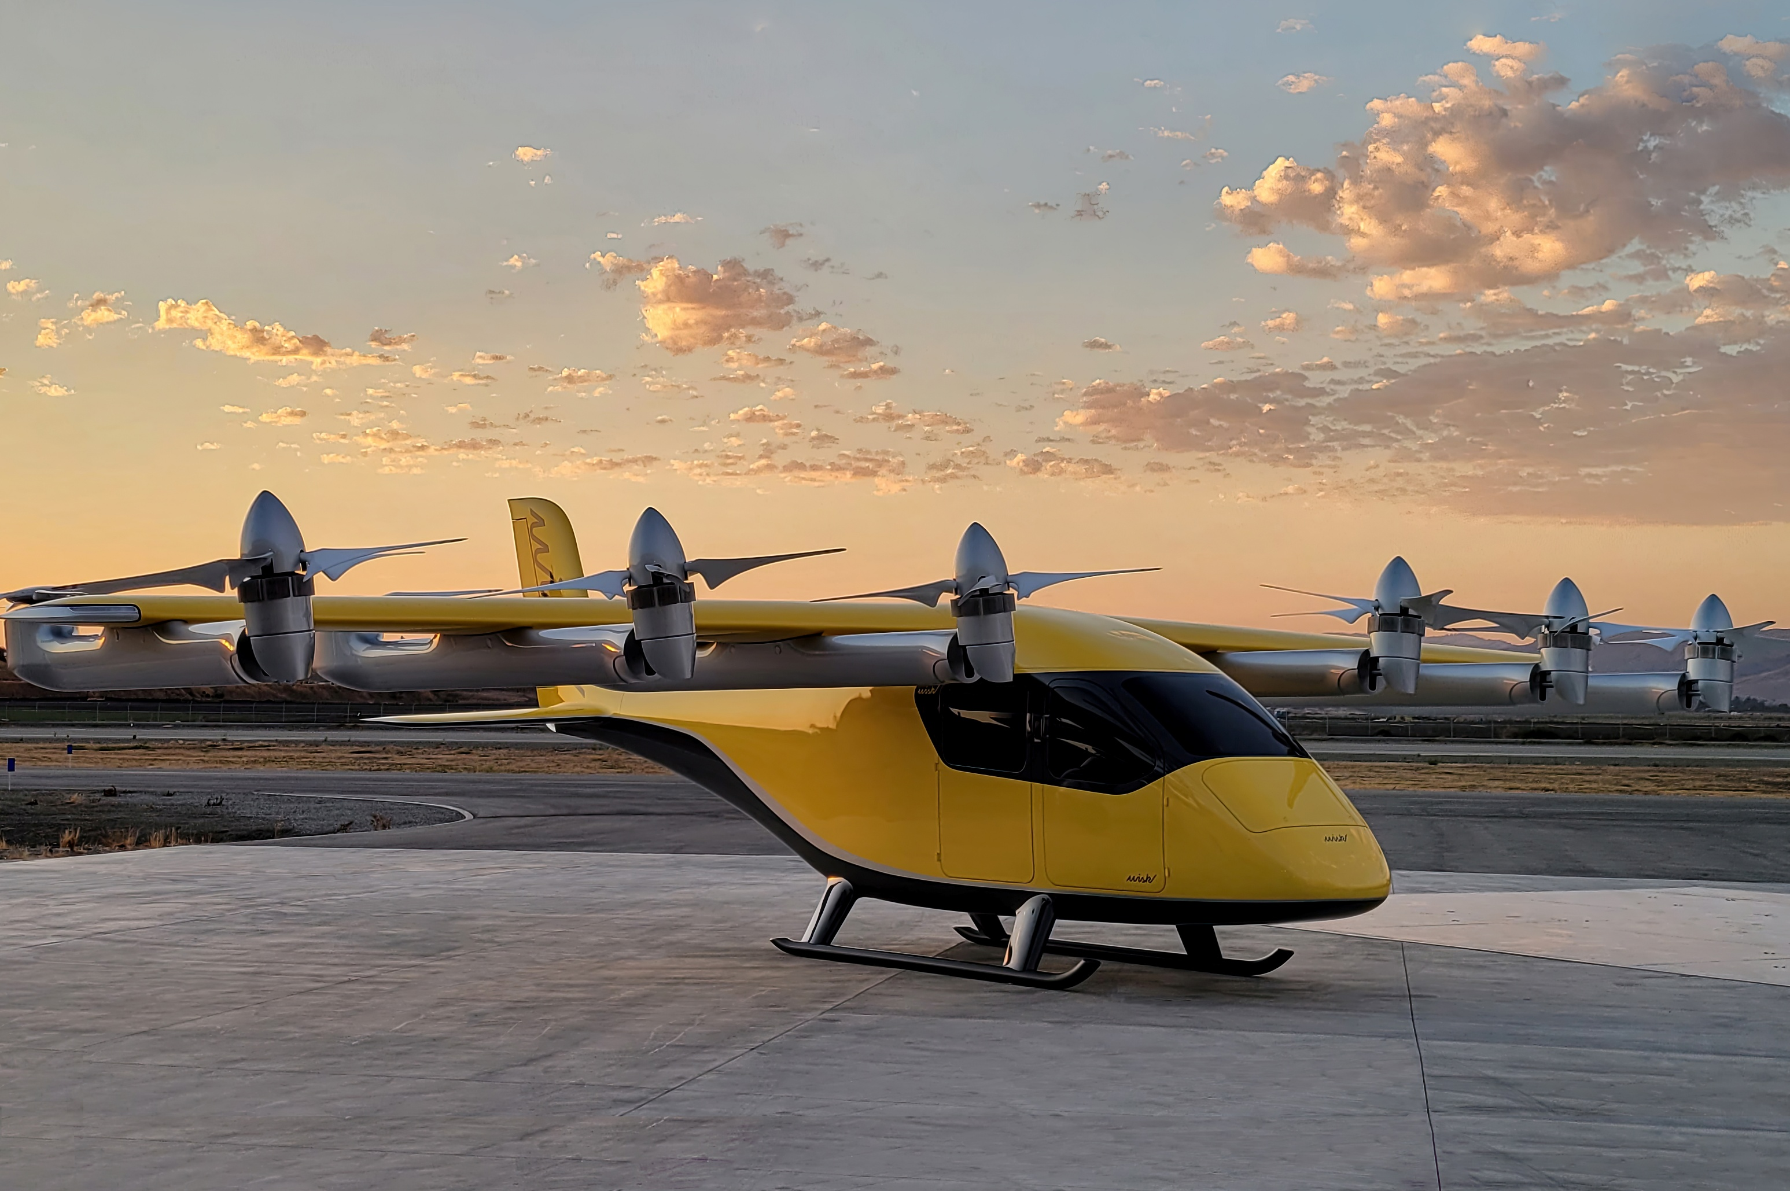
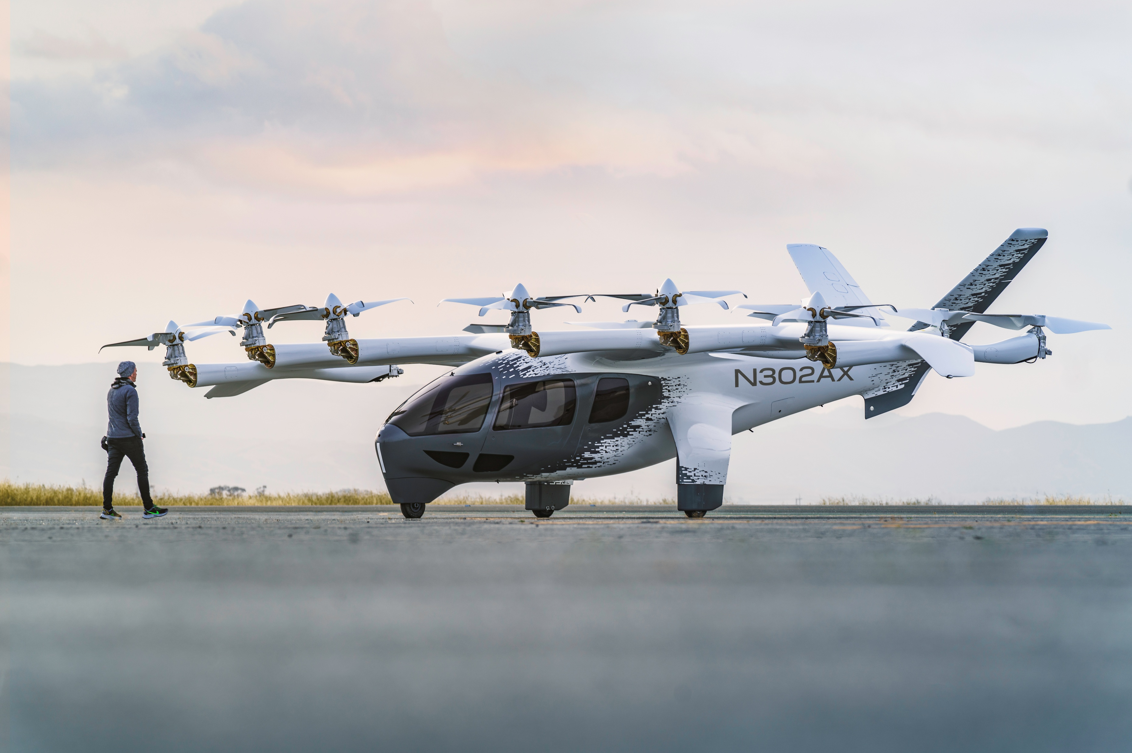
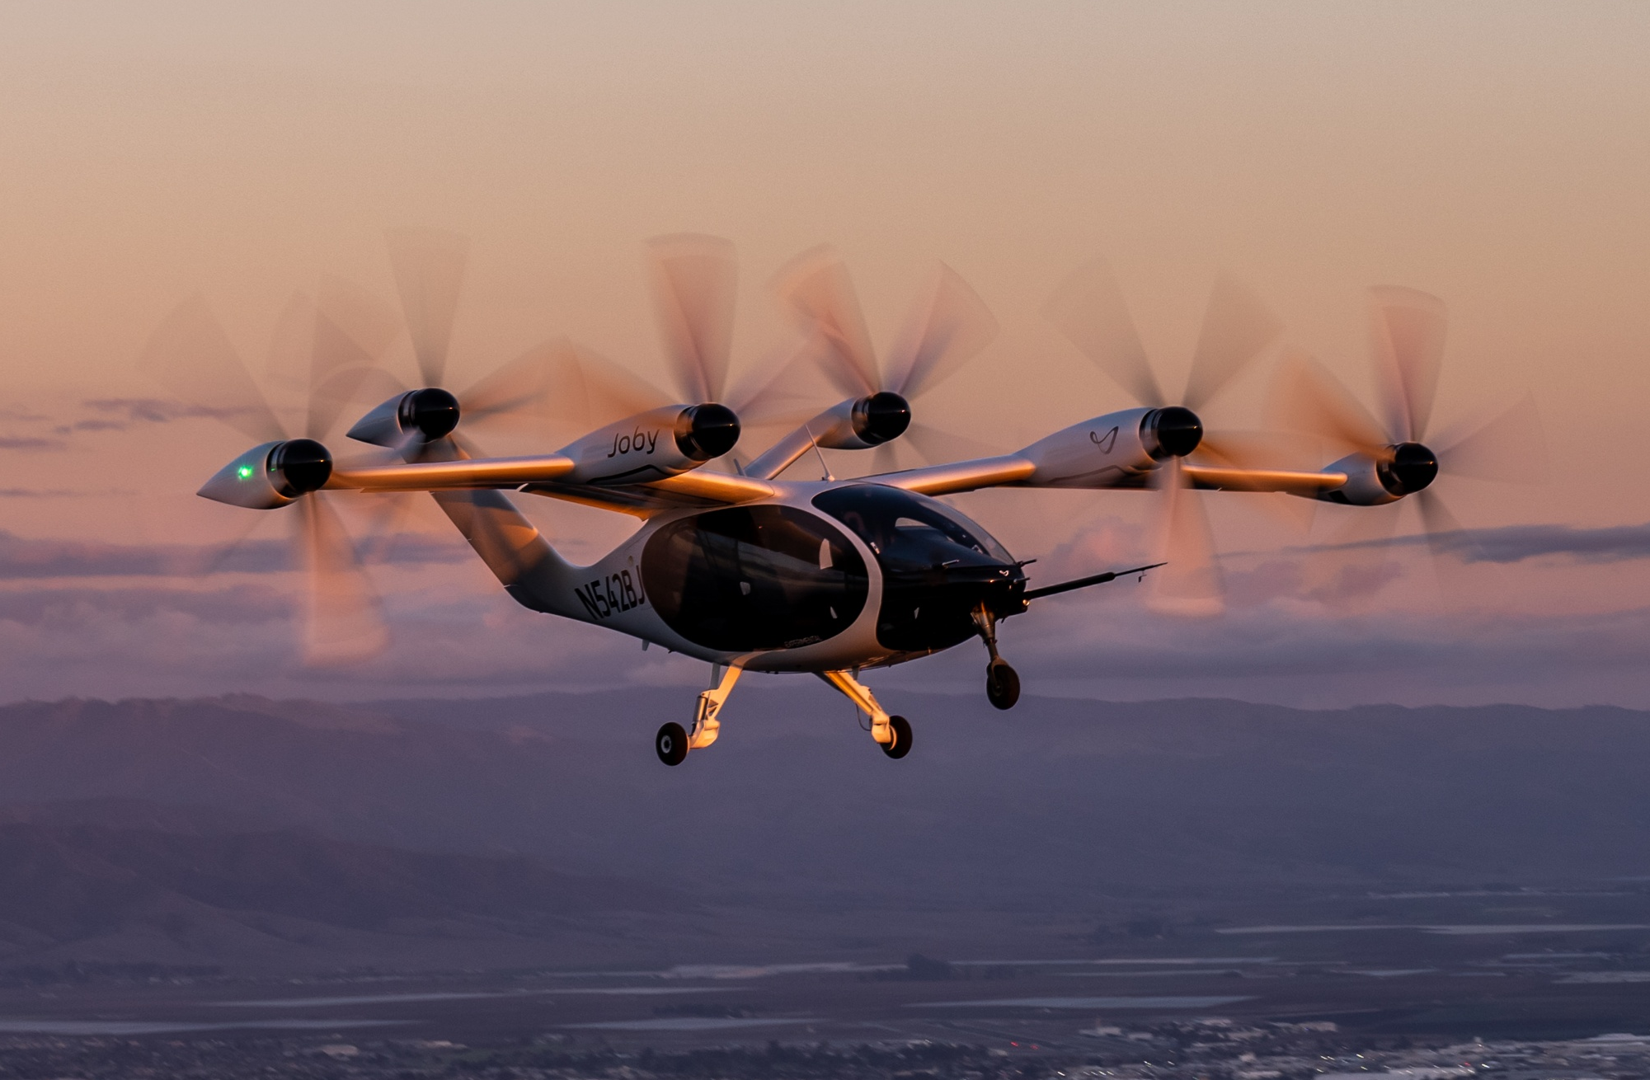
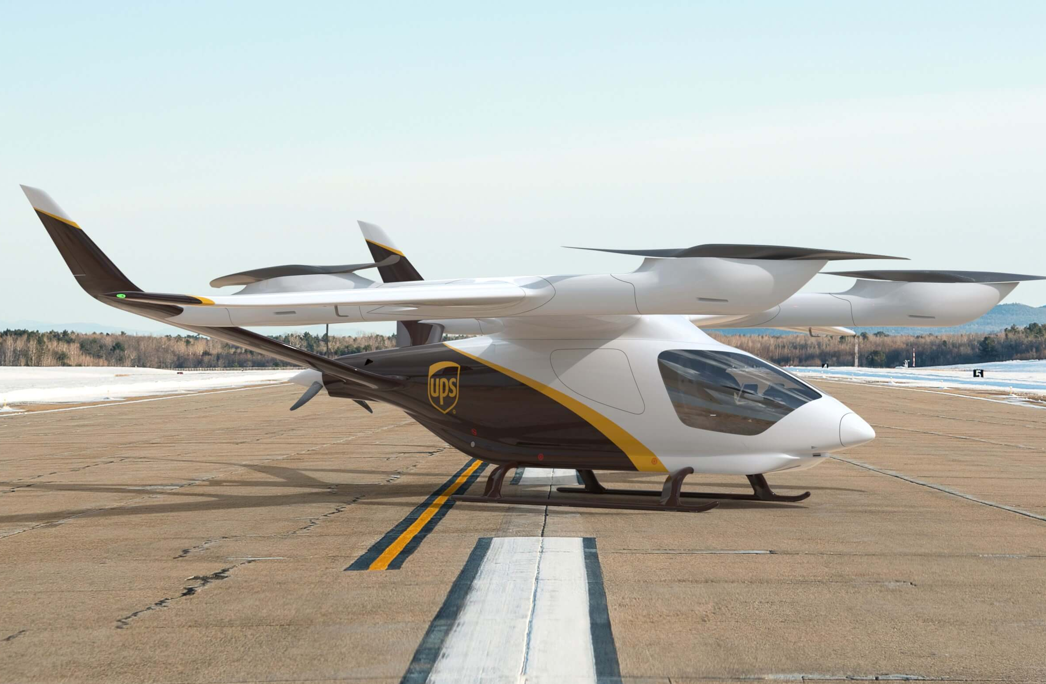



ELECTRIC VERTICAL TAKEOFF AND LANDING (eVTOL) AIRCRAFT
Midnight
100mi range
150 mph cruising speed
4 passengers + 1 crew
S4
150mi range
200 mph cruising speed
4 passengers + 1 crew
ALIA CX300
215mi range
176 mph cruising speed
5 passengers + 1 crew
OR
200 cubic feet of cargo + 2 crew

Slide 4
eVTOL
USE
CASES
Cargo
Air Taxi
Scheduled or on-demand transportation between major and regional airport and city center
Freight to/from airports, distribution centers, manufacturers, and end consumers
Offshore Ops
Emergency Response
Access remote locations such as offshore wind farms, oil rigs, and geothermal sites, etc.
Medical evacuations, patient/equipment transportation, organ delivery & search-and-rescue operations
Military
Transport
Recovery missions, humanitarian aid efforts, medical evacuation, logistics support, base operations etc.

Slide 5
INTERMODAL INTEGRATION:
ALLIANCETEXAS SMART PORT
NEXT GEN TECH LAYER
Perot Field
Flight Test Center
eVTOL / Drone operations
INTELLIGENCE LAYER
5G connectivity, V2X, IoT
EV Charging infrastructure
Microgrid resilience
FREIGHT BACKBONE
BNSF Intermodal Facility
Smart Connected Bridge
(SH-170)
Autonomous / Electric
Truck Port
32-Acre Intermodal
Depot + Warehouses

Slide 6



CENTER FOR ADVANCED AVIATION TECHNOLOGIES
(CAAT)
Led and hosted by the Autonomy Research Institute (ARI) of TAMU-Corpus Christi at the Fort Worth Campus.
A group of organizations from industry, academia, and government that focuses on facilitating the full and safe integration of Advanced Air Mobility (AAM) into the National Airspace System (NAS)
Working Groups: Airspace, Automation & Communication, Infrastructure, Regulation, Safety & Security
7-8 project launches scheduled each FY
TAMUS Managed
CAAT Consortium
(Industry Led Innovations)
Airspace Laboratory
(Project Planning & Management)
Flight Demonstration Zones
(Scaled Capability Testing)
National Airspace System
(Nation Wide Integration)
FAA Managed

Slide 7
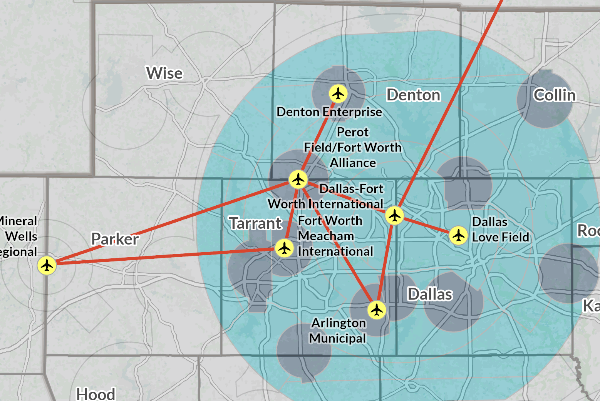
TXDOT PROJECT NEXUS
FAA Electric Vertical Takeoff and Landing Integration Pilot Program (eIPP)
Three year / Three phase program
No funding
Activities under the eIPP will accelerate the safe & efficient integration of eVTOL into the NAS
Generate data to inform FAA regulations, fostering public-private partnerships, and enabling the advancement of commercial-use operations
1 of 8 states selected
TxDOT and industry partners will support test flights connecting the Texas Triangle
Operations will initially start in North Texas in Fall 2026

Slide 8
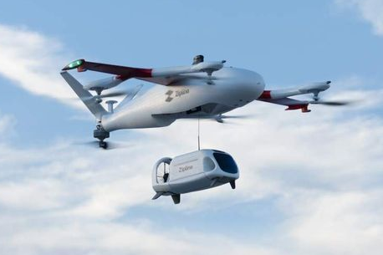
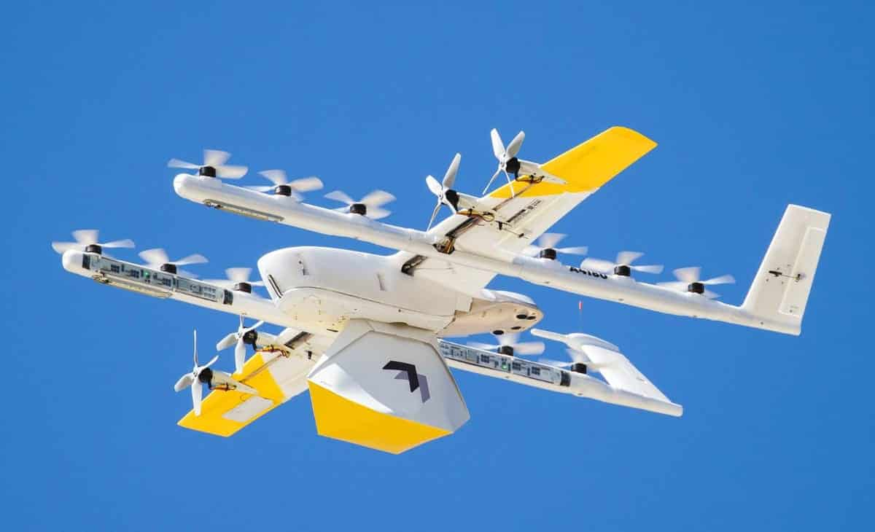
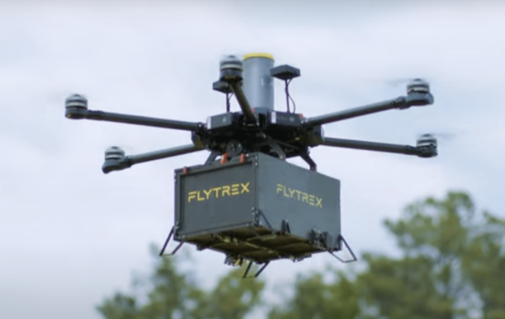
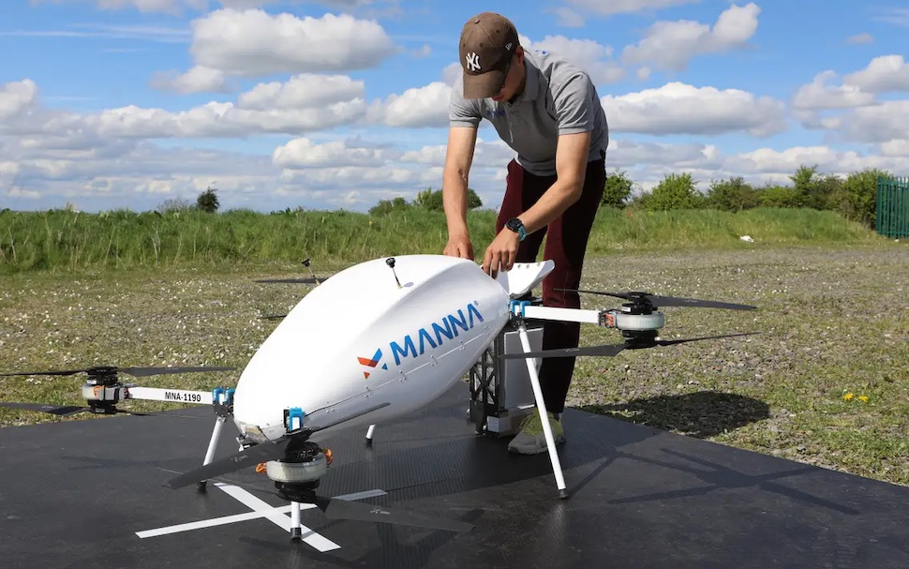
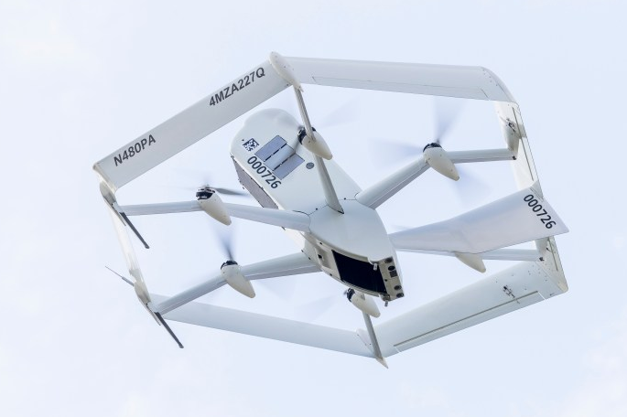
DRONE DELIVERY IN NTX
ZIPLINE Anna, Bedford, Dallas, Denton, Greenville, Kaufman, Lewisville, McKinney, Mesquite, Rowlett, Terrell, Waxahachie, and Weatherford
WING Arlington, Azle, Cedar Hill, Dallas, Denton, Garland, Fort Worth, Frisco, Lancaster, Lewisville, Mansfield, Mesquite, North Richland Hills, Plano, Richardson, and Seagoville
FLYTREX Granbury, Little Elm, and Frisco
MANNA Northlake
AMAZON Richardson

Slide 9
CONTACT INFORMATION
Nicole Johnson
Transportation Planner
njohnson@nctcog.org

